Slide 1
Research and research collaboration in Ny-Ålesund
Nalan Koc
Research director
Norwegian Polar Institute

Slide 2
Ny-Ålesund, March 2016
Why is Ny-Ålesund important for Arctic climate, environment and ecosystem research?

Slide 3
Ny-Ålesund, June 2016
How do we organize research in Ny-Ålesund?

Slide 4
Persistent global warming trend
UEA Climate Research Unit

Slide 5
The Arctic is warming at almost twice the rate of the rest of the world
NASA GISS temperature trend 2000–2009, showing strong arctic amplification

Slide 6
The Arctic is warming, getting wetter and fresher
Enhanced melting of sea ice, increased runoff, and changes in atmospheric circulation

Slide 7
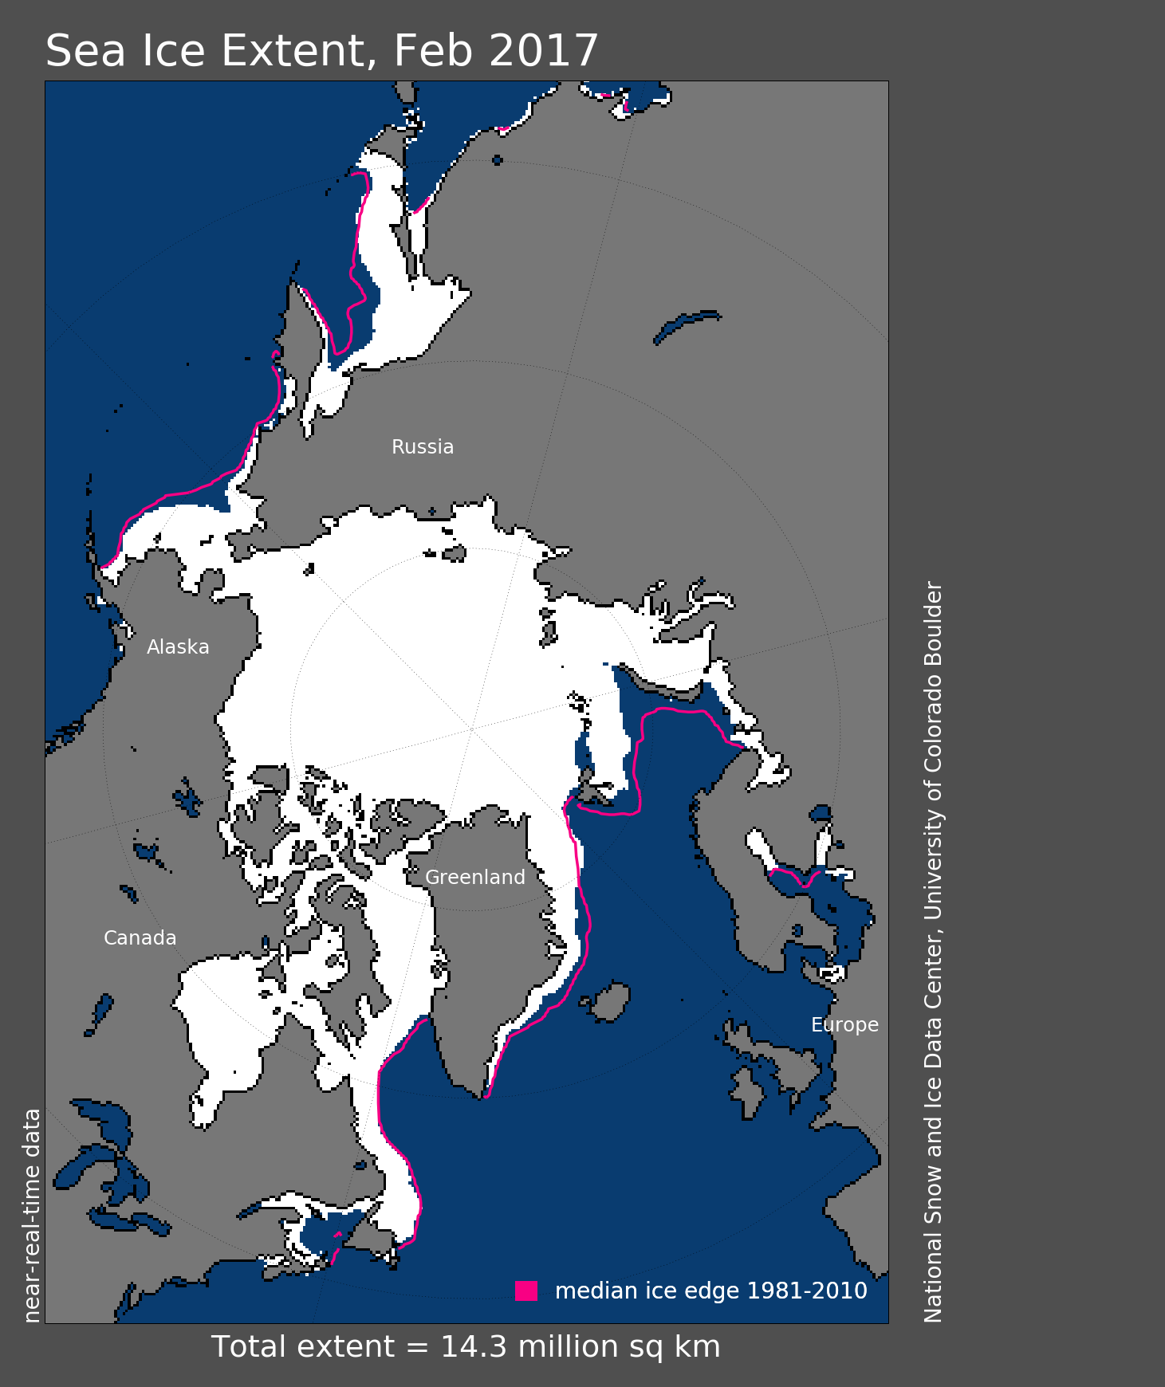
The general arctic trends are already a critical issue for the Svalbard and the Barents Sea Region
Notes:
the summer, open-water, season has increased between five and ten weeks over most of the Arctic, while it has increased by more than 20 weeks in the Barents Region

Slide 8
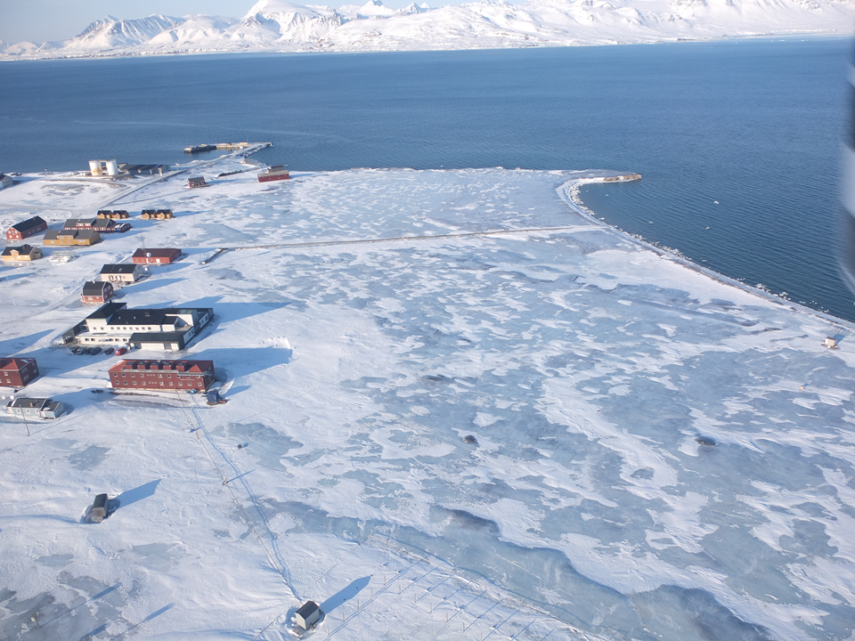
Warmer Svalbard winters & Rain-on-snow
Changes in winter climate and frequency of «rain-on-snow» events represent one of the most important facets of ongoing climate change in Arctic terrestrial ecosystems.
«Rain-on-snow» cause ground ice and block herbivore access to food resources
The winter is the bottle-neck for survival of herbivores!
2012

Slide 9
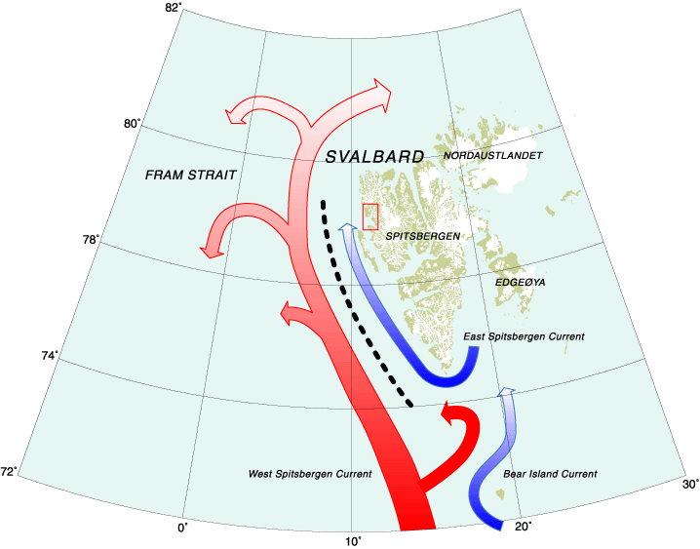
«Atlantification»
Clear increase in warm Atlantic water in recent years
This warming of the sea is the main cause of the changes in sea ice extent and dynamics around Svalbard

Slide 10
Ny-Ålesund serves both as an observatory, laboratory, and field base for Arctic research

Slide 11
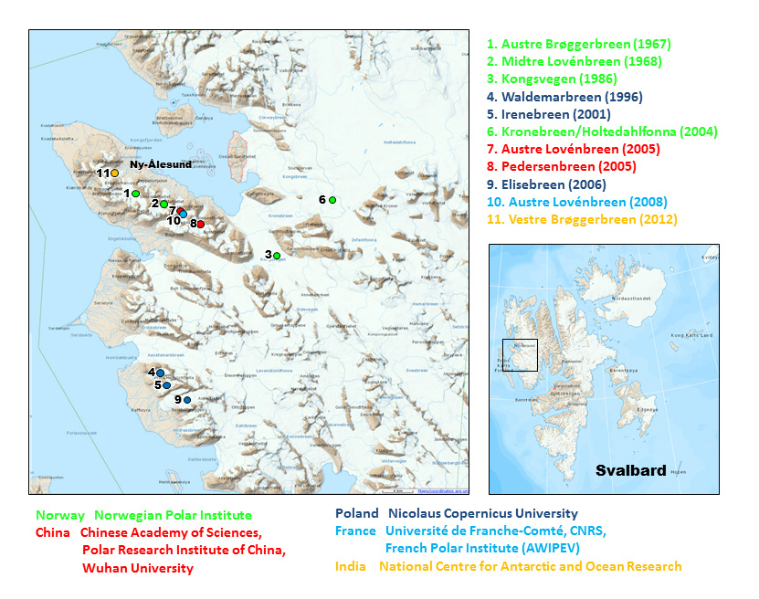

Slide 13
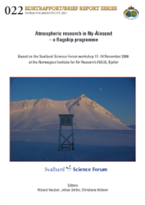
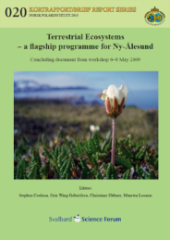
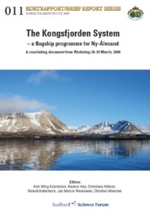
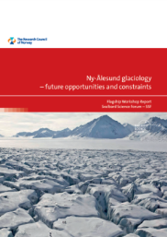

Slide 14
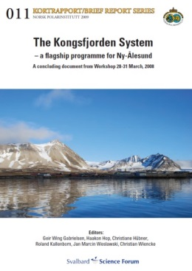
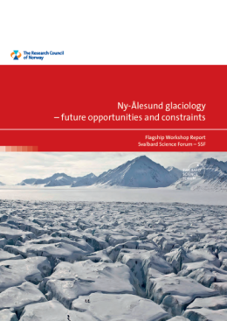
Ny-Ålesund flagships
Webpage at www.nysmac.npolar.no
Scientific committee with chair and co-chair
Funding from Svalbard Science Forum for coordination
International and institutional cooperation
Flagship document containing:
Review of current status, identify knowledge gaps, plan for exchange of knowledge
Priorities, recommendations, and strategies for future work and data sharing
Upcoming activities

Slide 15
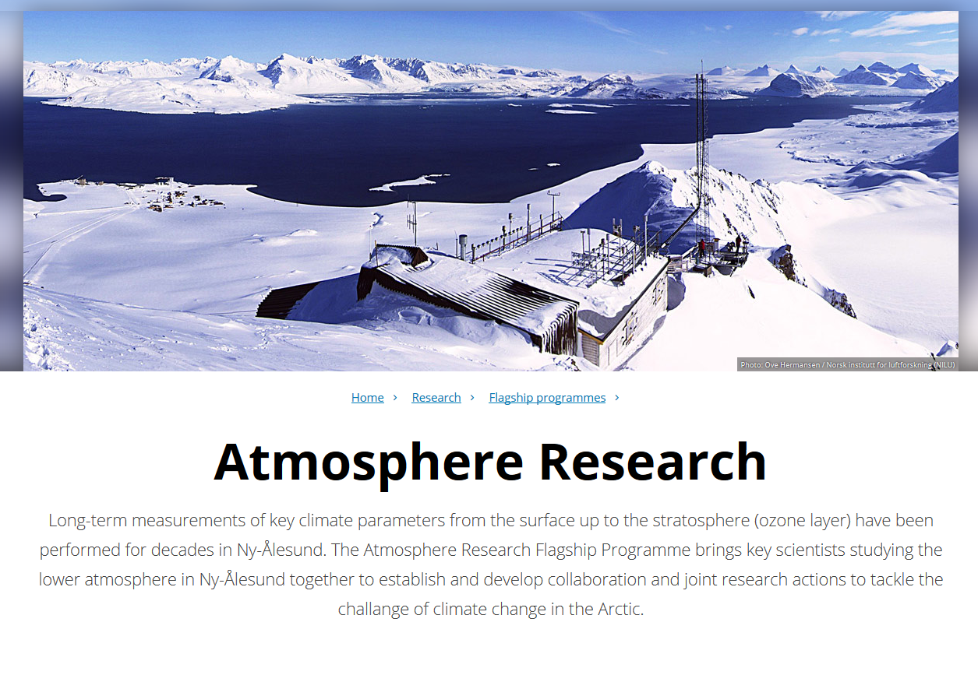

Slide 16
Atmosphere flagship
Scientific committee:
Roland Neuber, Alfred-Wegener Institute (Chair)
Hans-Christen Hanssen, Stockholm University (Co-chair)
Ove Hermansen, Norwegian Institute for Air Research
Boris Ivanov, Arctic and Antarctic Research Institute
Grzegorz Karasiński, Polish Academy of Sciences
Satheesan Karathazhiyath , NCAOR
Christina A. Pedersen, Norwegian Polar Institute
Masataka Shiobara , NIPR
Vito Vitale, CNR
Young Jun Yoon , KOPRI
The Atmosphere Flagship have established work groups focusing on specific scientific questions
WG1. Clouds, humidity, precipitation
WG2. Long-term observations and trends in temperature, precipitation, clouds and radiation
WG3. Boundary layer meteorology
WG4. Interaction of snow, atmosphere, and aerosols
WG5. Atmospheric aerosol
WG6. Variability in surface UV irradiance and ozone column

Slide 17
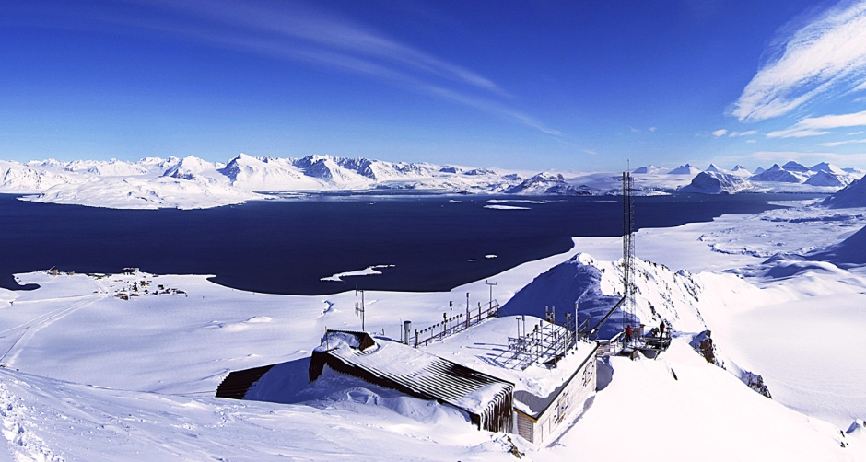
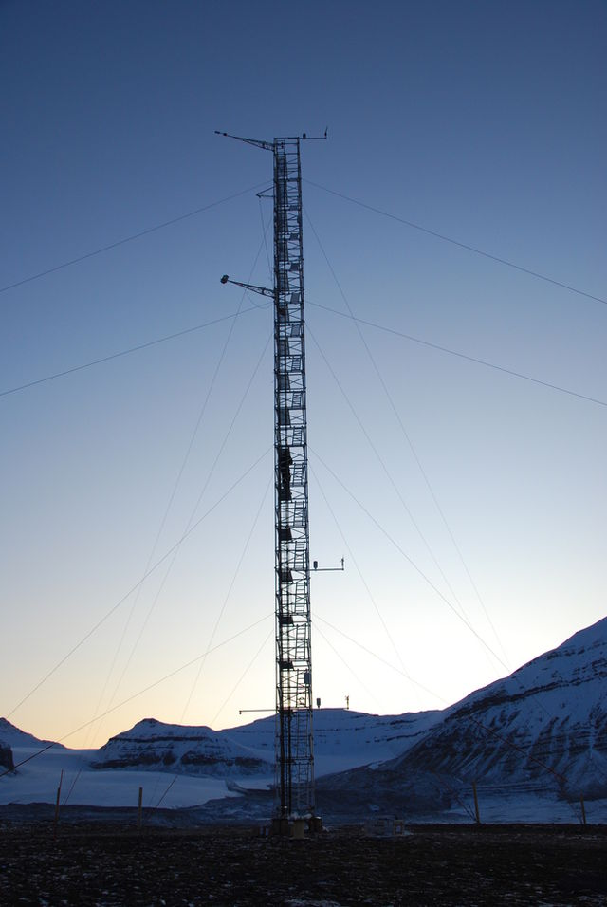
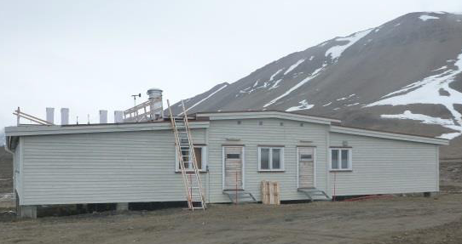
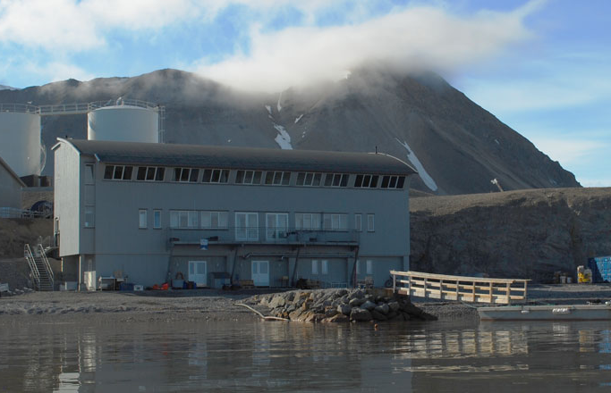
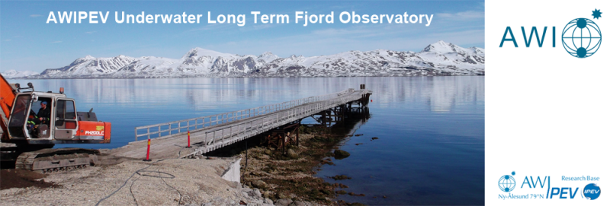
Common research infrastructures Ny-Ålesund
Zeppelin Atmosphere Observatory
Atmosphere Laboratory Gruvebadet
Amundsen-Nobile Climate
Change Tower
Marine Laboratory

Slide 18
Oslo 6 – 8 November 2017
Monday 6 November - Setting the stage
Tuesday 7 November - Connecting Svalbard research - Invited speakers
Wednesday 8 November - Thematic research and cooperation within and across disciplines - Parallel sessions
Thursday 9 November - Back to back meetings (open for all conference participants)
The goal is to stimulate and inspire in a way that advances research from Svalbard.
Together with updates on new strategies and the latest from the frontier of research, we expect your active participation in presentations from ongoing and planned projects, poster session and stimulating decisions.
Still open for abstract submissions for poster contribution.
www.rcn.no/svalbardscienceconference

Slide 19
Present research institutes
Norwegian Polar Institute (NPI), Norway
Norwegian Mapping Authority (NMA), Norway
Norwegian Institute for Air Research (NILU), Norway
The University Centre in Svalbard (UNIS), Norway
University of Tromsø (UiT), Norway
Northern Research Institute Tromsø (NORUT), Norway
Norwegian Space Centre (NSC), Norway
Stockholm University (SU), Sweden
Natural Environment Research Council (NERC), UK
Alfred Wegener Institute (AWI), Germany
National Institute of Polar Research (NIPR), Japan
University of Groningen (UoG), The Netherlands
Korea Polar Research Institute (KOPRI), South Korea
Chinese Arctic and Antarctic Administration (CAA), China
GeoForschungsZentrum Potsdam (GFZ), Germany
Consiglio Nazionale delle Ricerche (CNR), Italy
Institut Polaire Francais, Paul Emile Victor (IPEV), France
National Centre for Antarctic and Ocean Research (NCAOR), India

Slide 20
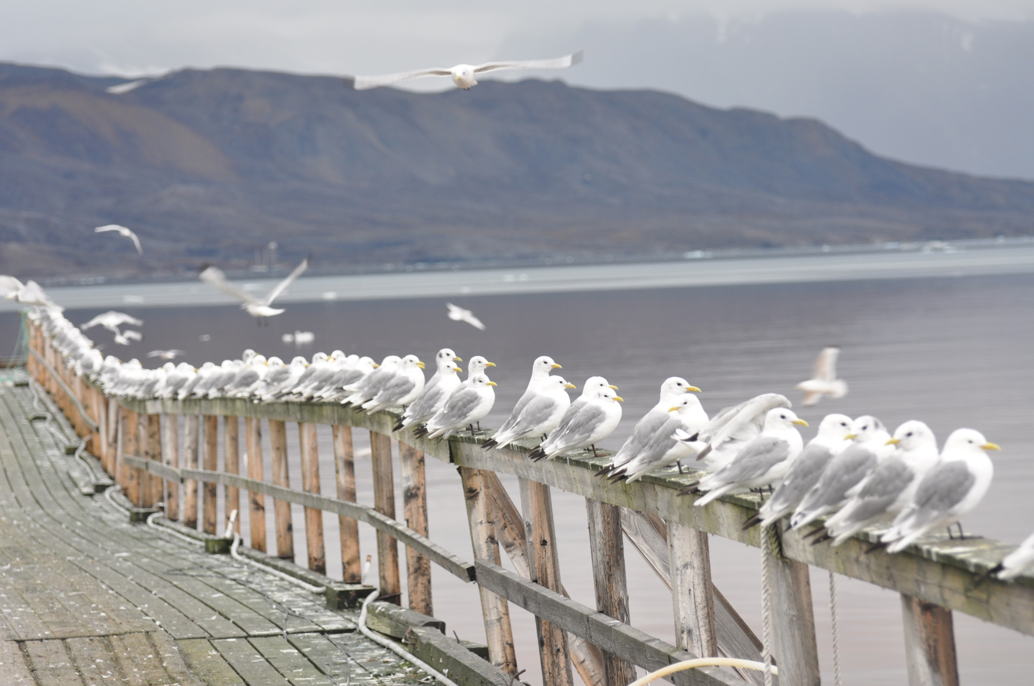
Thank you for your attention
www.nysmac.npolar.no
Photo: Geir W. Gabrielsen, NPI

