Slide 1
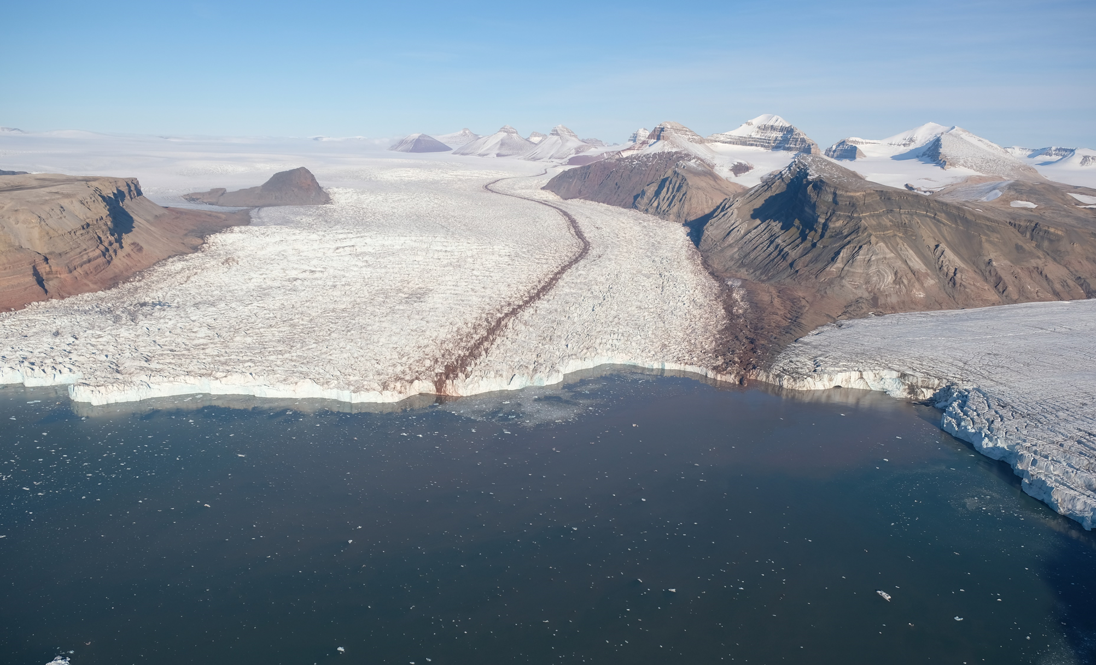
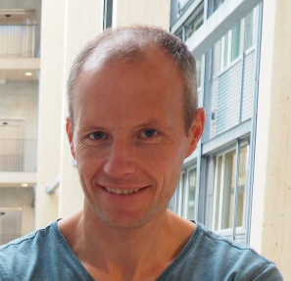

S4F Svalbard
Jack Kohler, Geir Moholdt
Norwegian Polar Institute

Slide 2
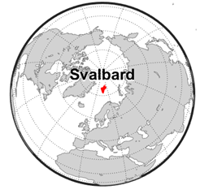
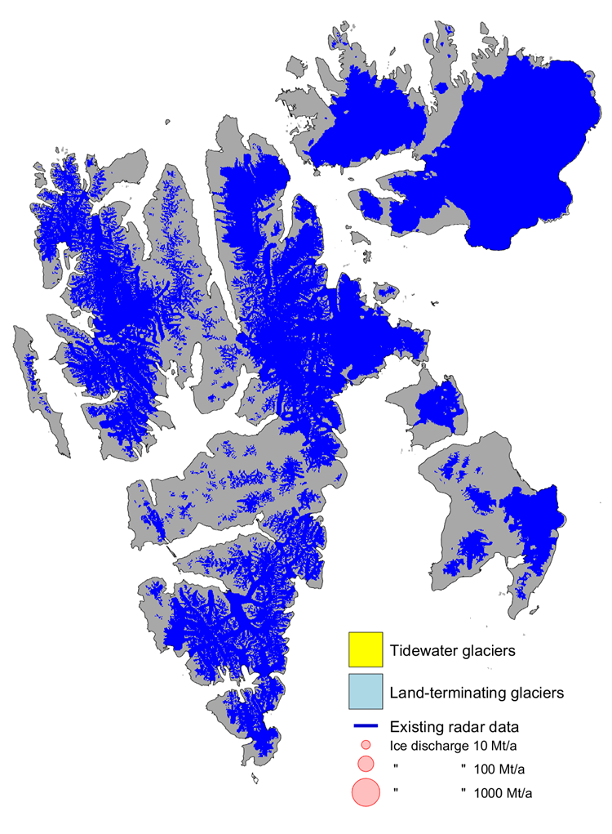
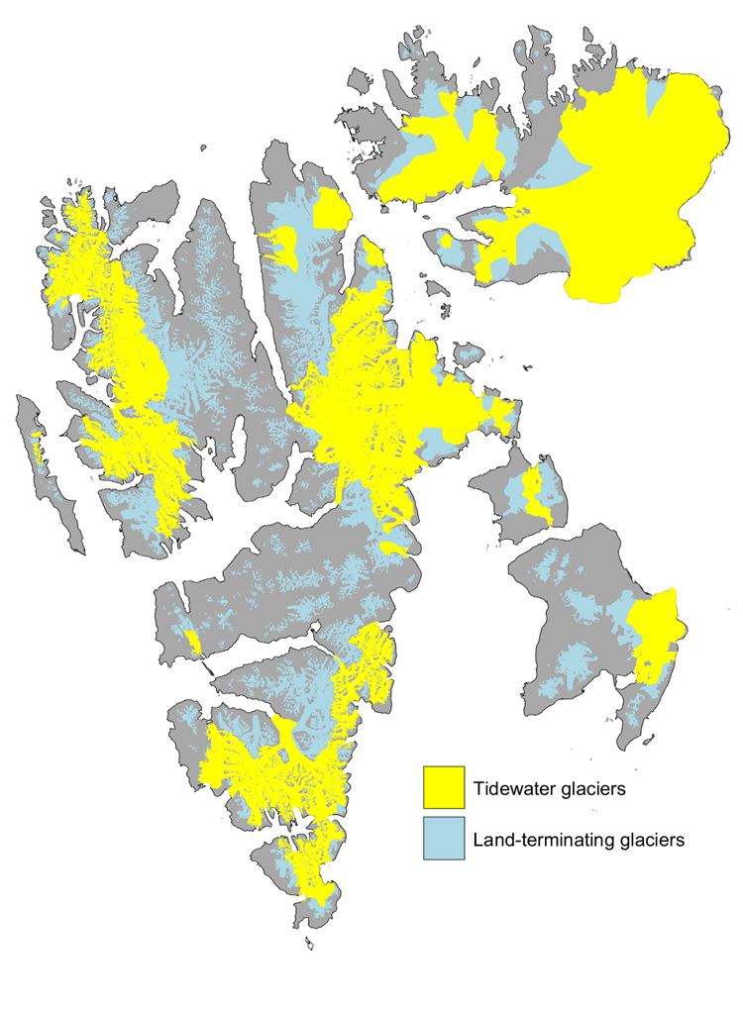
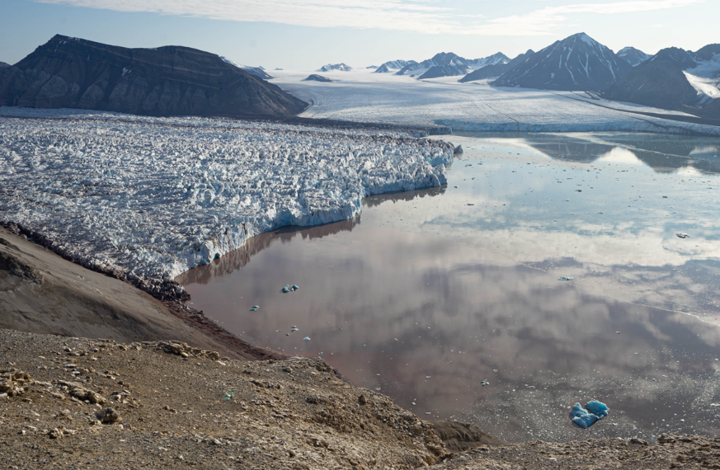
Svalbard
54% glacier-covered
Ice caps, valley glaciers, tidewater glaciers
tidewater glaciers
Surface mass balance
Dynamic mass balance

Slide 3
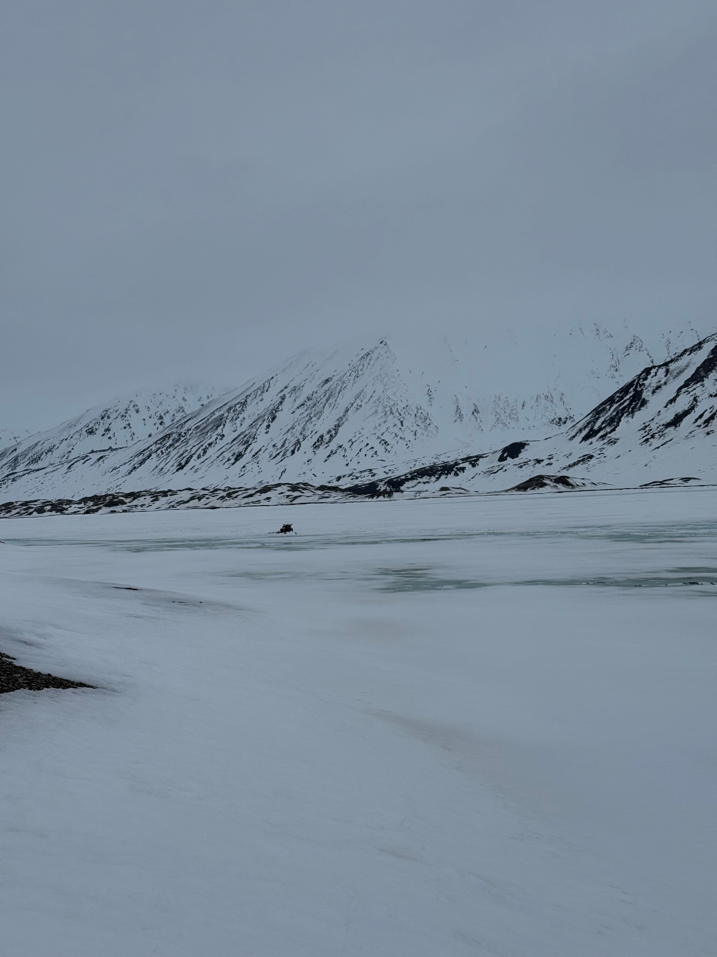
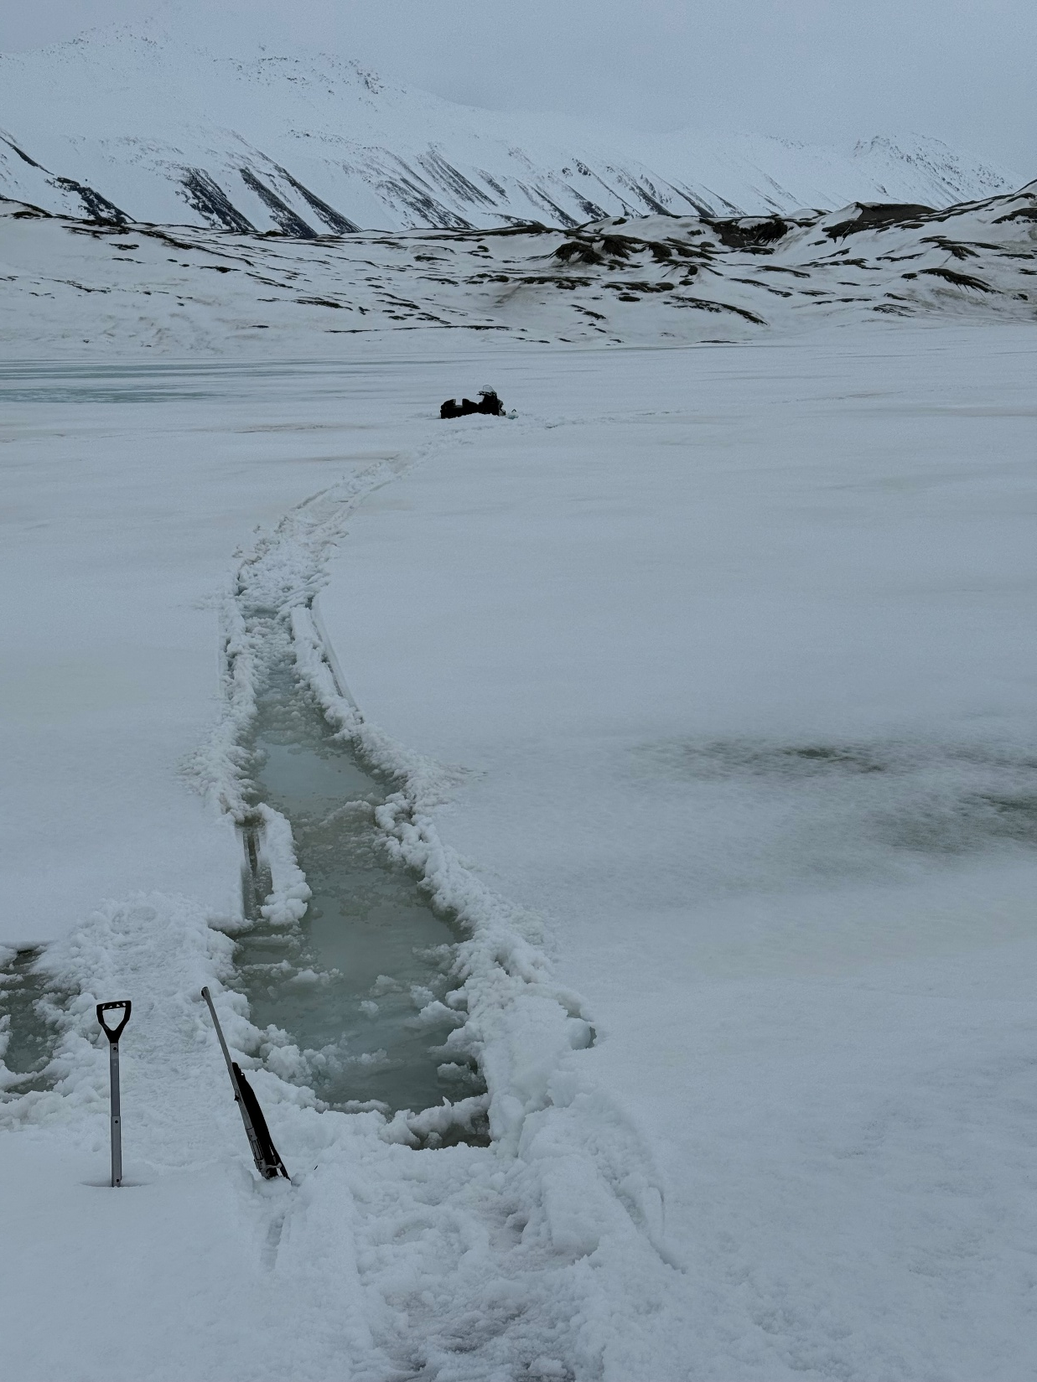

Slide 4
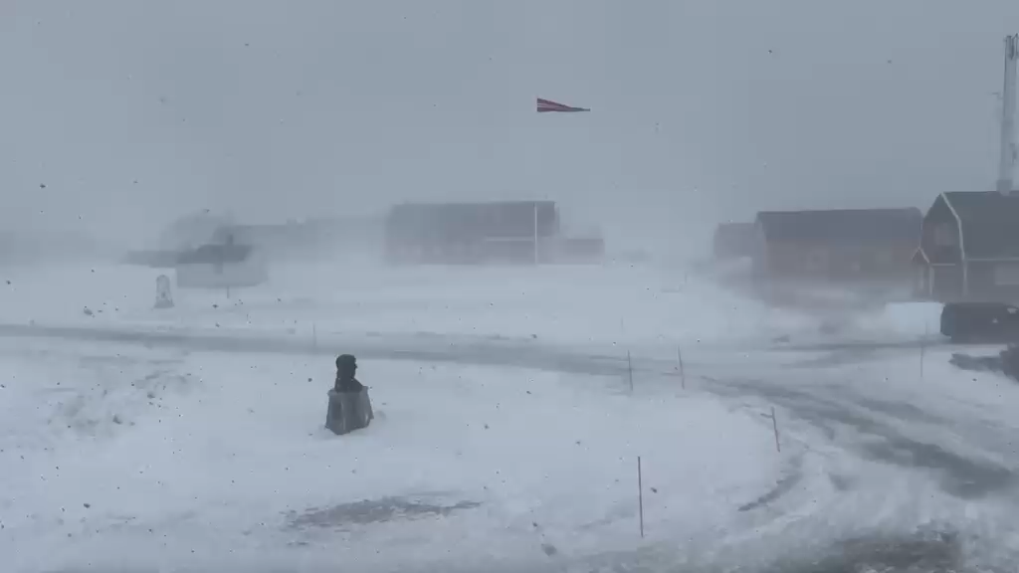

Slide 5
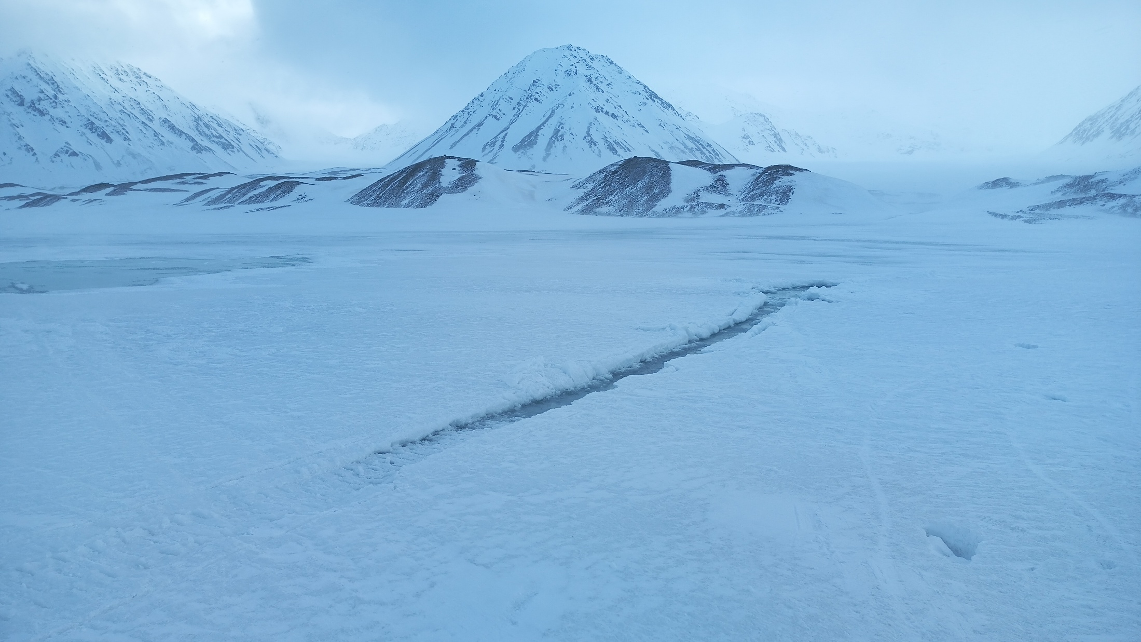

Slide 6
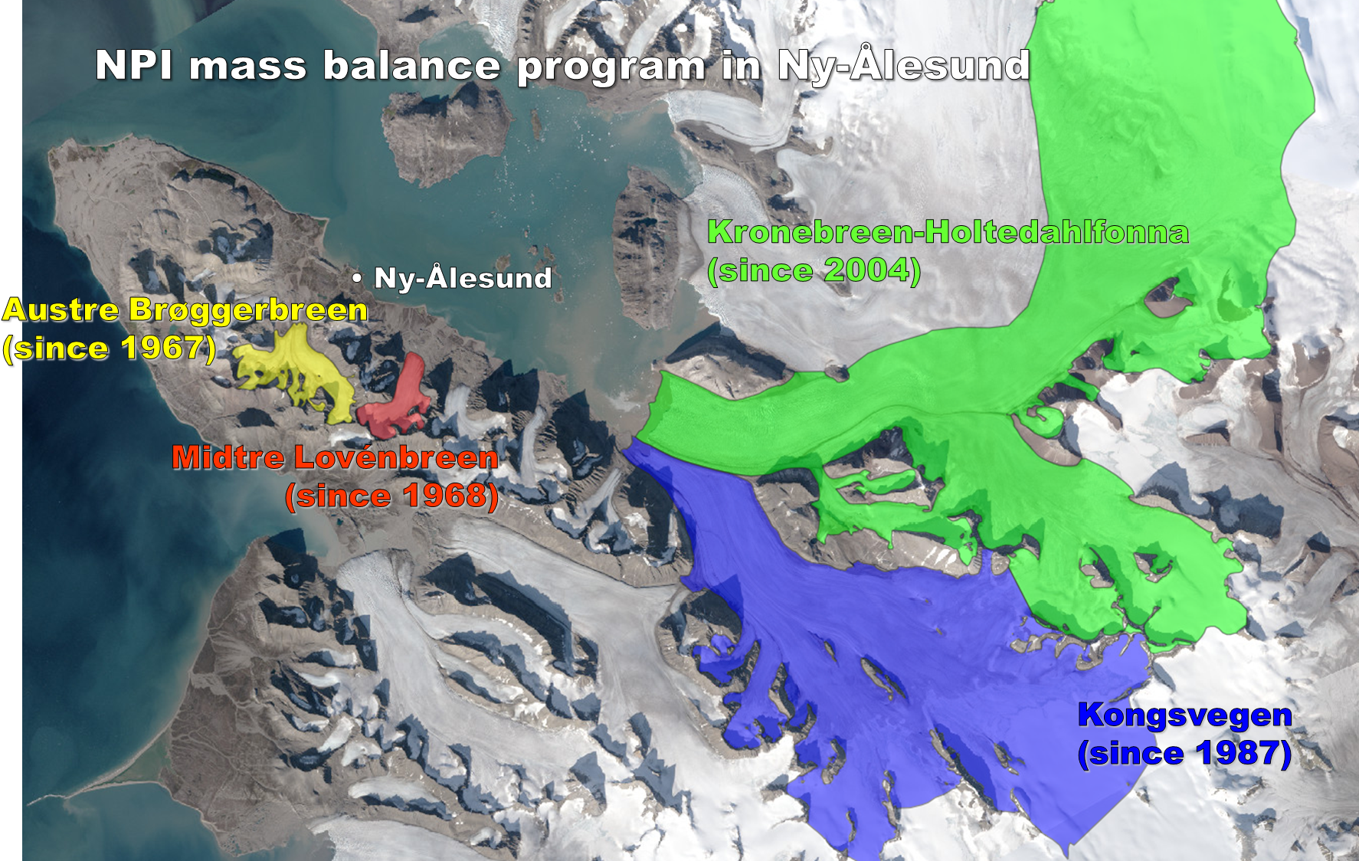

Slide 7
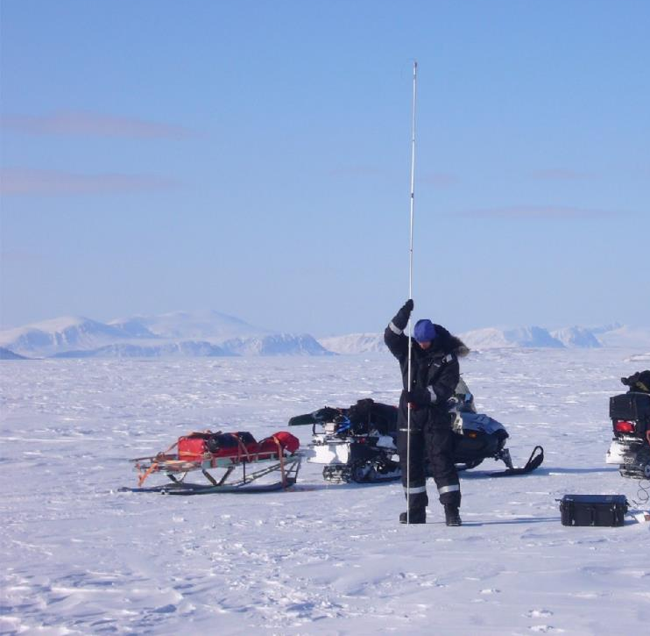
Winter balance:
Snow depth
Winter mass balance

Slide 8
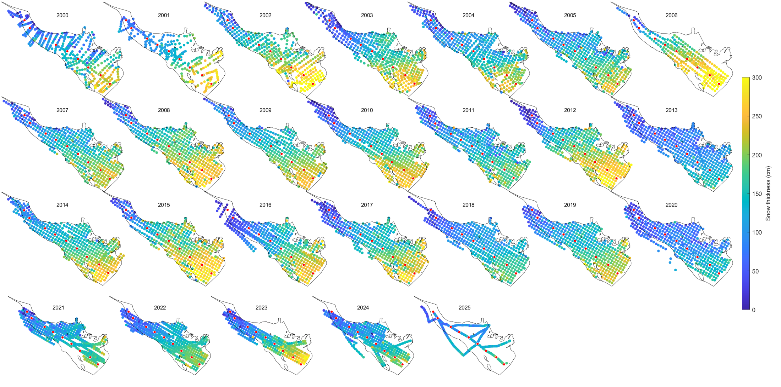

Slide 9
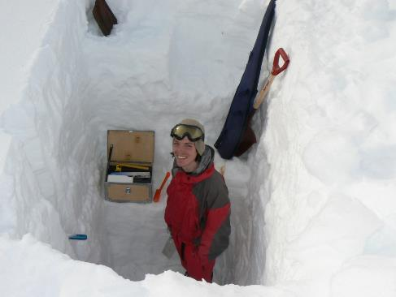
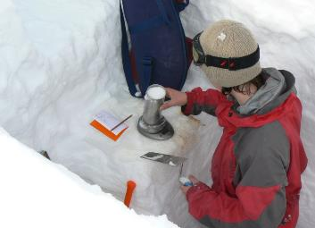
Winter mass balance

Slide 10
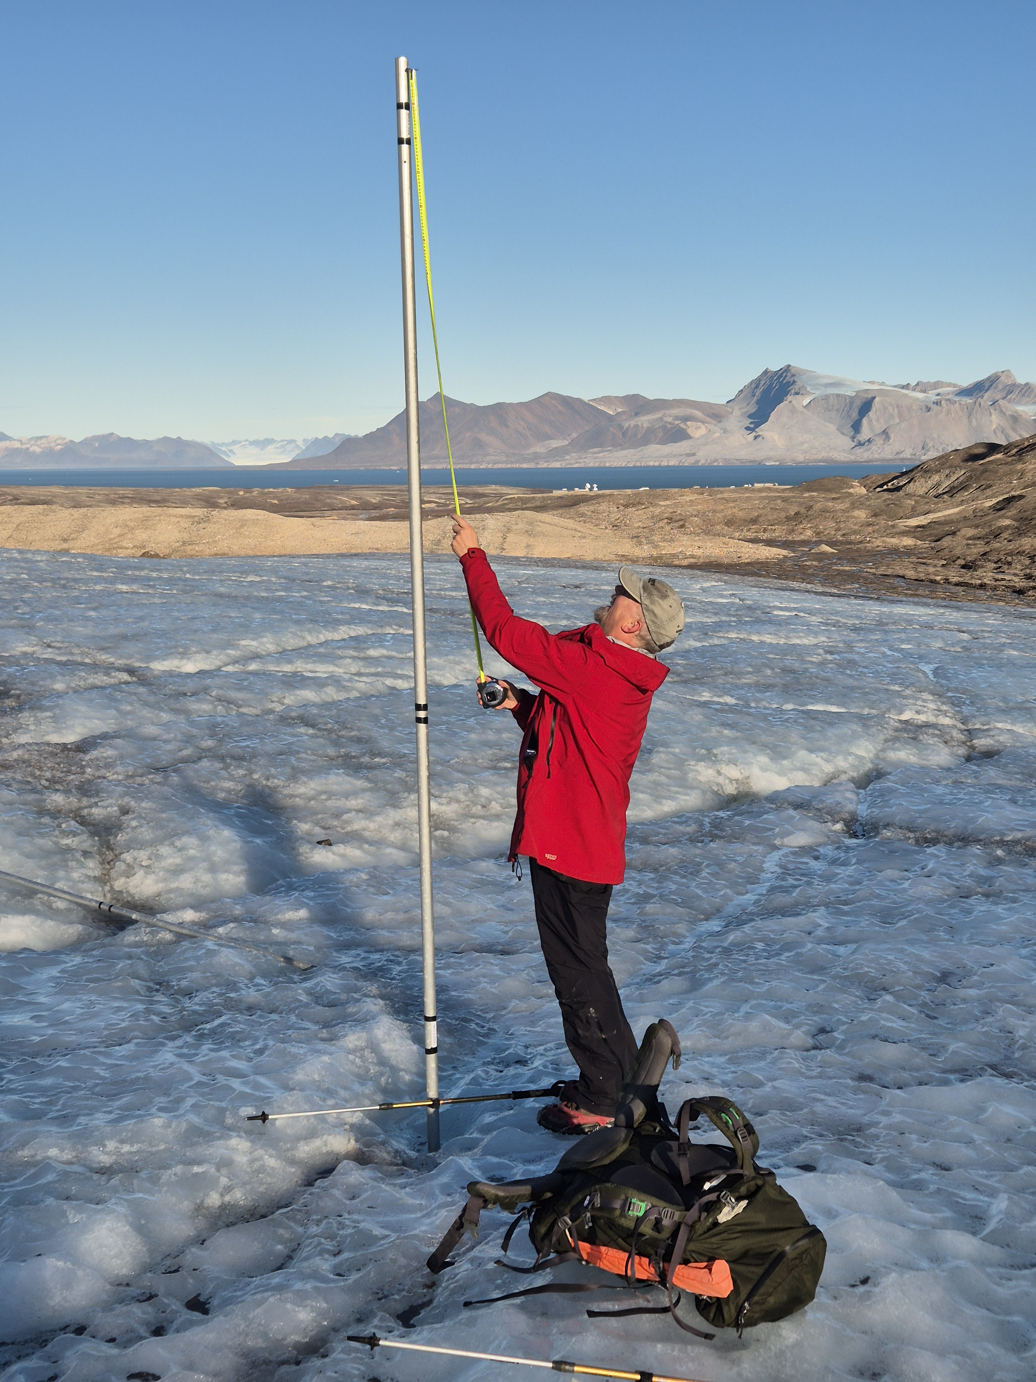
Summer mass balance

Slide 12
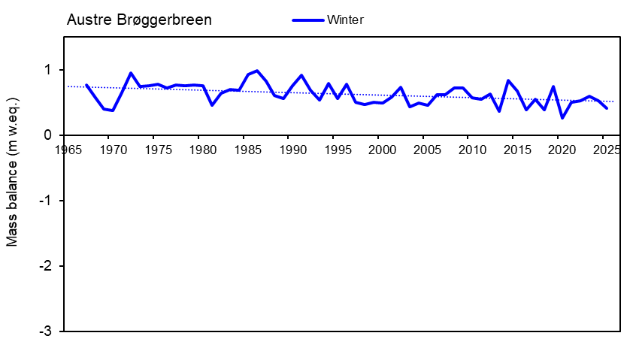
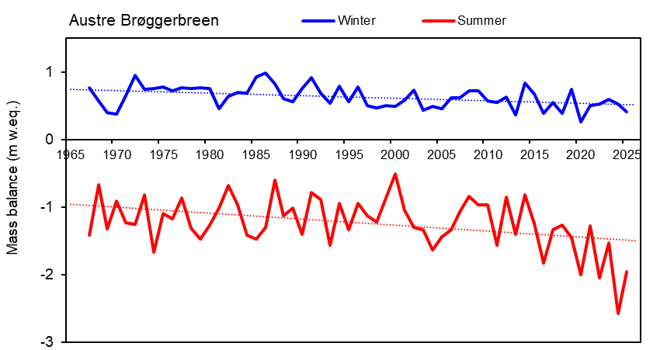
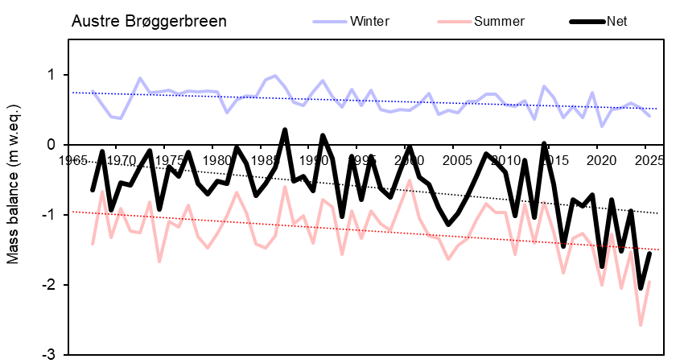
2024

Slide 14
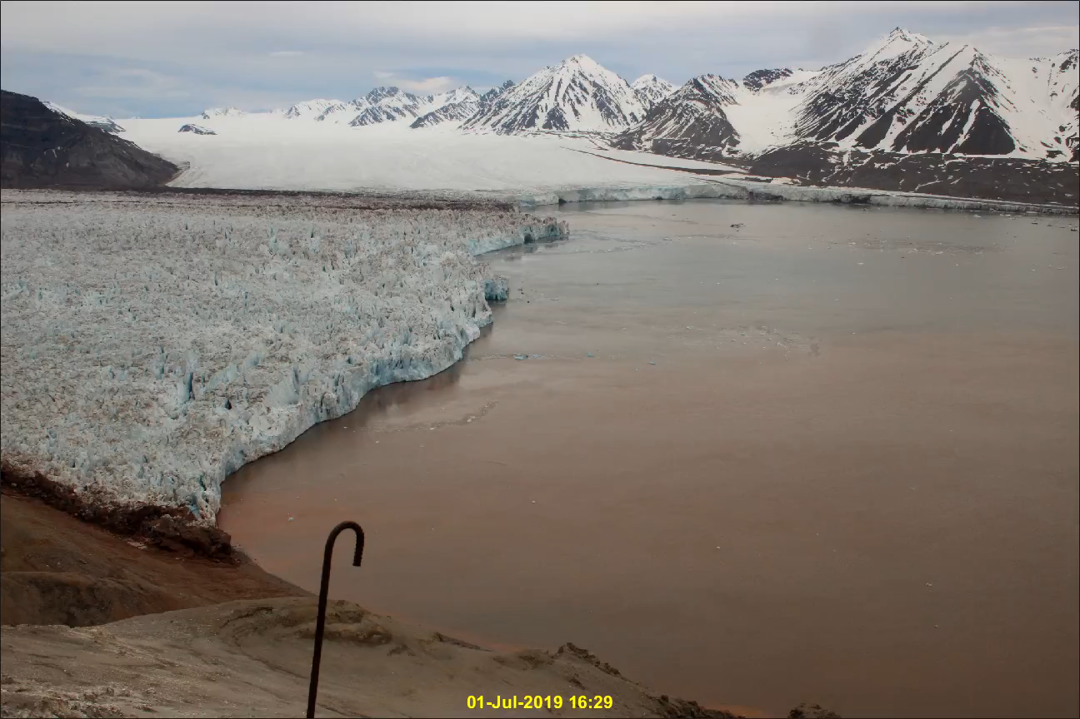

Slide 15
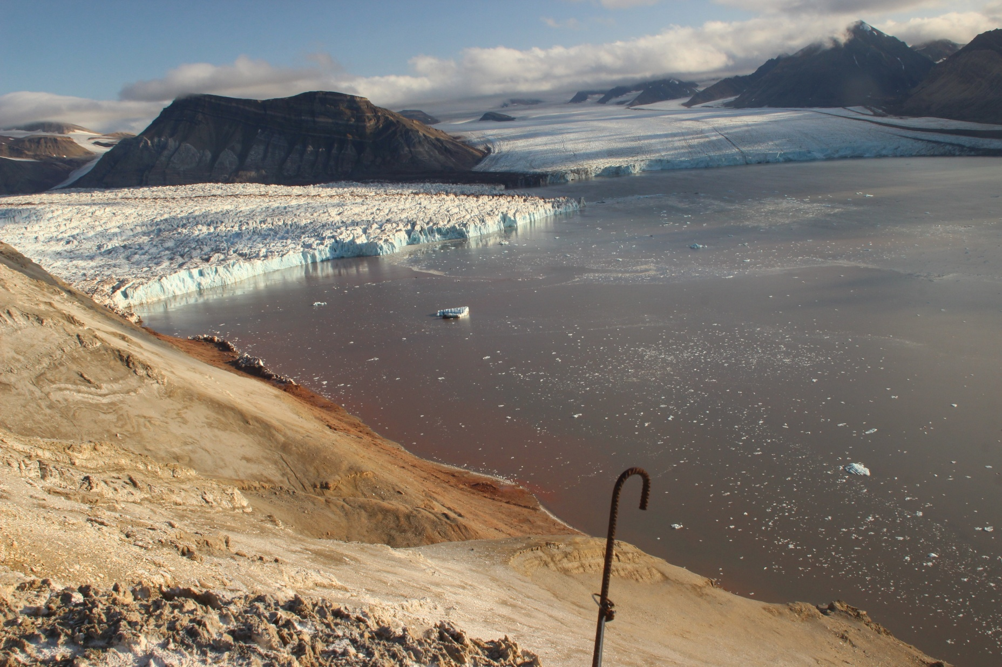
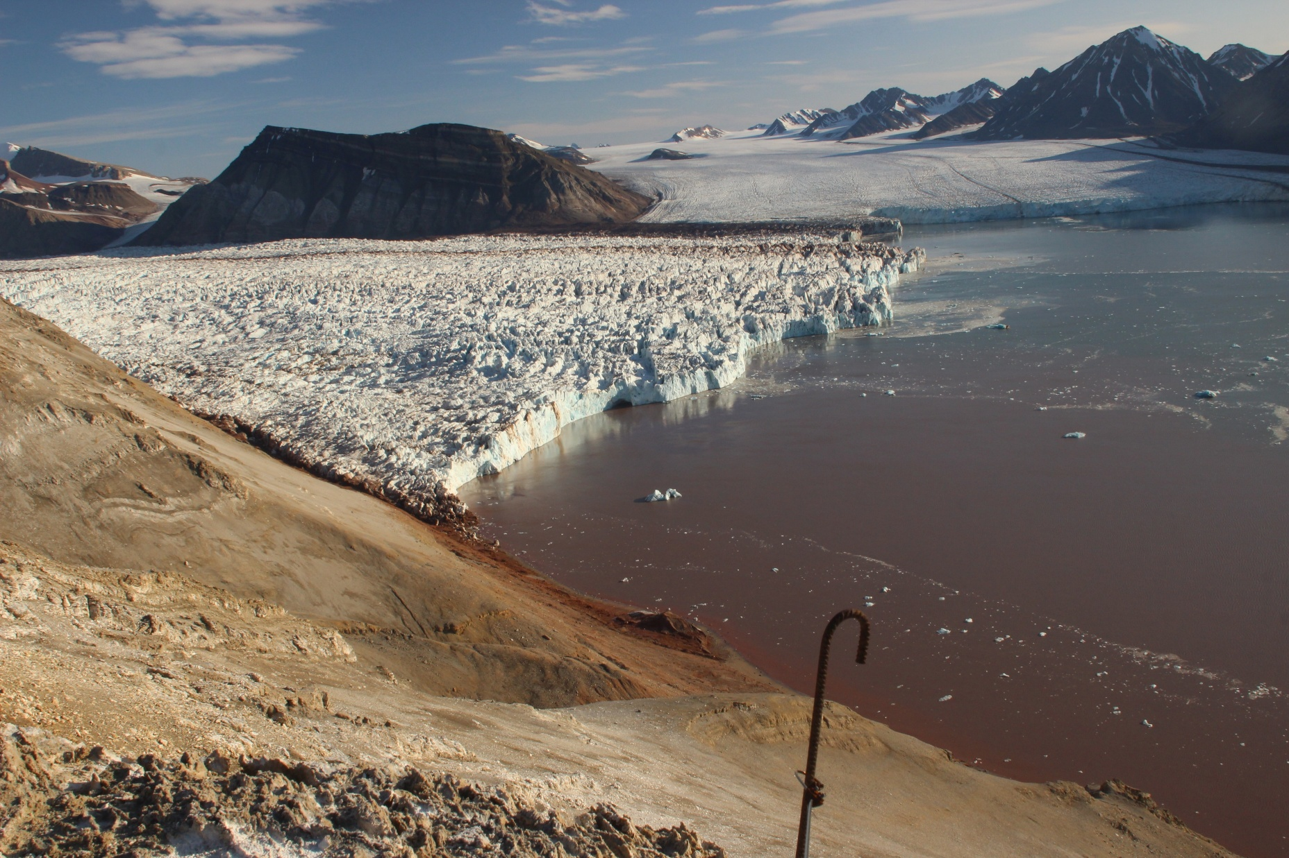
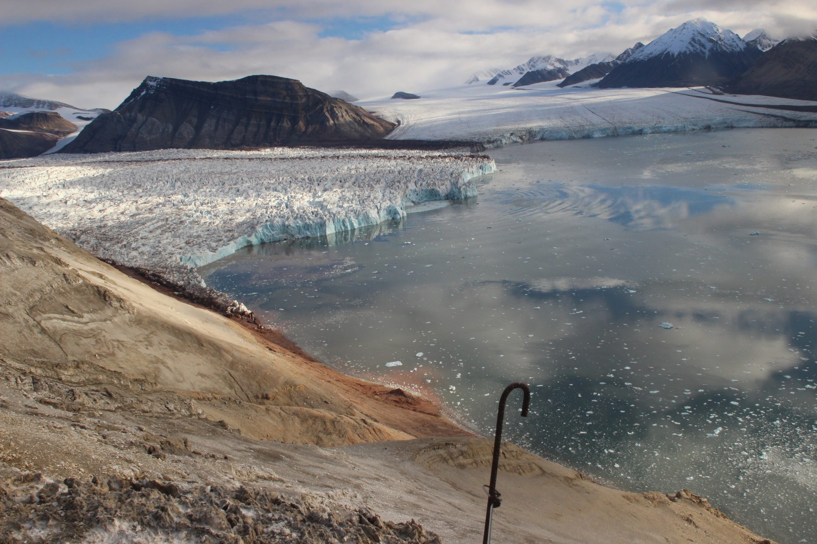
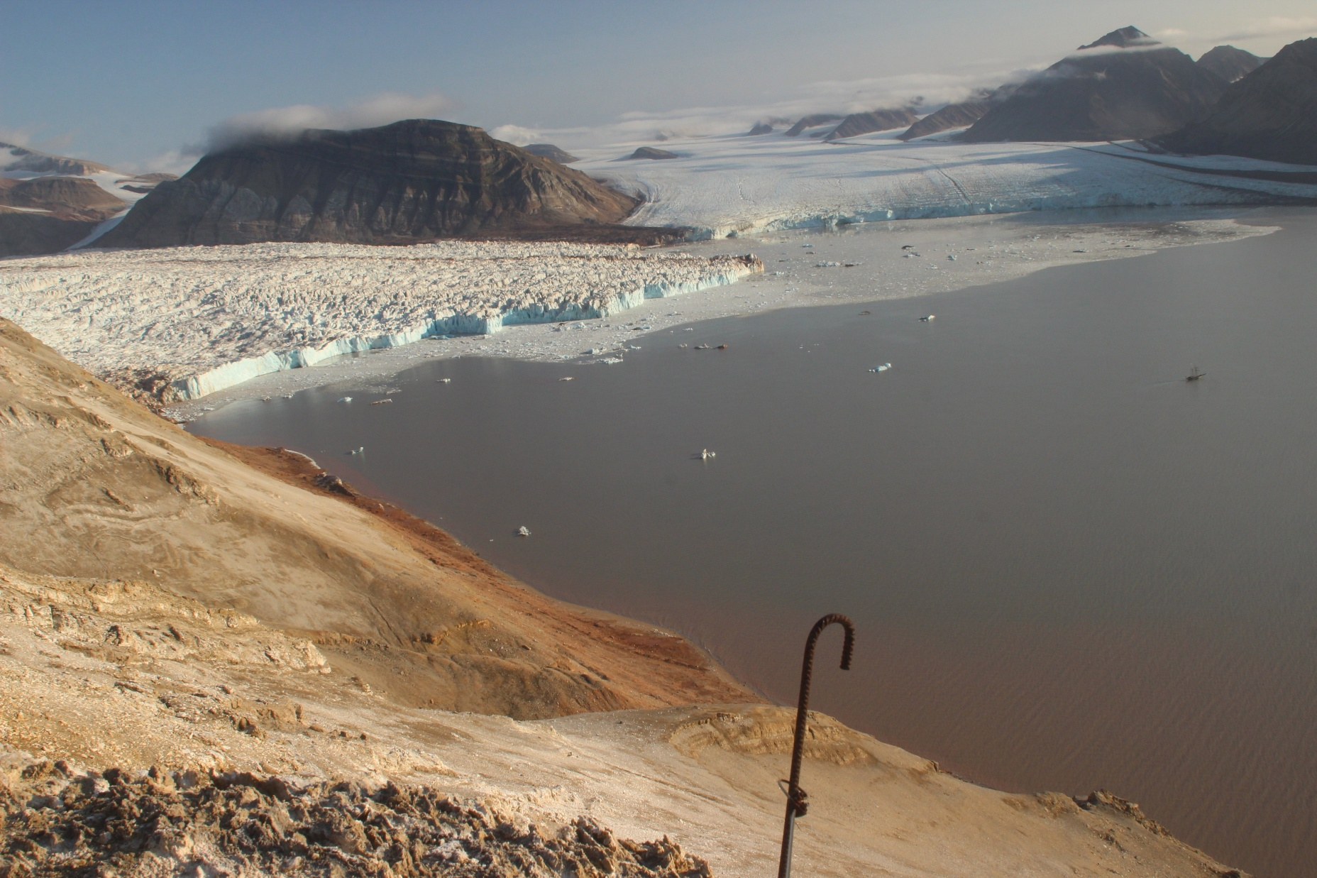
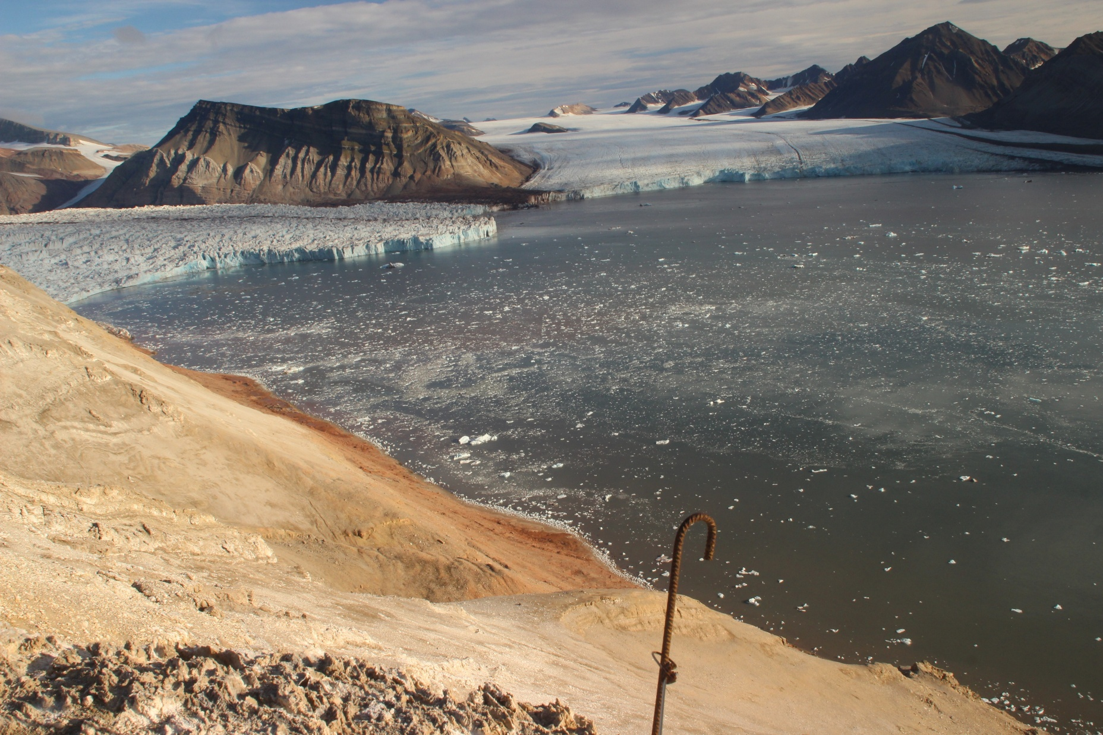
3 km
2024
2023
2021
2022
2025

Slide 16
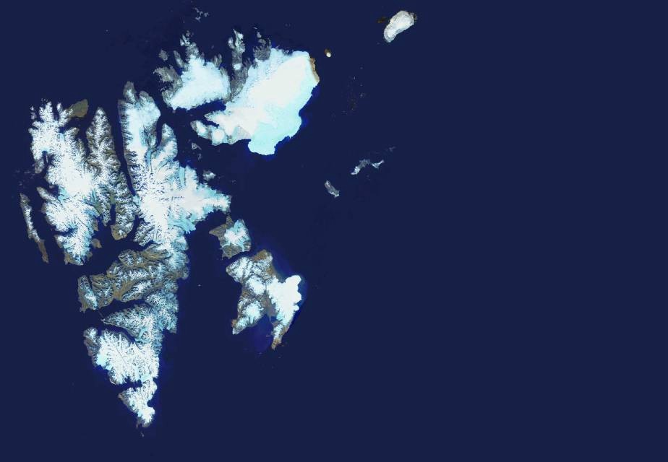


?
?
?
NPI
Other institutions
?
?
→?
?
?
?

Slide 17
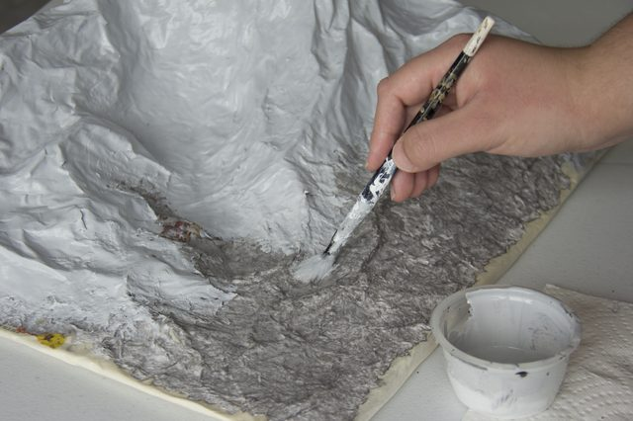
Models

Slide 18
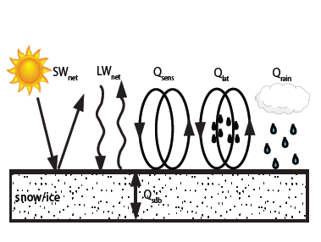
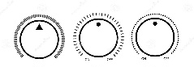

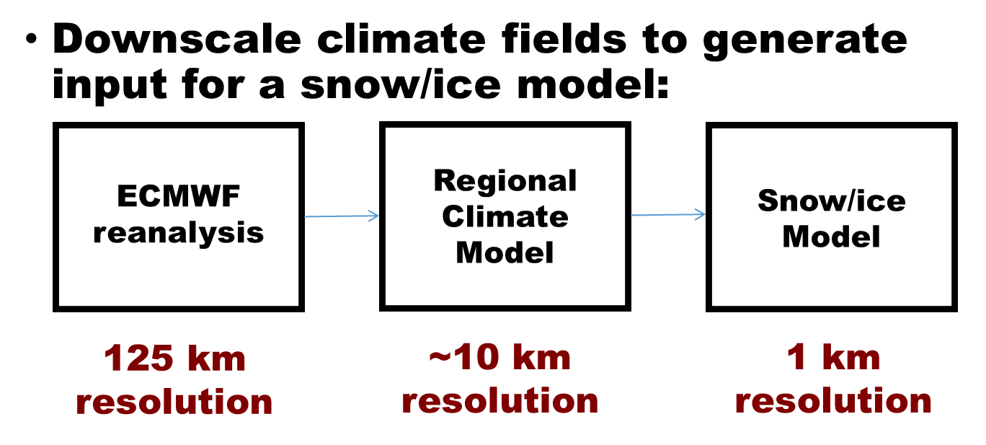
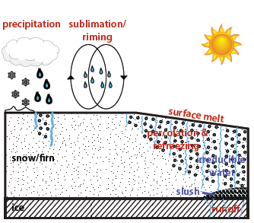
Mass balance model:
Ward van Pelt (U. Uppsala)
Surface energy balance model used to compute surface temperature and melt production.
Surface model coupled to multilayer snow model
x
x
NORA10 (10 km)
NORA3 (3 km)
CARRA (2.5 km)
1 km, 2019 paper
0.5 km

Slide 19
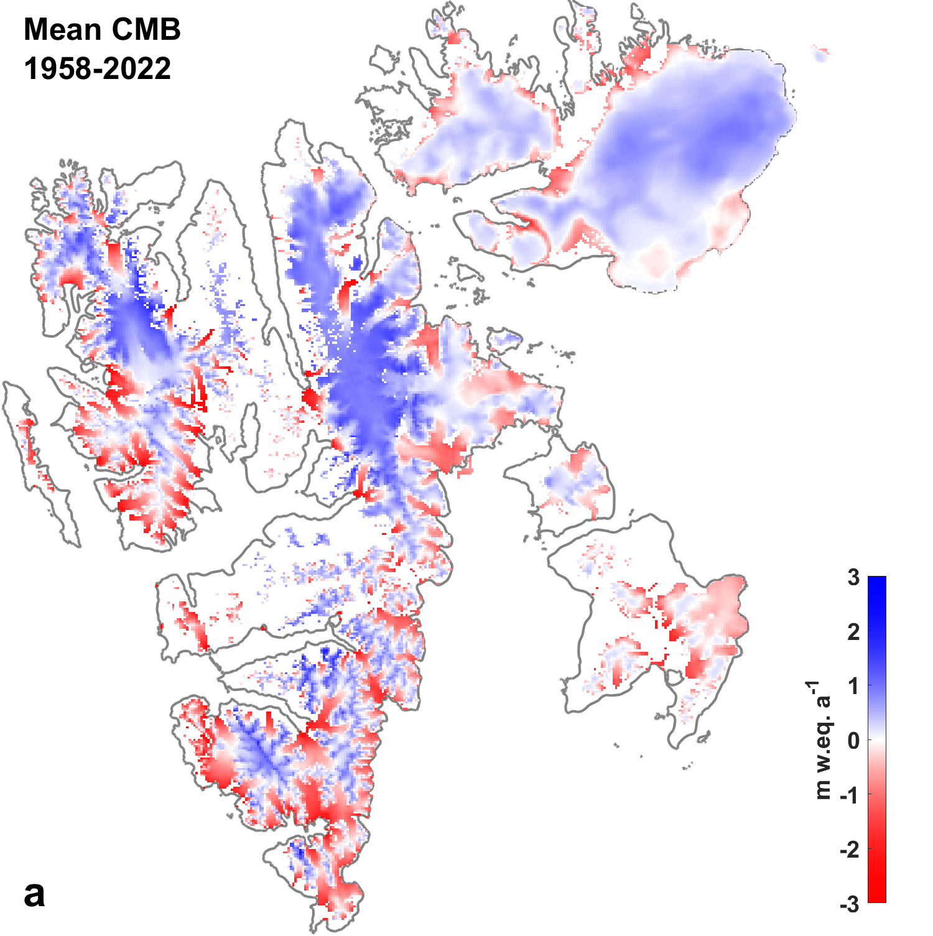

Slide 20
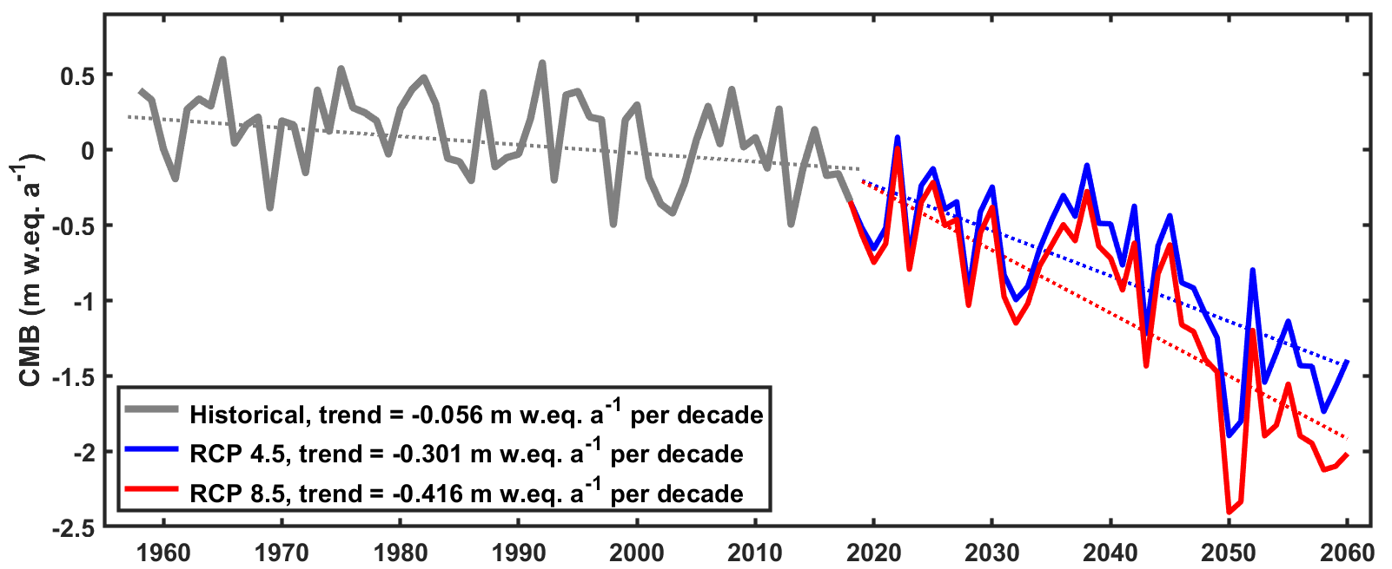
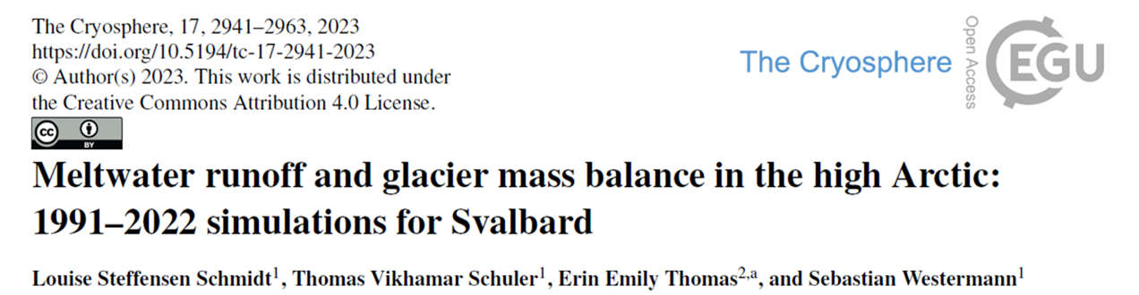
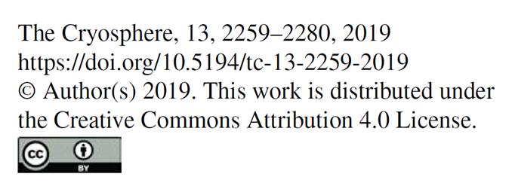
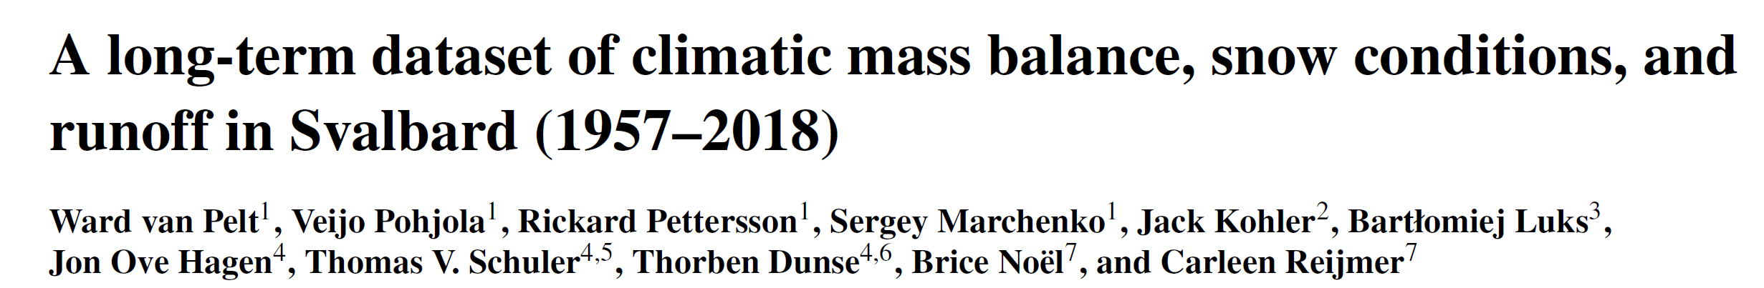
2024

Slide 21
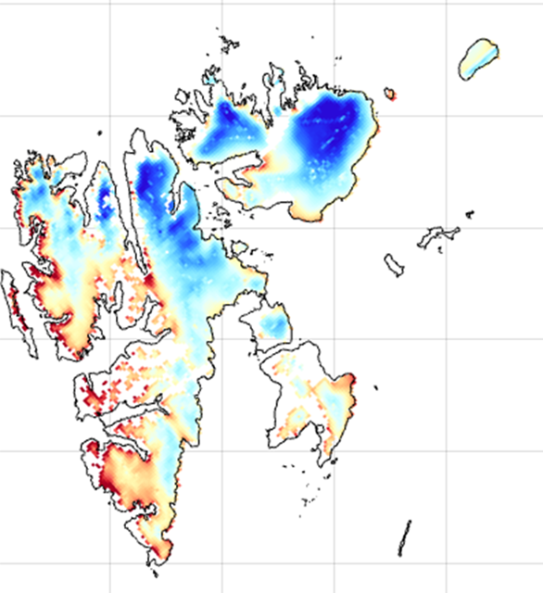
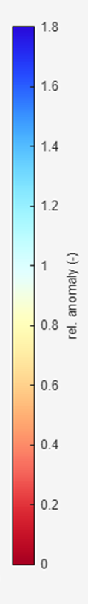
Mass balance

Slide 22
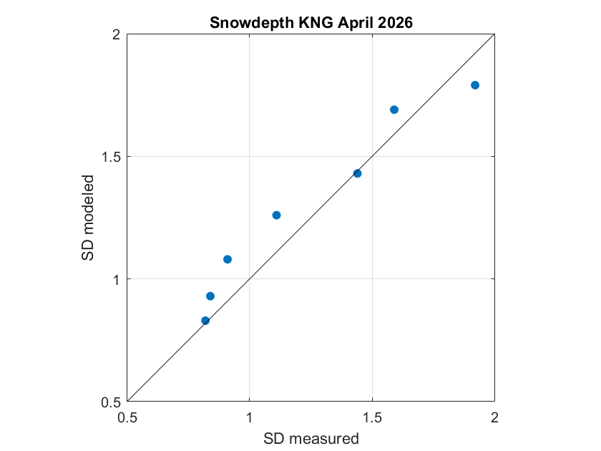

Slide 23


Slide 24
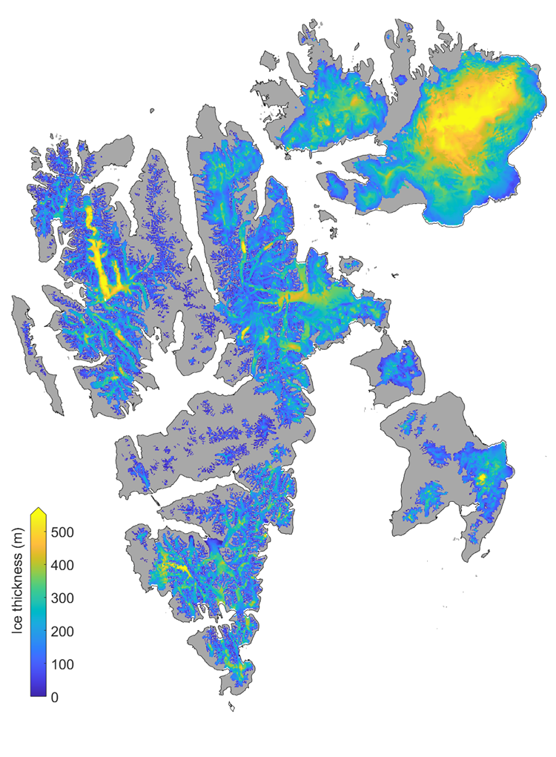
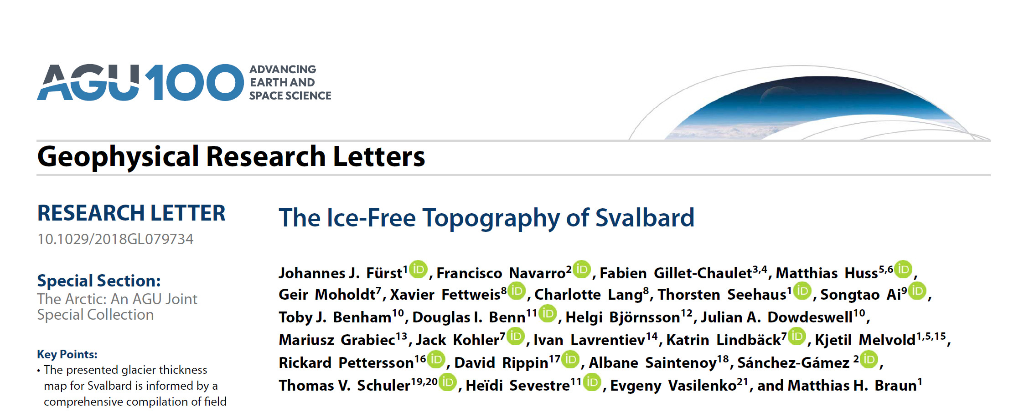
Ice Thickness

Slide 25
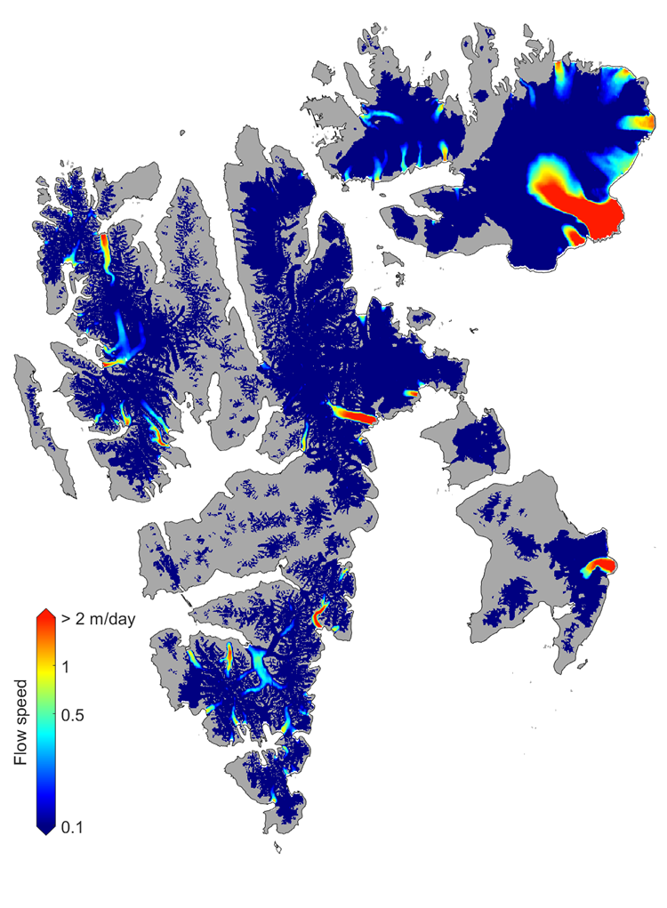
Velocity
Go_LIVE
ITS_LIVE
Friedl et al 2021
Luckman

Slide 26
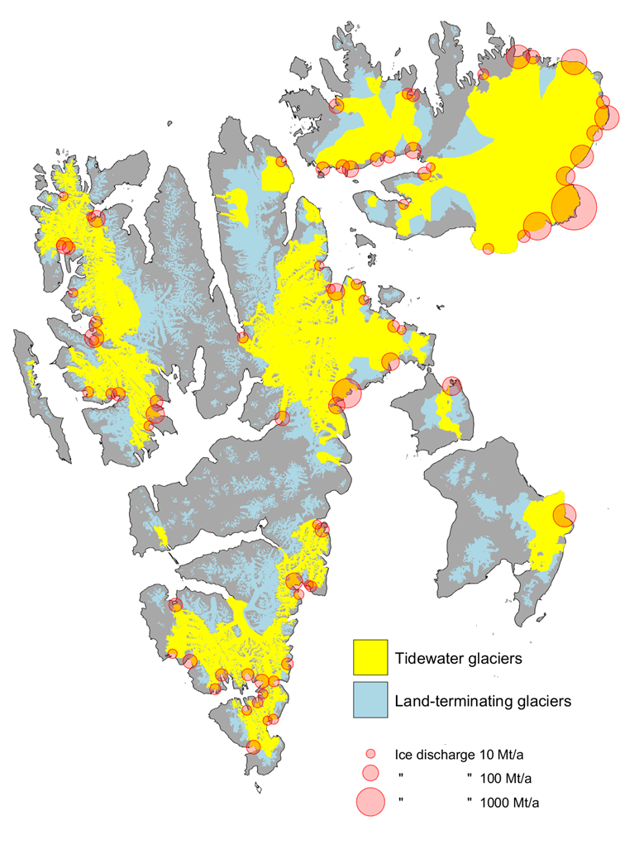
Tidewater glacier ice discharge

Slide 27
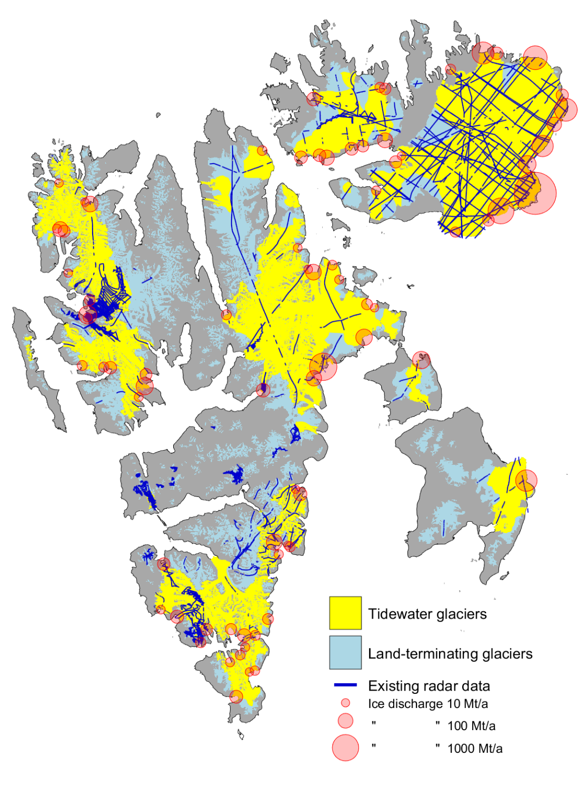
Radar coverage

Slide 28
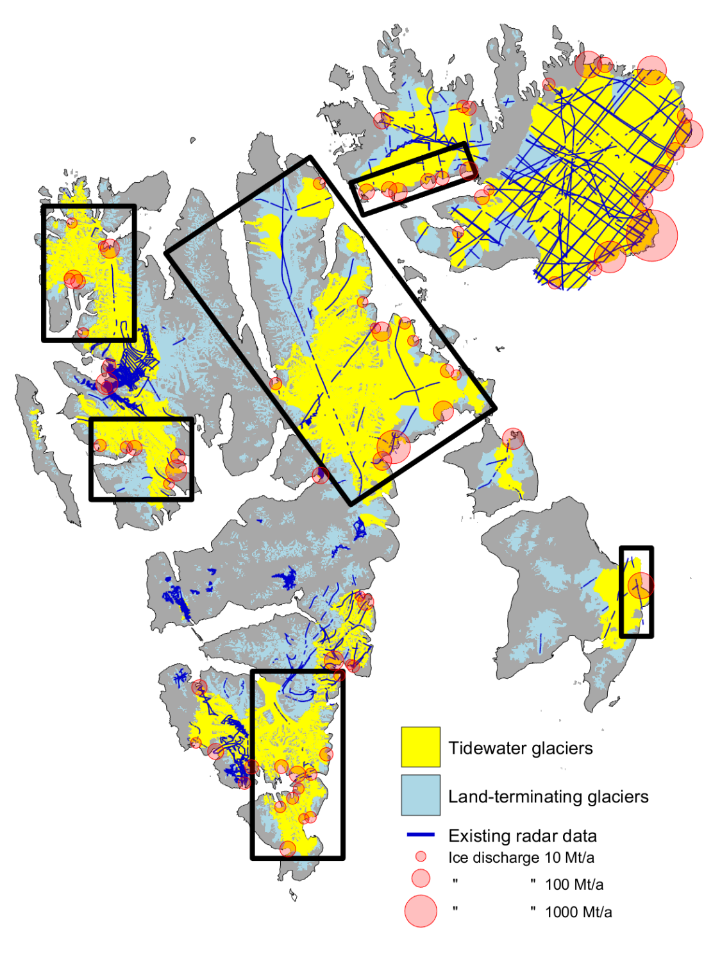
Planned areas for new radar data

Slide 29
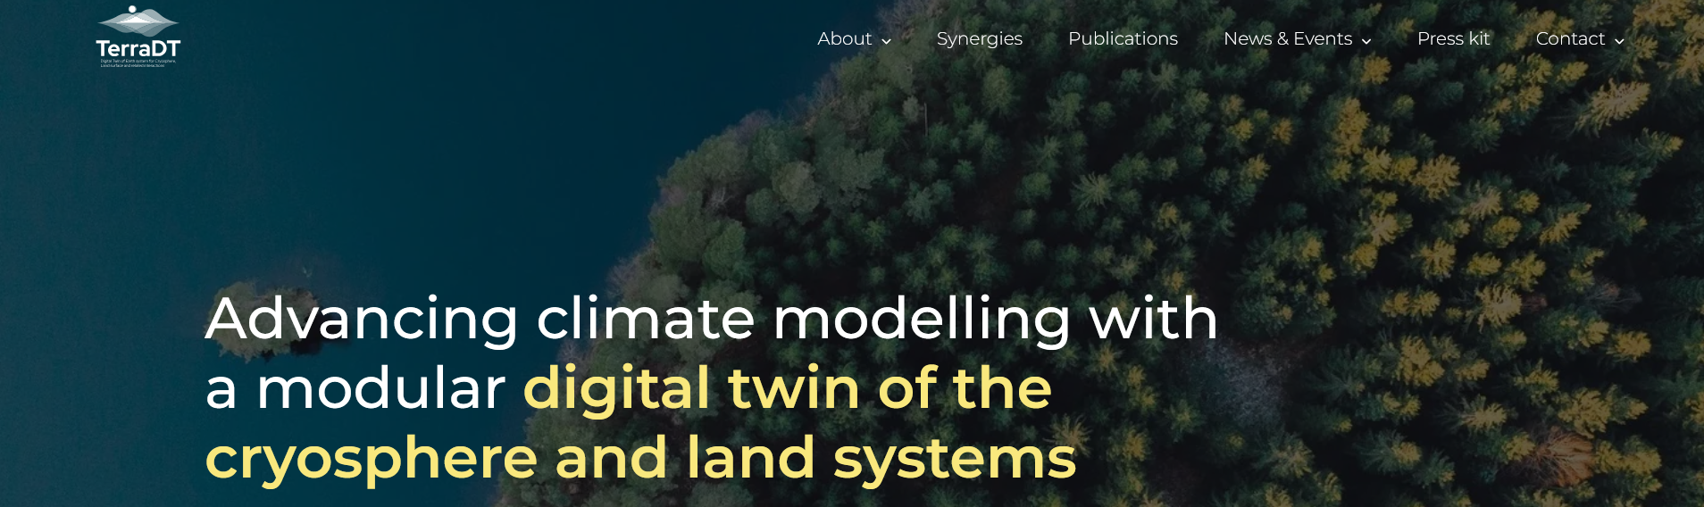
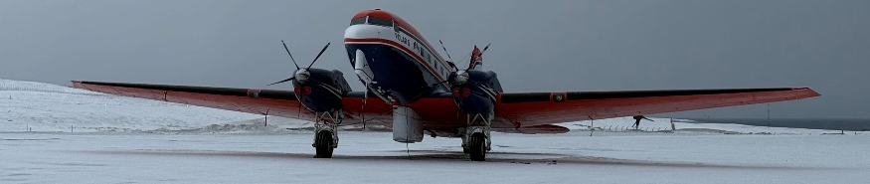
Detailed Svalbard bedrock map using airborne radar surveys, particularly at crucial marine glacier fronts
Merge relevant land-ice bedrock data; coastal bathymetry, land topography, ice thickness surveys and models
Svalbard airborne survey May 2027
Improve bedrock map with new data and ice thickness modeling
Apply detailed bedrock map in calving rate calculations for Svalbard's marine-terminating glaciers
Satellite-based mapping of glacier elevation, velocity and glacier front positions in time -> time series of calving for Svalbard glaciers
Use data for training/validation of calving implementation in DTC

