Slide 1
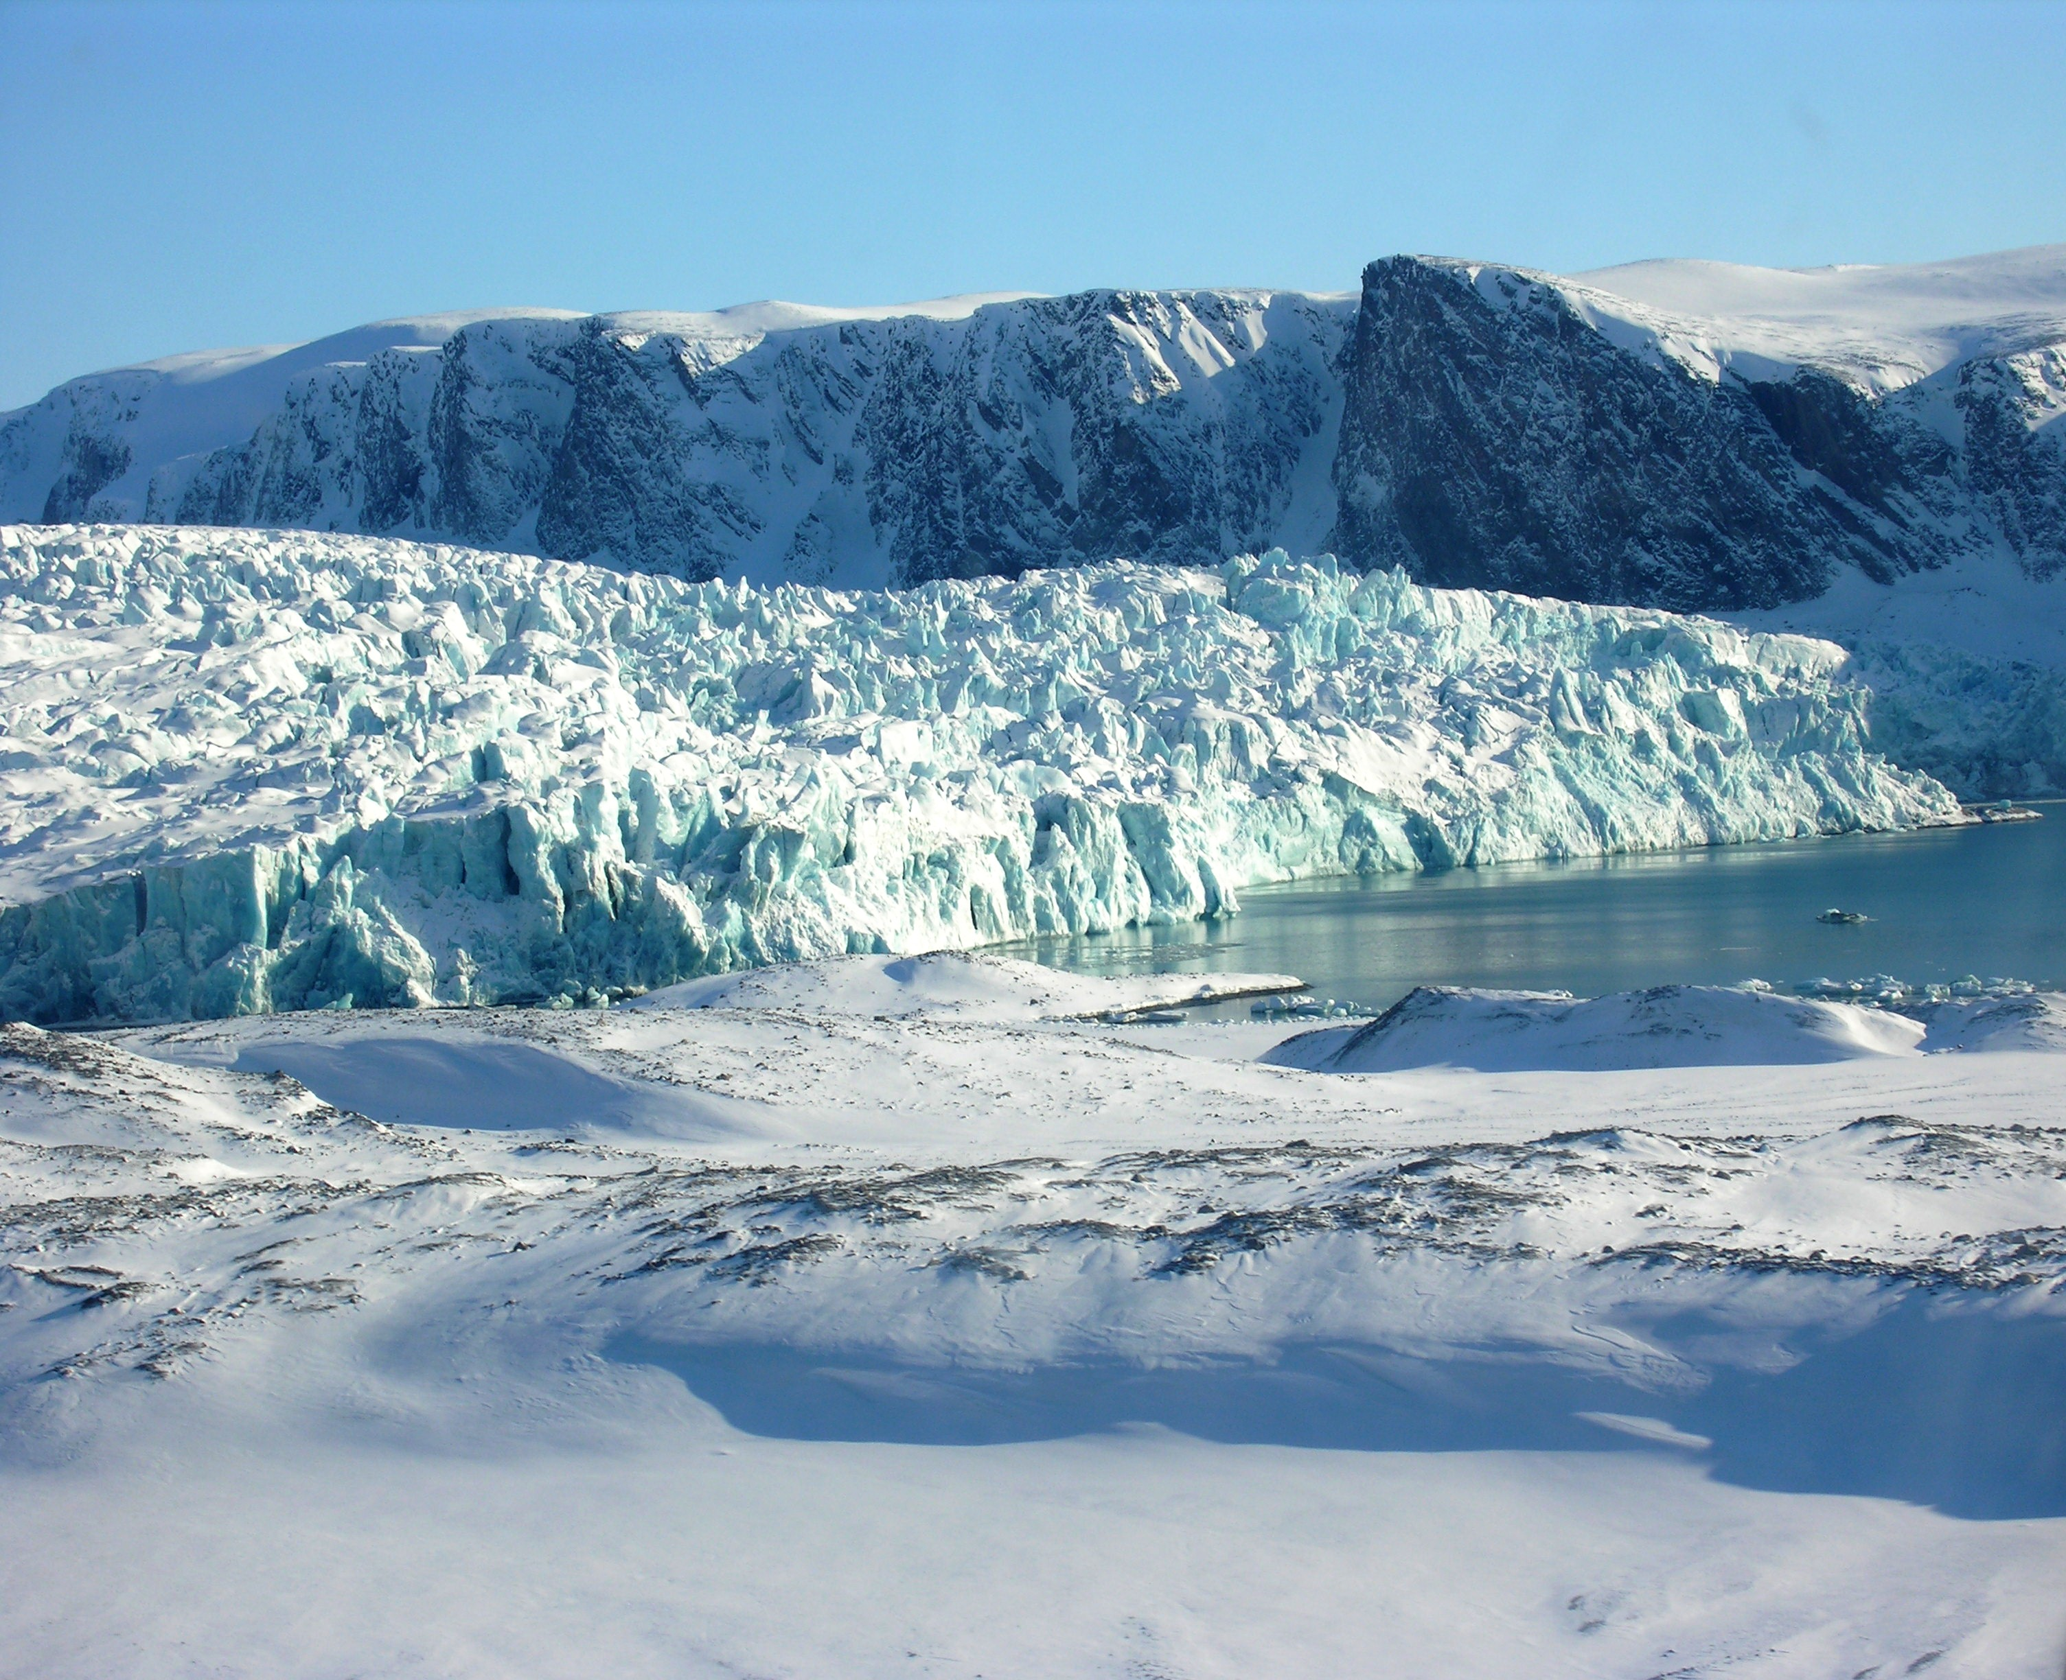
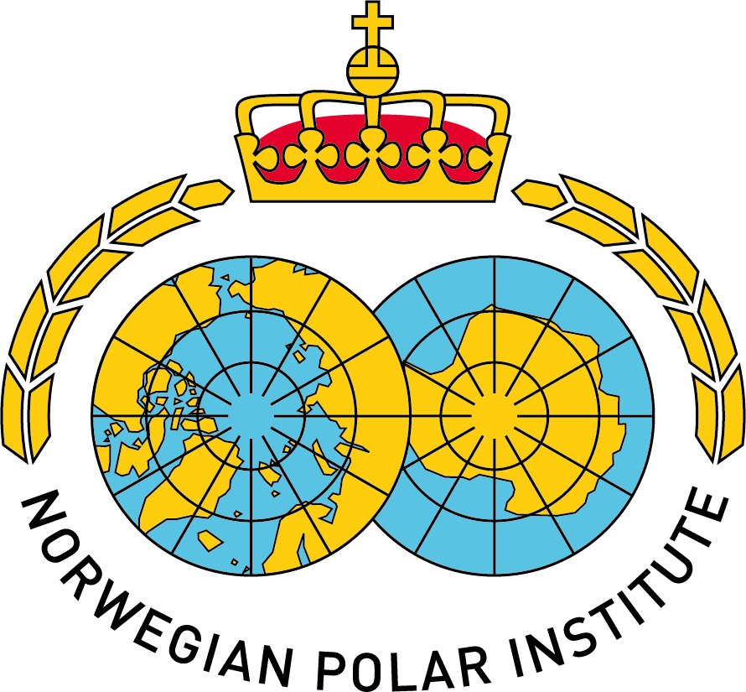
Hazardous substances in the Arctic – where do they come from and the role of Arctic in international processes Heli Routti Senior researcher

Slide 2
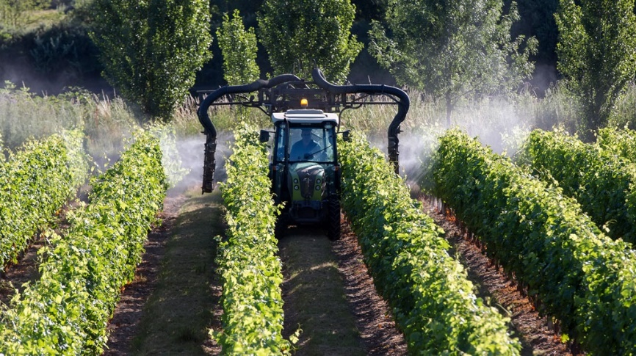
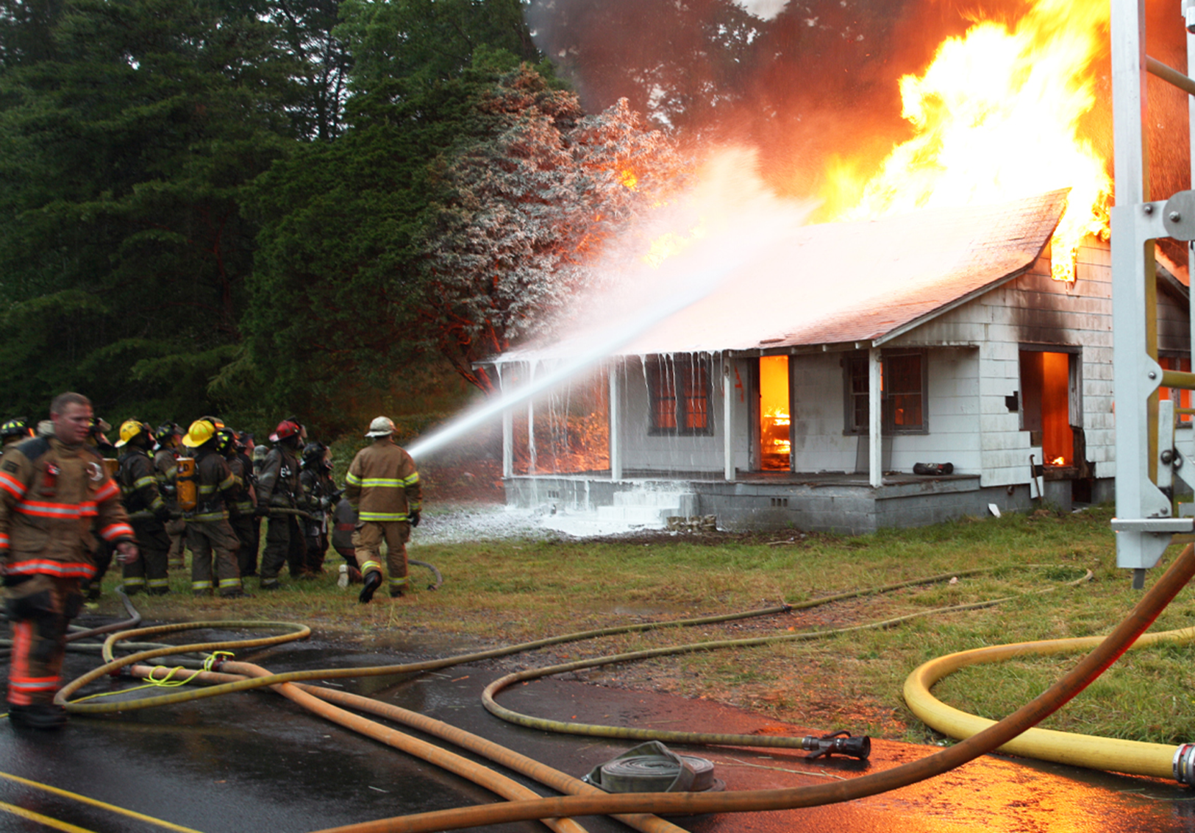
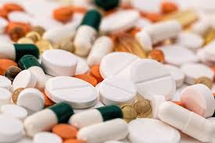
The chemical industry (including pharmaceuticals) is the second largest manufacturing industry in the world (measured as sales).
Production capacity almost doubled, from about 1.2 to 2.3 billion tonnes, between 2000 and 2017
Global chemicals outlook II. 2020. UNEP

Slide 3
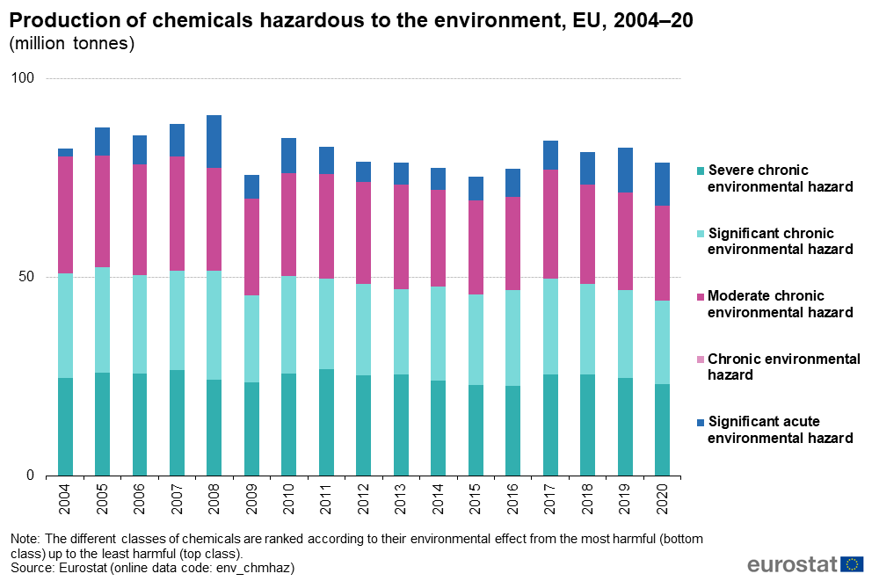
Historical global production of PCBs:
1.3 million tons

Slide 4
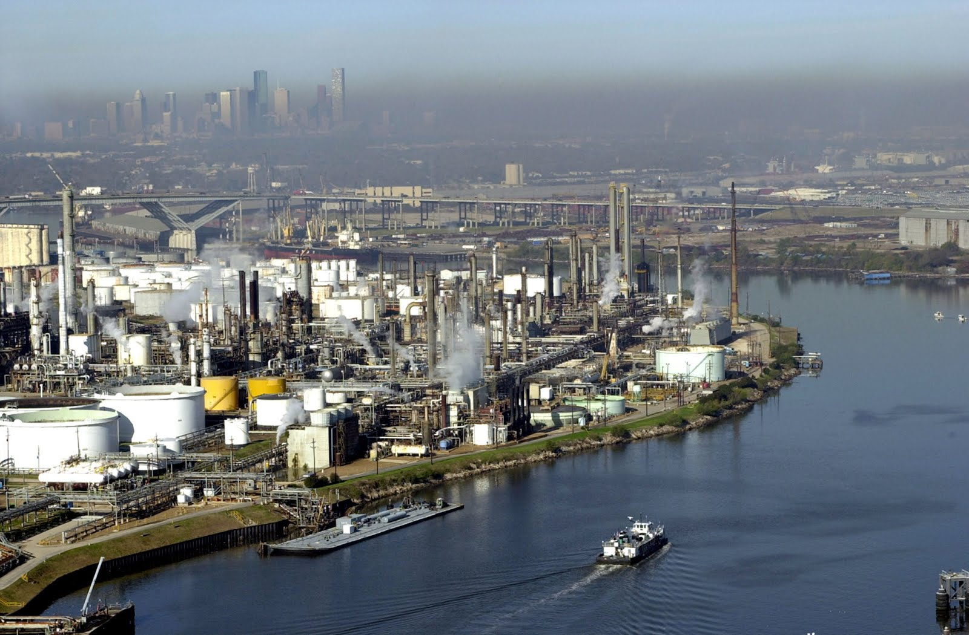
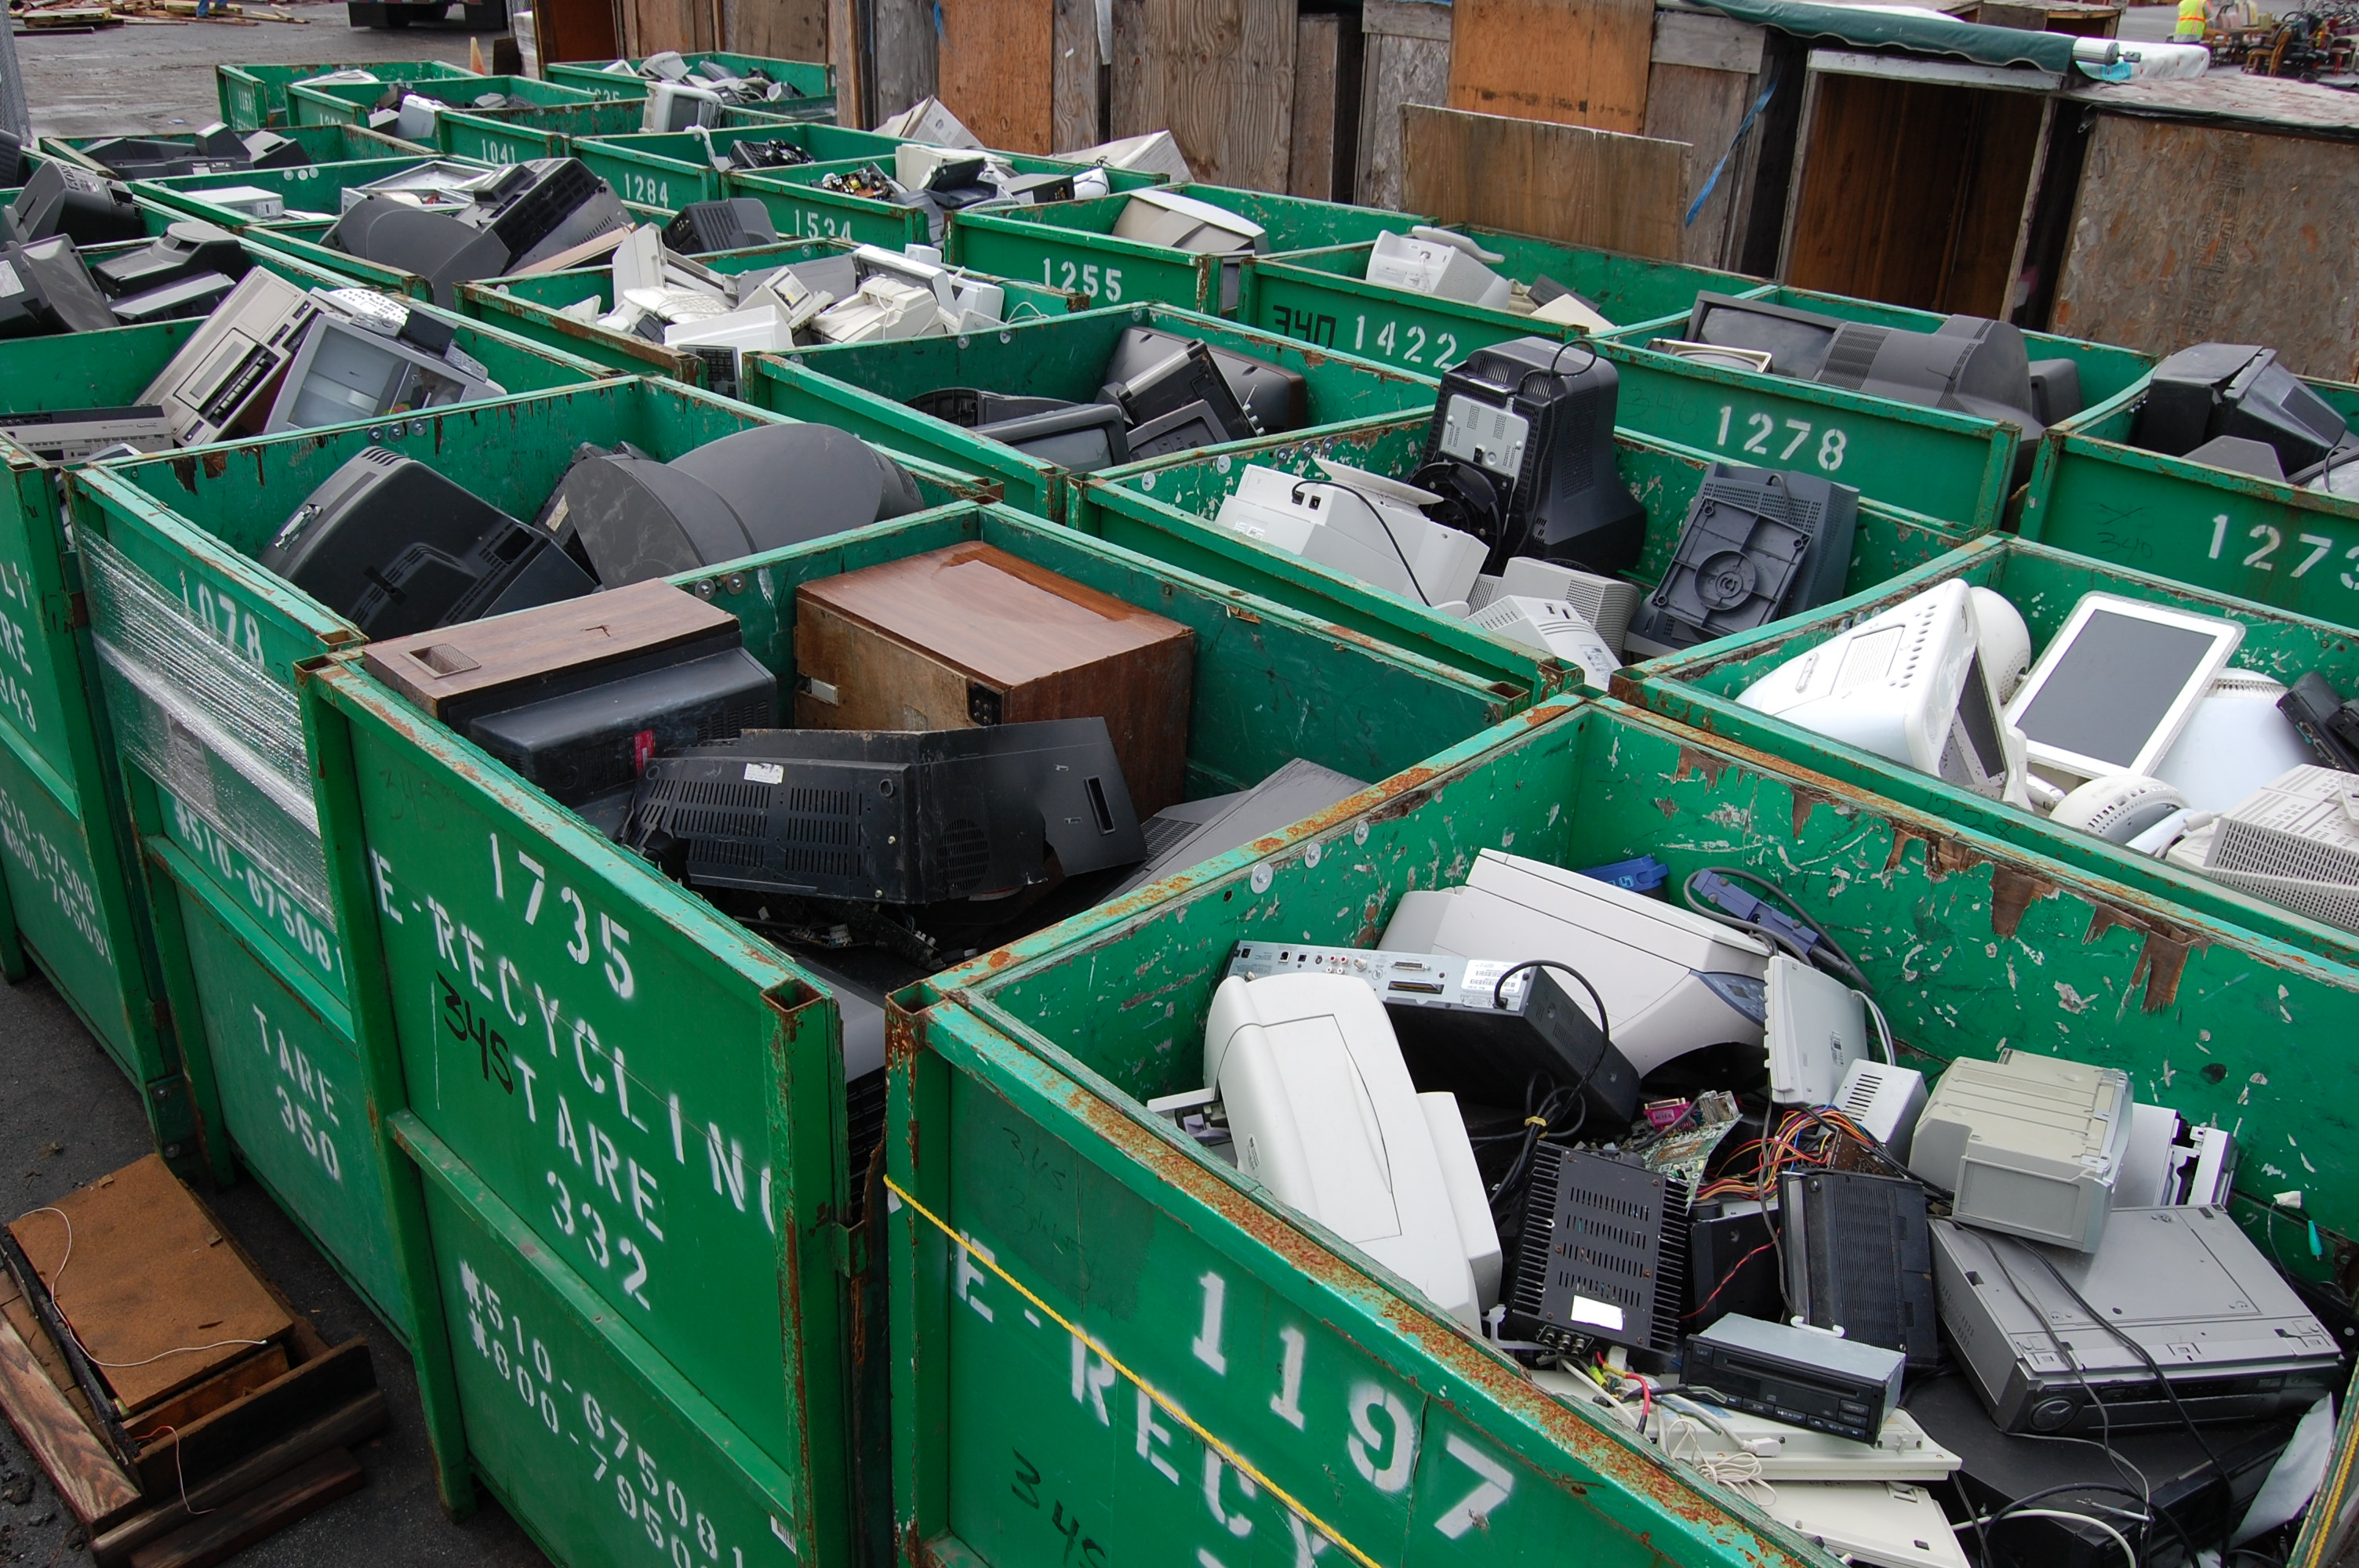
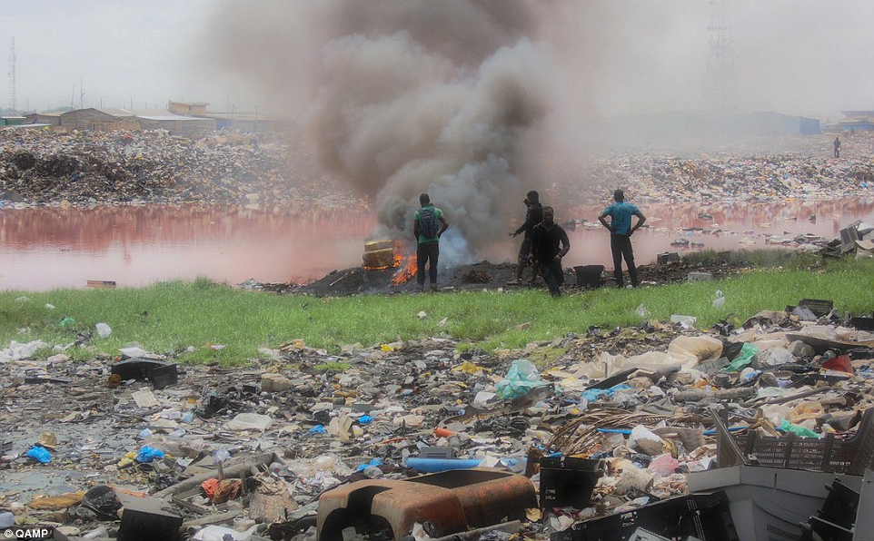
10 million tons of toxic chemicals released into our environment by industries each year
www.worldometers.info

Slide 5
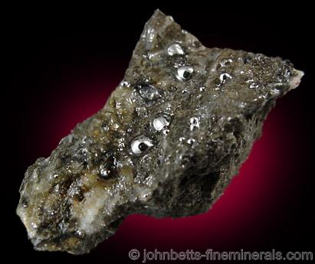
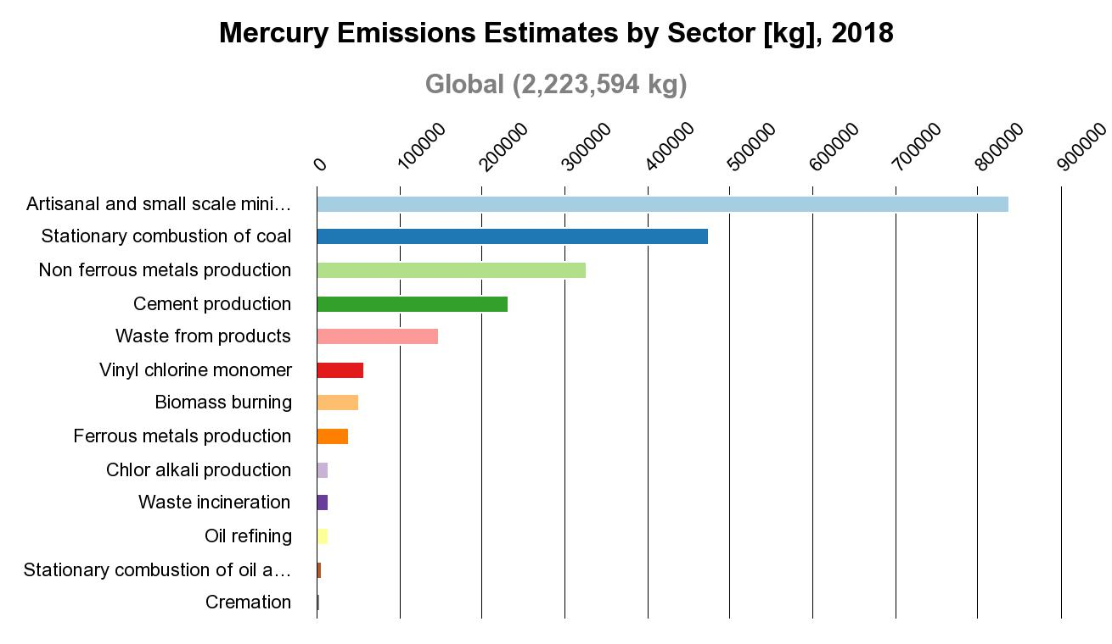
UNEP: Global Mercury Assessment 2018
Notes:
Also natural, though toxic elements, such as mercury are released into the environment. Mercury is released into the atmosphere through both natural and anthropogenic processes. Both volcanic activities, biomass burning, mobilization from soil and vegetation release mercury in the air. But, anthropogenic emission is the most important and they include activities as mining, coal combustion and metal and cement production.

Slide 6
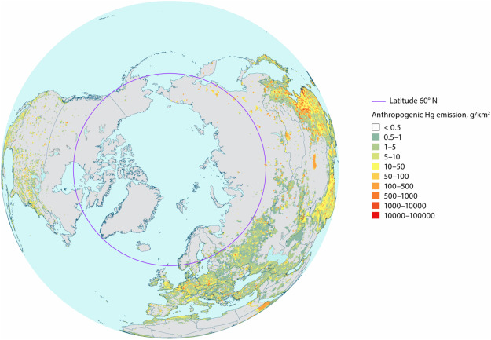
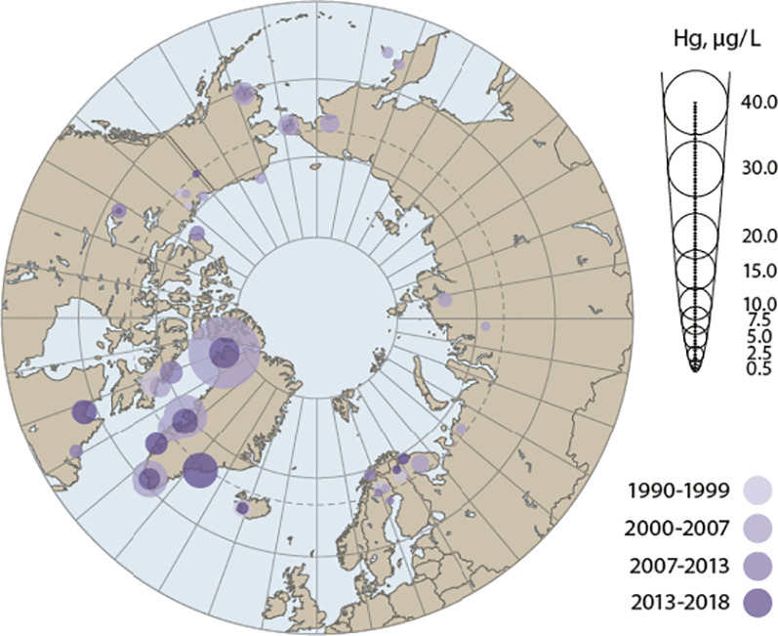
Mercury emissions Levels in humans
Dastoor et al. 2022 Sci Total Environ.
Basu et al. 2022 Sci Total Environ.

Slide 7
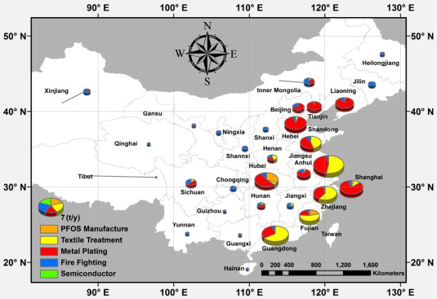
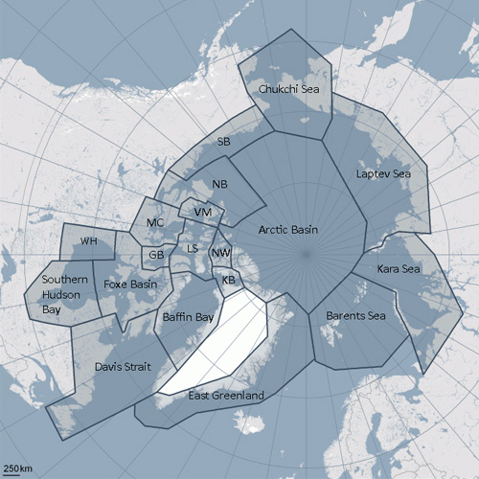
Xie et al. 2013 Environ. Int.
PFOS in plasma | Median (ng/g or ng/mL) | Reference
Polar bears from Svalbard | 197 | Tartu et al. 2017. Env. Pollut.
Local residents around fluorochemical plant in China | 197 | Fu et al. 2015. Sci .Rep.
General population in China | 2 | Li et al. 2017. Sci. Rep.
Notes:
A perfluoroalkyl substances were formerly produced in Europe and North America but since early 2000 the production shifted to China, mainly into south Eastern China. If we compare plasma levels of PFOS, one of the major compound of perfluoroalkyl substances, in local residents around one of worlds largest fluorochemical plants to levels in polar bears from the remote Svalbard, the levels are exactly the same.

Slide 8
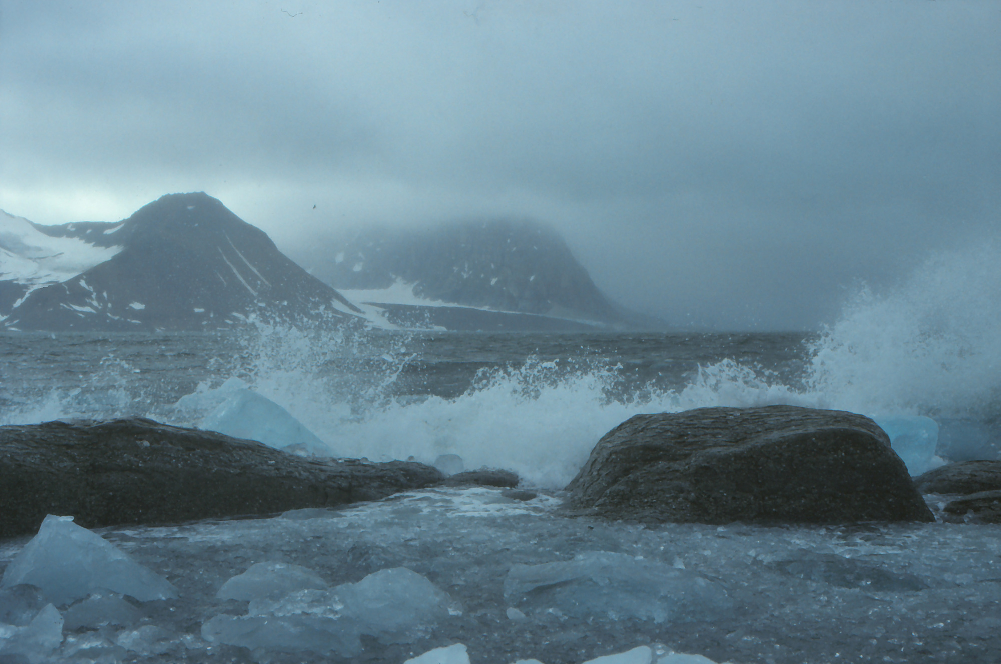
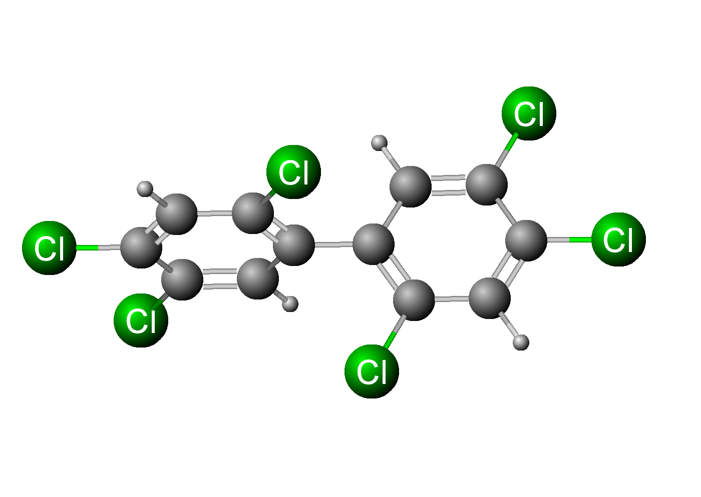
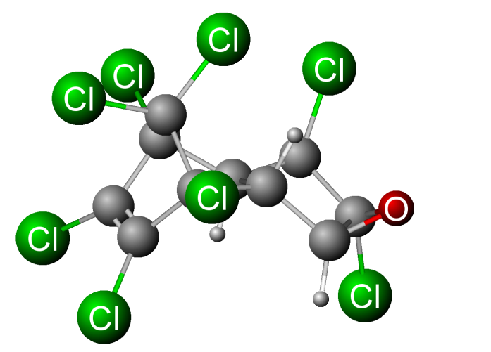
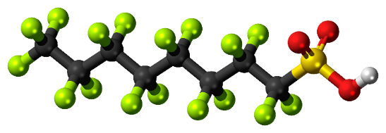
Photo: W. Dahlmann
Notes:
Why. Transport.. Ocean, air, riverine currents

Slide 9
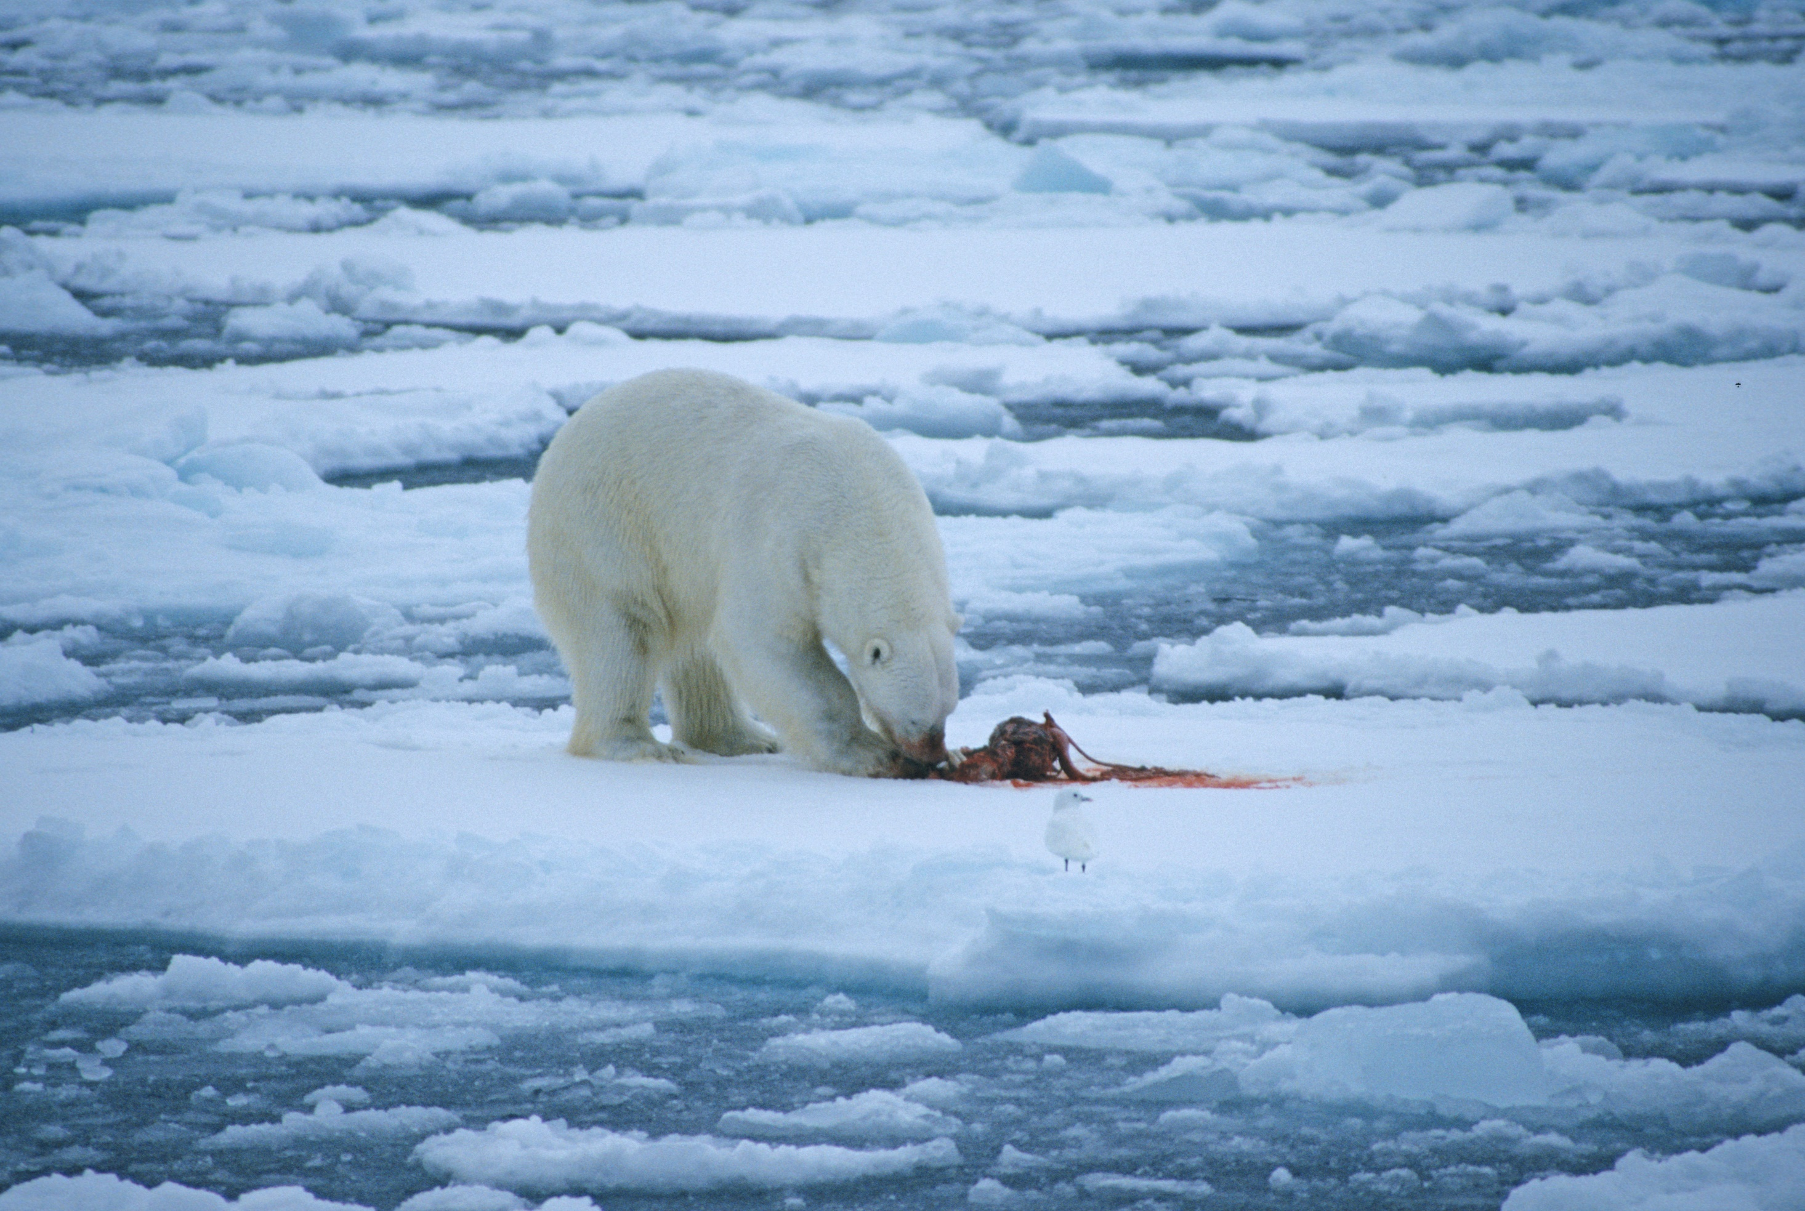
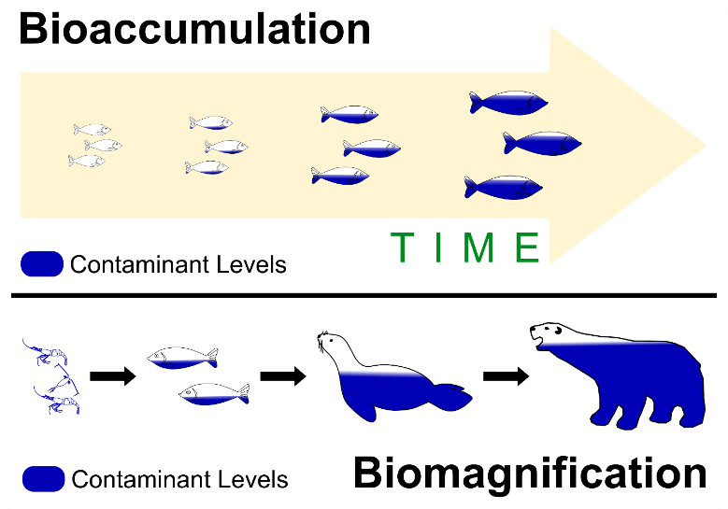
Notes:
Hvis man I tillegg detekterer disse stoffene på arter som troner på toppen av næringskjeden, tyder det på at disse stoffene hoper seg opp i nærinskjeden.

Slide 10
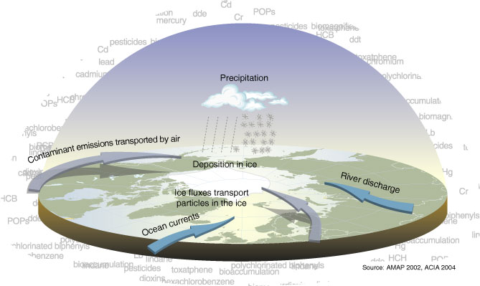
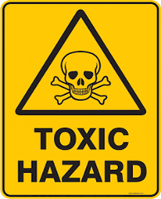
Persistent Organic Pollutants (POPs)
Mercury (Hg)

Slide 11
Minamata Convention on Mercury
A global treaty to protect human health and the environment from the adverse effects of mercury
It includes
A ban on new mercury mines, the phase-out of existing ones
The phase-out and phase-down of mercury use in a number of products and processes
Control measures on emissions to air and on releases to land and water
The regulation of the informal sector of artisanal and small-scale gold mining.
Adopted in 2013, entered into force in 2017

Slide 12
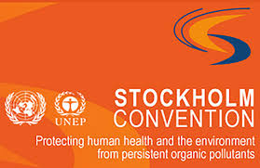
The Stockholm Convention on Persistent Organic Pollutants
Global treaty to protect human health and the environment from chemicals that
persistent
long-range transport
bioaccumulate, biomagnify
have harmful impacts on human health or on the environment
Entered into force 2004
PCBs, several chlorinated pesticides, dioxins
Several compounds added later
Currently 35 (groups of) compounds banned or restricted
Notes:
Stocholm convensjon er en global avtale som regulerer produksjon og bruk av miljøgifter som er persistente, som transporteres over lang avstander, bioakkumulerer og biomagnifiserer og som er giftige. Stoffene som har slike egenskaper er kalt persistente organiske miljøgifter og de inneholder for eksempel PCBr, klorerte pestisider, bromerte flammehemmer og noen perfluorerte miljøgifter.

Slide 13
The role of Arctic studies in forming of the Conventions
“The initiative on the Minamata Convention was mainly driven by research showing negative effects on human health and the environment in the Arctic. “
“The Arctic Council, through AMAP, has been a crucial supplier, knowledge provider and broker in the establishment of the Minamata Convention. “
Platjouw et al. 2018 Arctic Review on Law and Politics
“Arctic studies have played an important role in creating both awareness of these contaminants and providing scientific input.”
Rottem, 2017 Arctic Review on Law and Politics
“Orchestrating the interplay between scientists and policy makers, the working group [AMAP] has put multiple stressors on the political agenda internationally.”
Steindal et al. 2021 Arctic Review on Law and Politics
→ 2015: POPRC-9/8: Guidance on how to assess the possible impact of climate change on the work of the Persistent Organic Pollutants Review Committee

Slide 14
Workflow under the Stockholm Convention
Wang et al. 2022 Environ. Sci. Technol.

Slide 15
The Stockholm Convention on Persistent Organic Pollutants
Criteria:
persistent
long-range transport
bioaccumulate, biomagnify
have harmful impacts on human health or on the environment
If a compound is found in an Arctic predator, ¾ criteria fullfilled
Notes:
Stocholm convensjon er en global avtale som regulerer produksjon og bruk av miljøgifter som er persistente, som transporteres over lang avstander, bioakkumulerer og biomagnifiserer og som er giftige. Stoffene som har slike egenskaper er kalt persistente organiske miljøgifter og de inneholder for eksempel PCBr, klorerte pestisider, bromerte flammehemmer og noen perfluorerte miljøgifter.

Slide 16
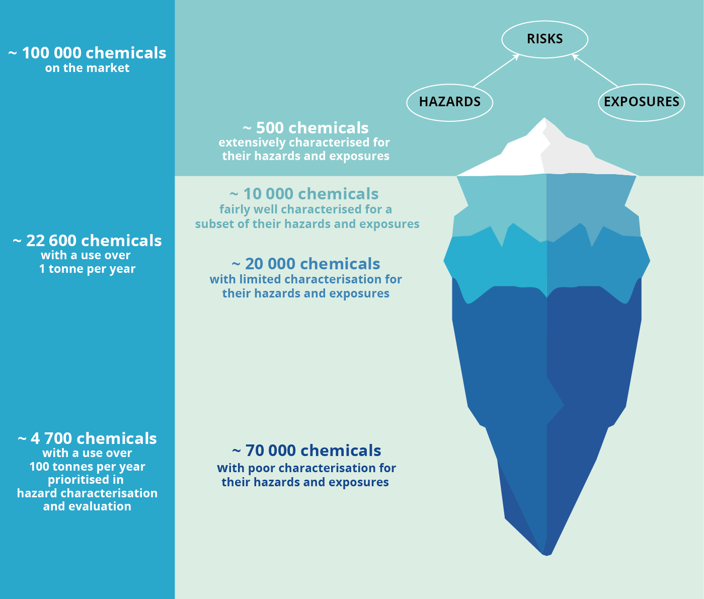
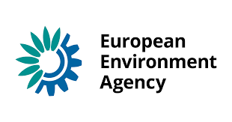
The unknow territory of chemical risks
– An example from Europe
Source: The European environment — state and outlook 2020

Slide 17
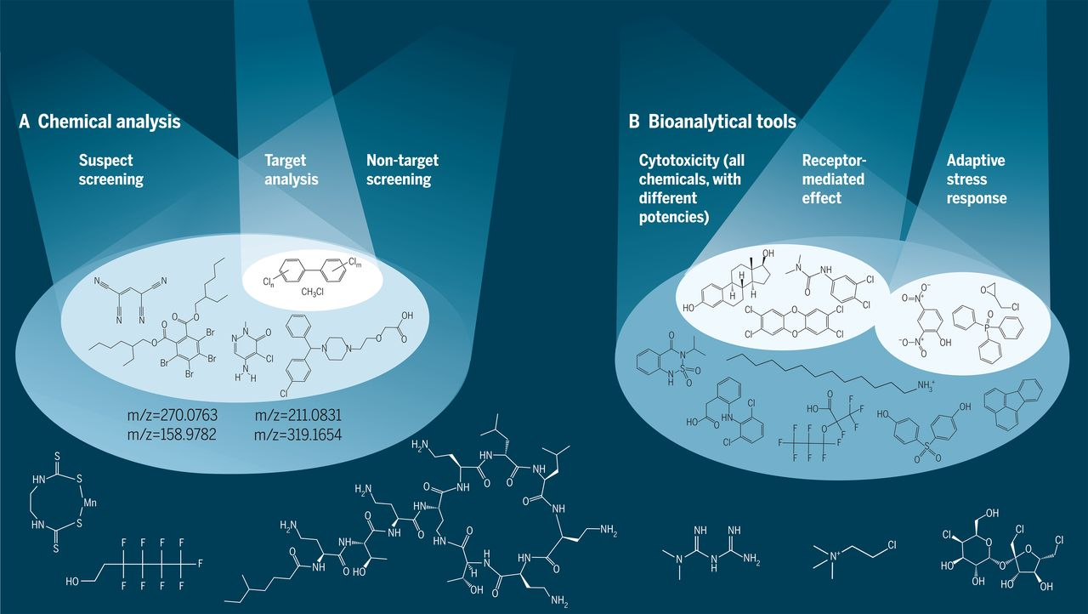
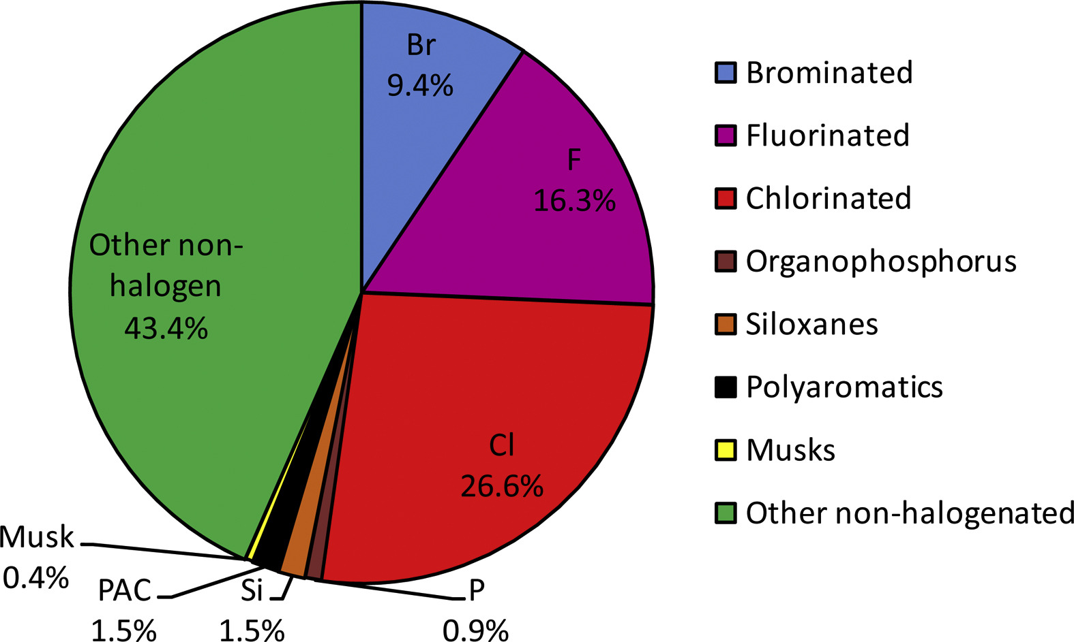
Tracking chemicals….
Target analyses
Emerging perfluoroalkyl substances
Emerging brominated flame retardants
Organophospate esters (flame retardants, plasticizers)
Phthaltes (plasticizers)
Metabolites of emerging compounds…
Non-target analyses
Fig. 1. Broad classes of the 3421 chemicals with POP-like properties identified by the eight screening studies.
Muir et al. 2019. Emerging Compounds
Escher et al. 2020 Science

Slide 18
Workflow under the Stockholm Convention
Wang et al. 2022 Environ. Sci. Technol.
Notes:
Risk profile and risk management are written

Slide 19
Concluding statements in risk profile on perfluorohexane sulfonic acid (PFHxS)
PFHxS is released into the environment … Globally, the occurrence and distribution of PFHxS is shown for humans, wildlife and the environment. Detections include measurements in the Arctic and Antarctic.
PFHxS is one of the most frequently detected PFAS in human blood…
…risk for adverse effects on the general population..
The concern for adverse effects relates to observed effects on the liver... Furthermore, effects on lipid and lipoprotein metabolism add to the concern both for humans and Arctic animals.
Recent data from polar bear studies at Svalbard (Norway) revealed increasing levels of PFHxS in plasma. PFASs, including PFHxS, contribute to the multiple-stressor effects observed in polar bears from Svalbard indicating a risk for adverse effects in wildlife.
Based on the persistence, bioaccumulation, toxicity in mammals including humans and the widespread occurrence in environmental compartments including at remote regions, it is concluded that PFHxS, its salts and PFHxS related compounds are likely, as a result of their long-range environmental transport, to lead to significant adverse human health and environmental effects such that global action is warranted.
Routti et al. 2017 Environ. Sci. Technol.
UNEP/POPS/POPRC.14/6/Add.1

Slide 20
Workflow under the Stockholm Convention
Wang et al. 2022 Environ. Sci. Technol.

Slide 21
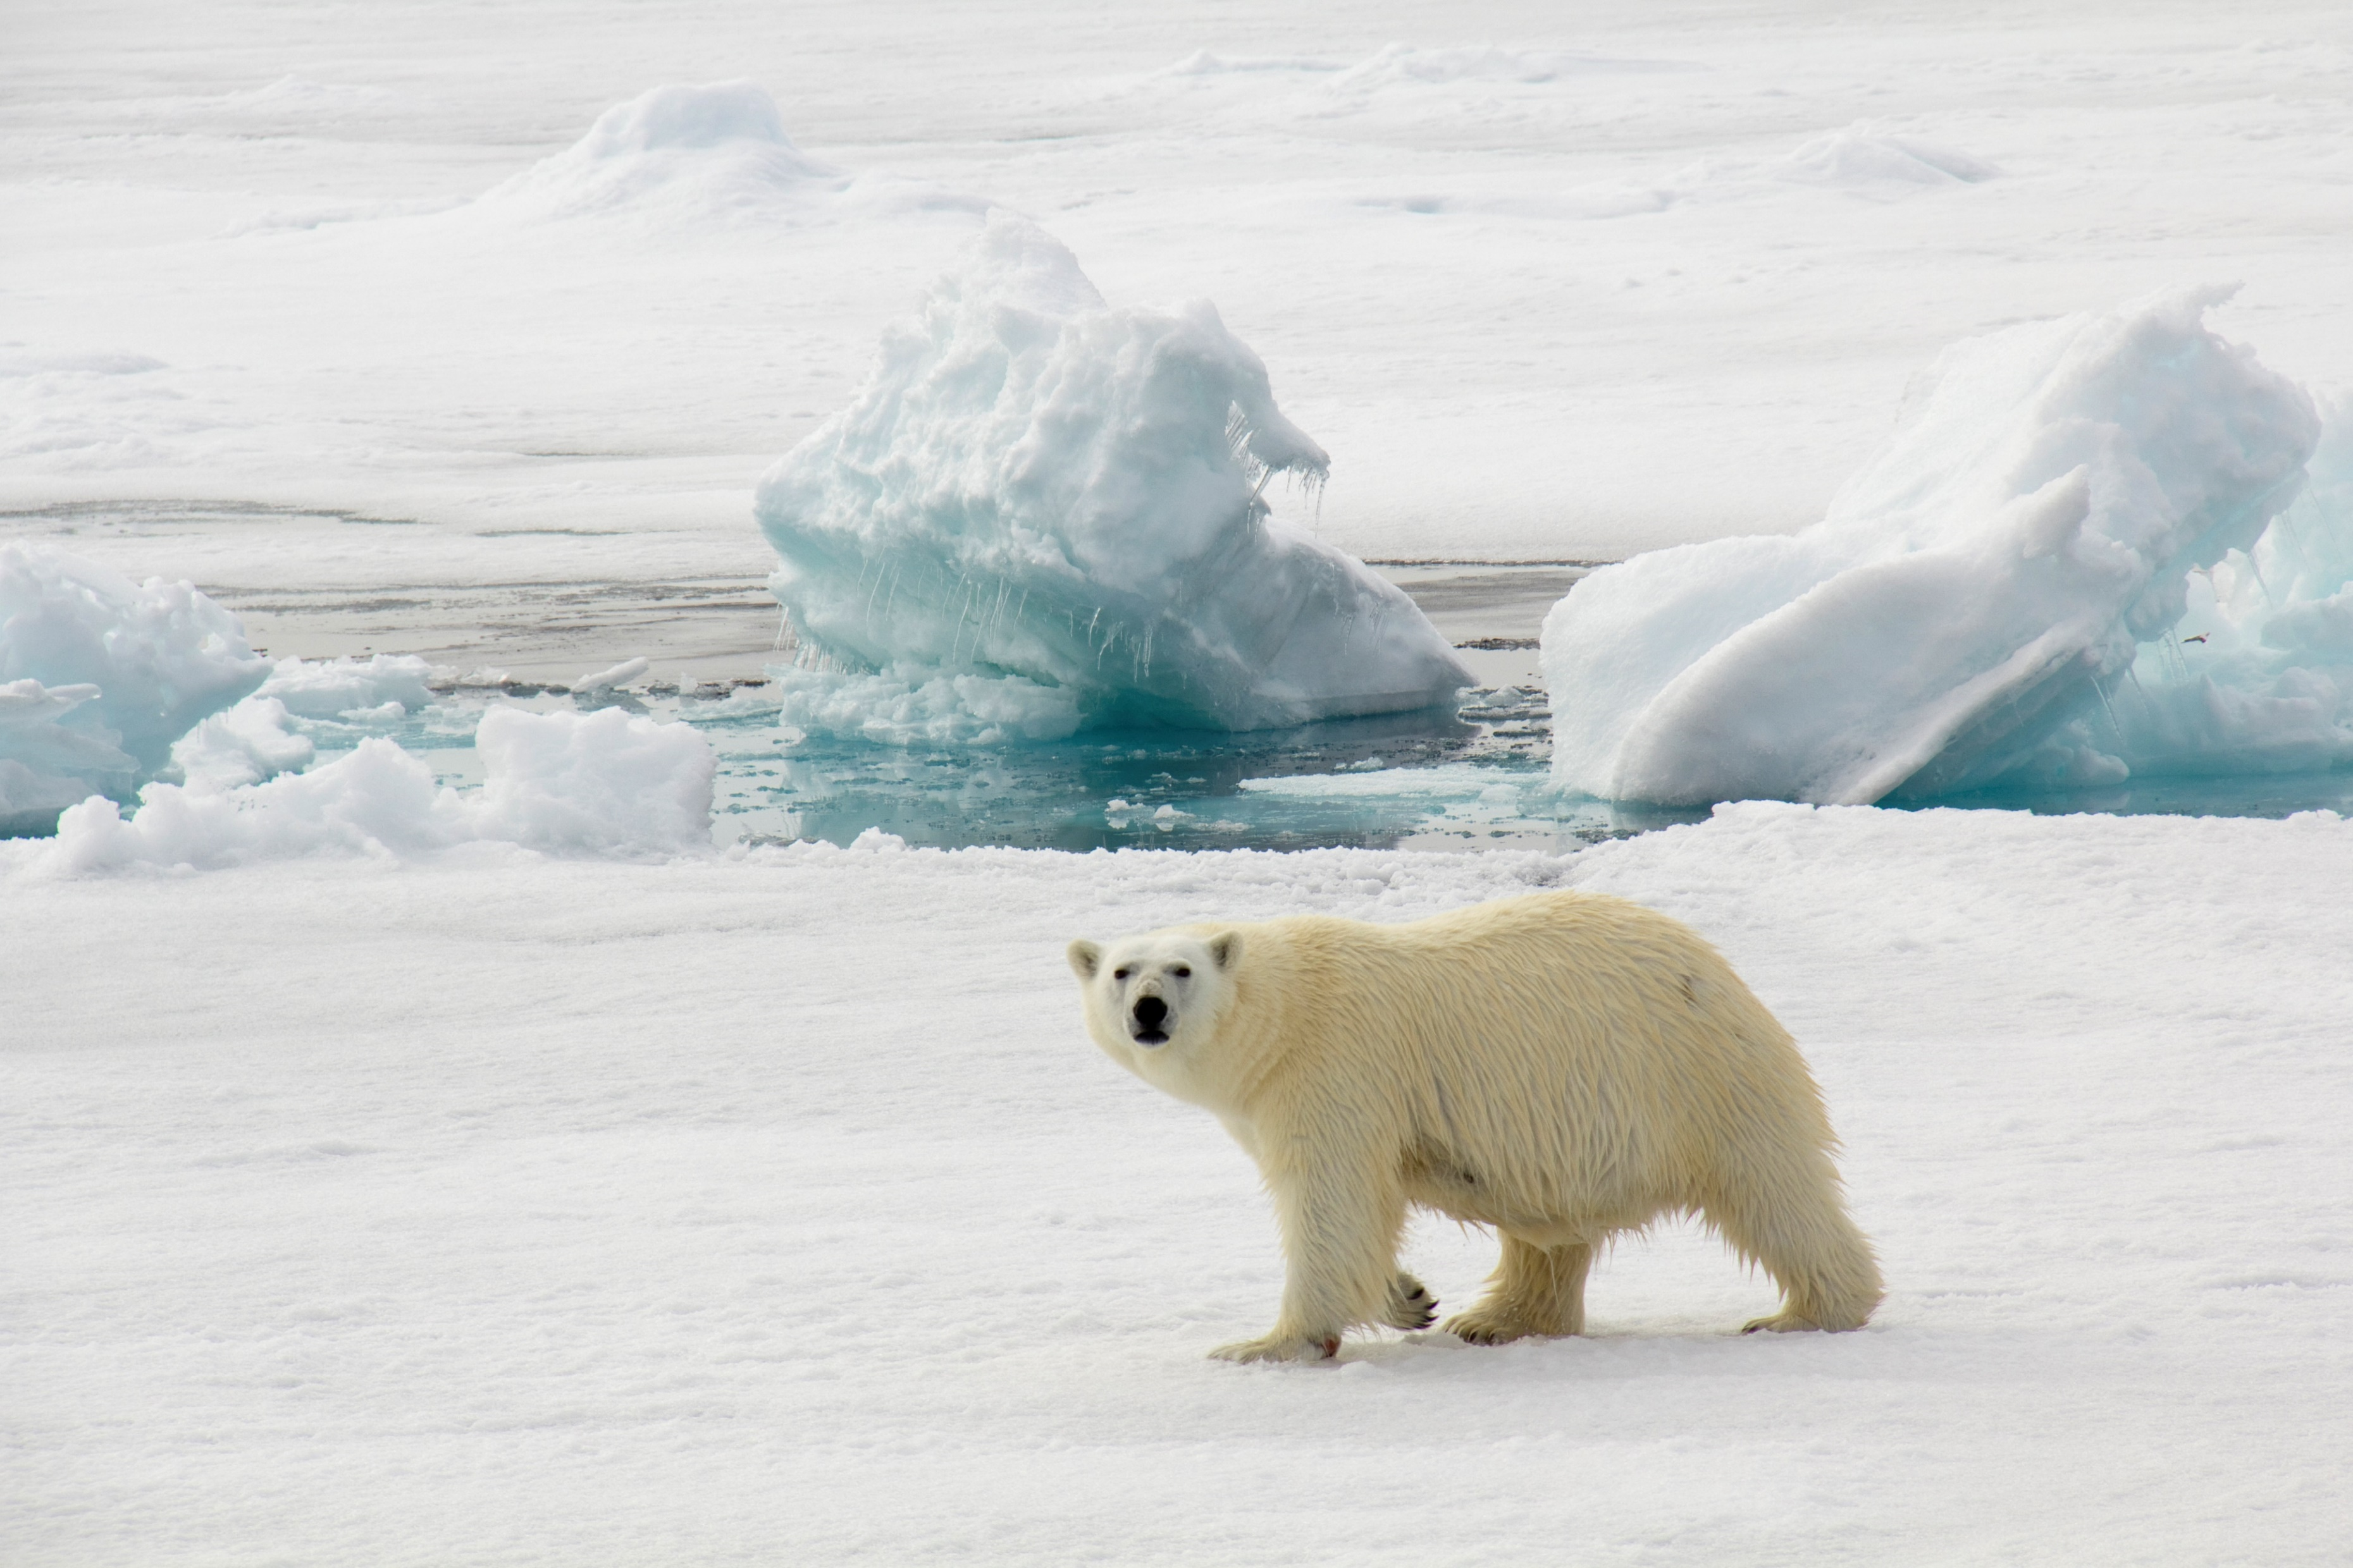
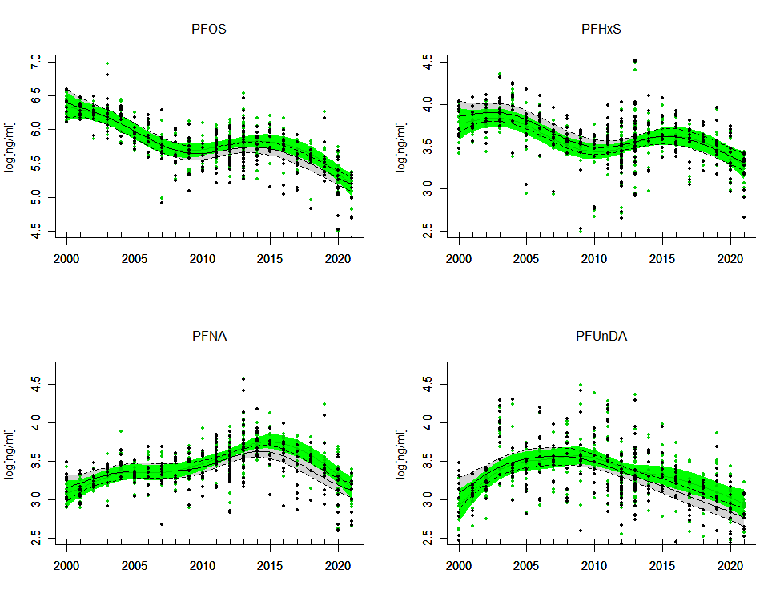
Routti et al., unpublished
Foto: Ann Kristin Balto/NP

Slide 22
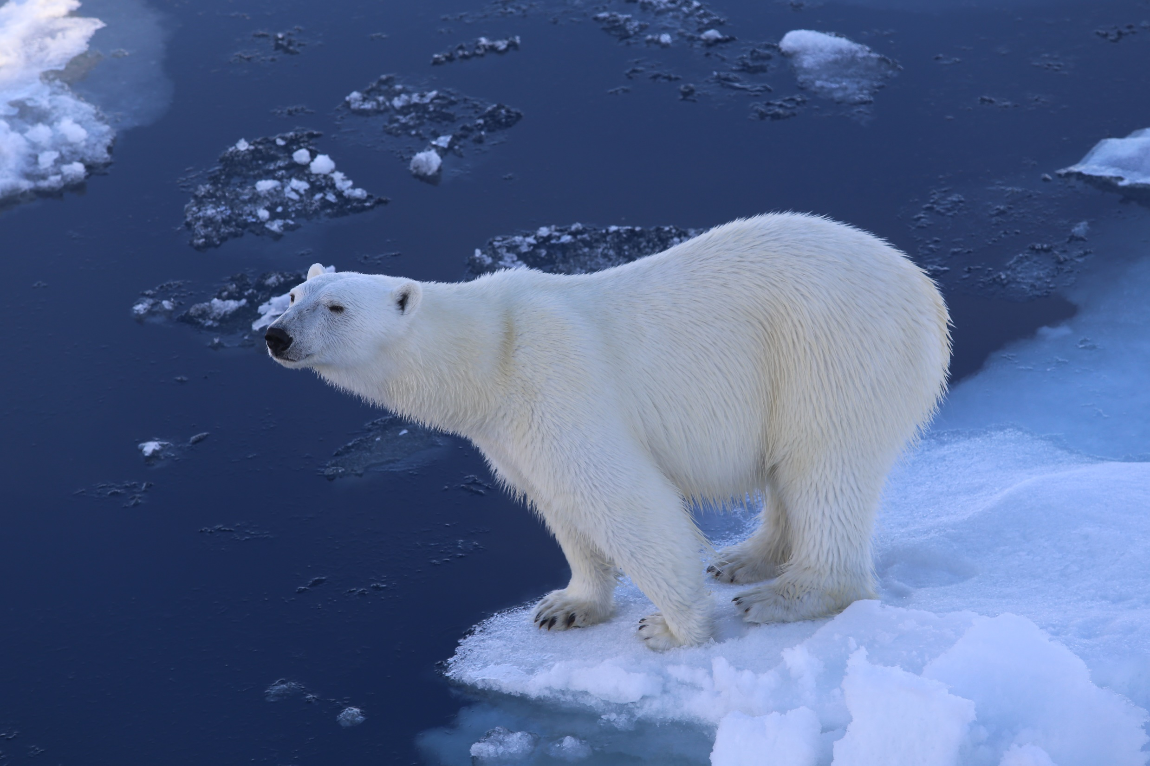
Thank you!
heli.routti@npolar.no
Photo: Magnus Andersen

