Slide 1
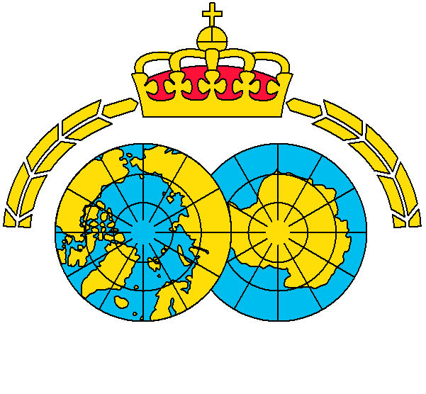
9
Joint colony survey of ivory gull
in the Russian and Norwegian Arctic
2019
Norwegian Polar Institute, Tromsø, Norway
Association “Maritime Heritage: Explore & Sustain”, St. Petersburg, Russia
Hallvard Strøm
Maria Gavrilo
© Graupner

Slide 2
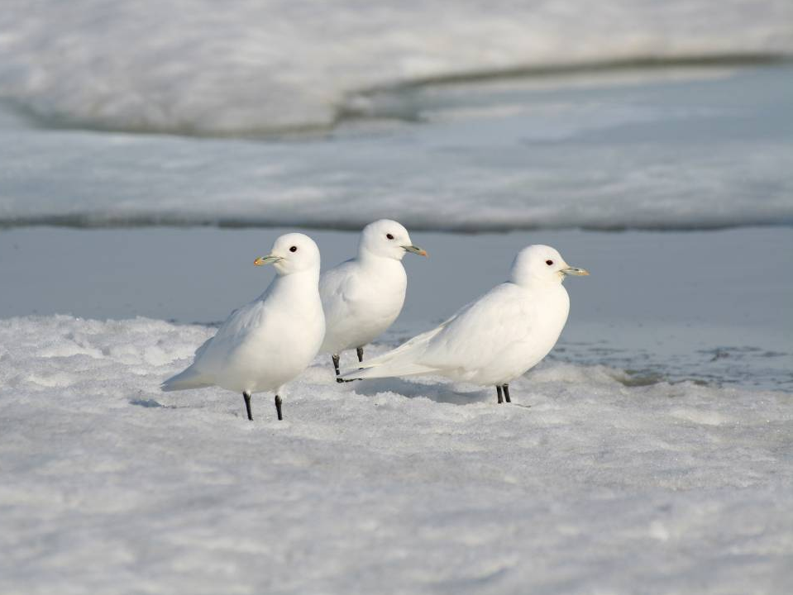
The ivory gull
Breeds in colonies
Colonies unstable through time
Ice-specialist
A rare species (10 000 – 15 000 pairs)
Threatened & Red-listed in both countries
© Gilg & Sabard/GREA

Slide 3
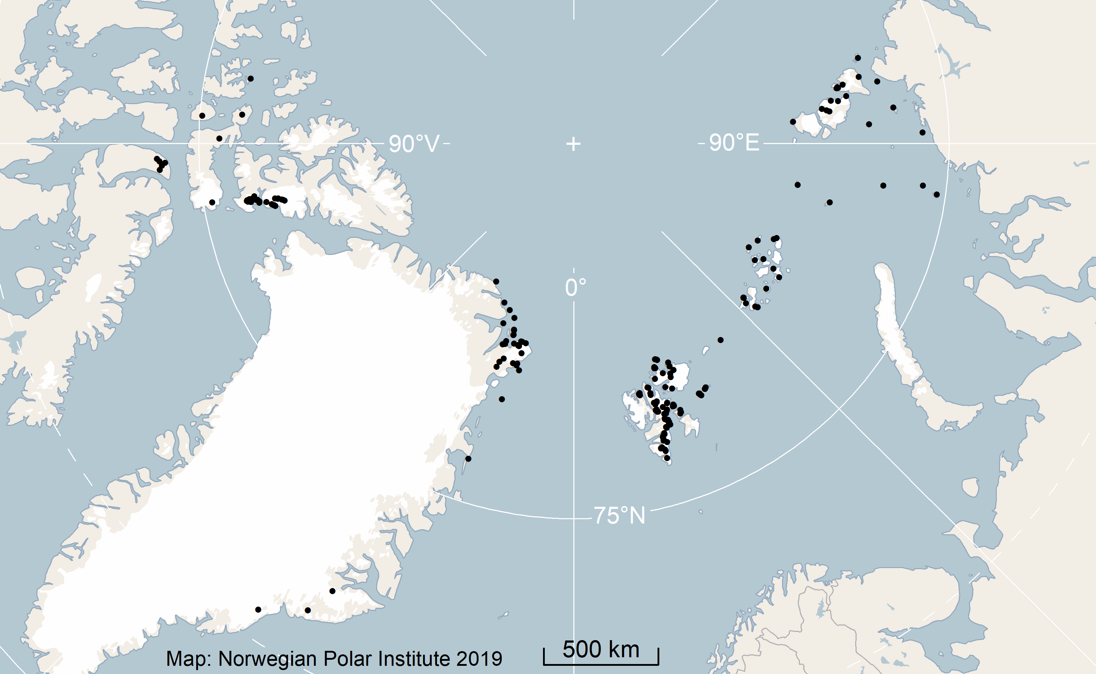
High-Arctic breeding range

Slide 4
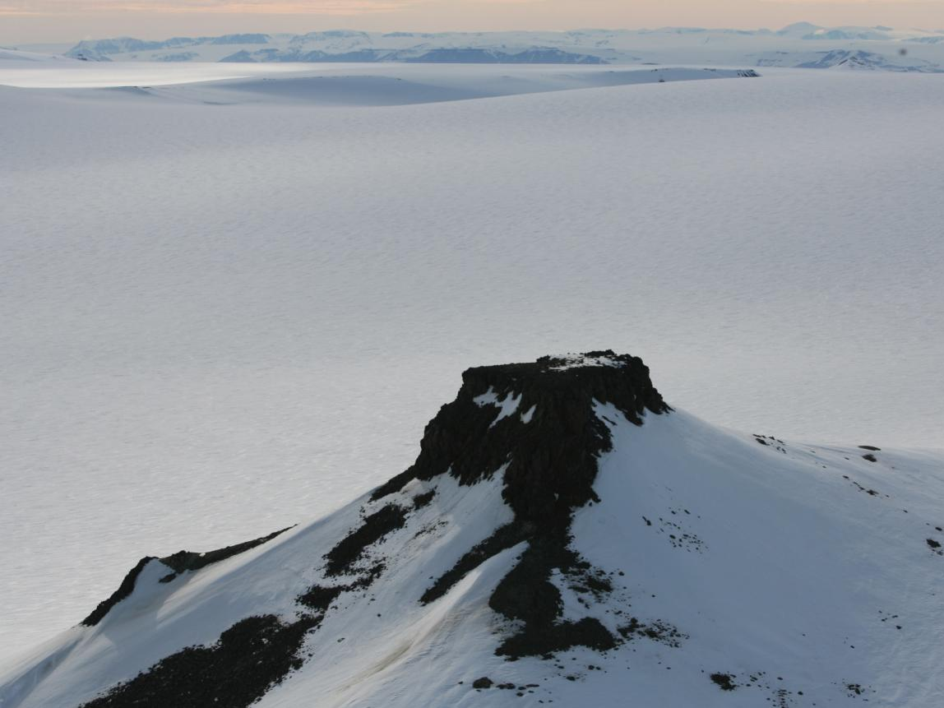
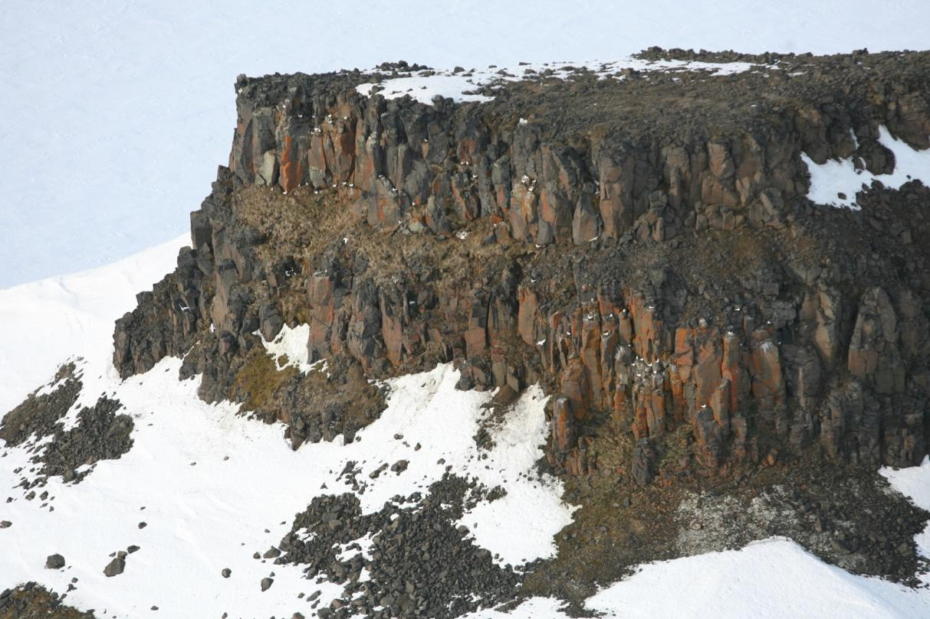
Breeding habitat: cliffs

Slide 5
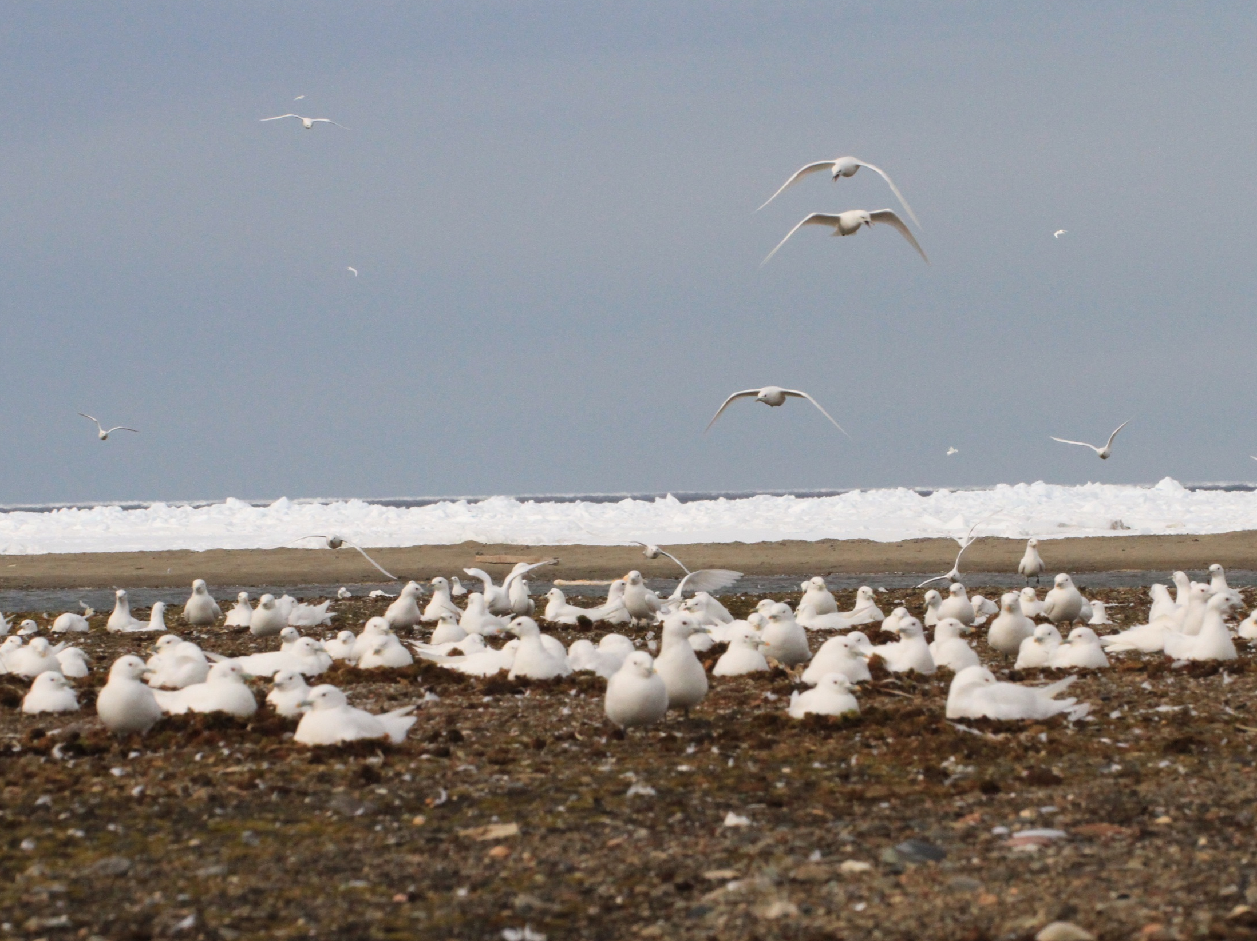
Breeding habitat: ground
© Mikhail Ivanov

Slide 6
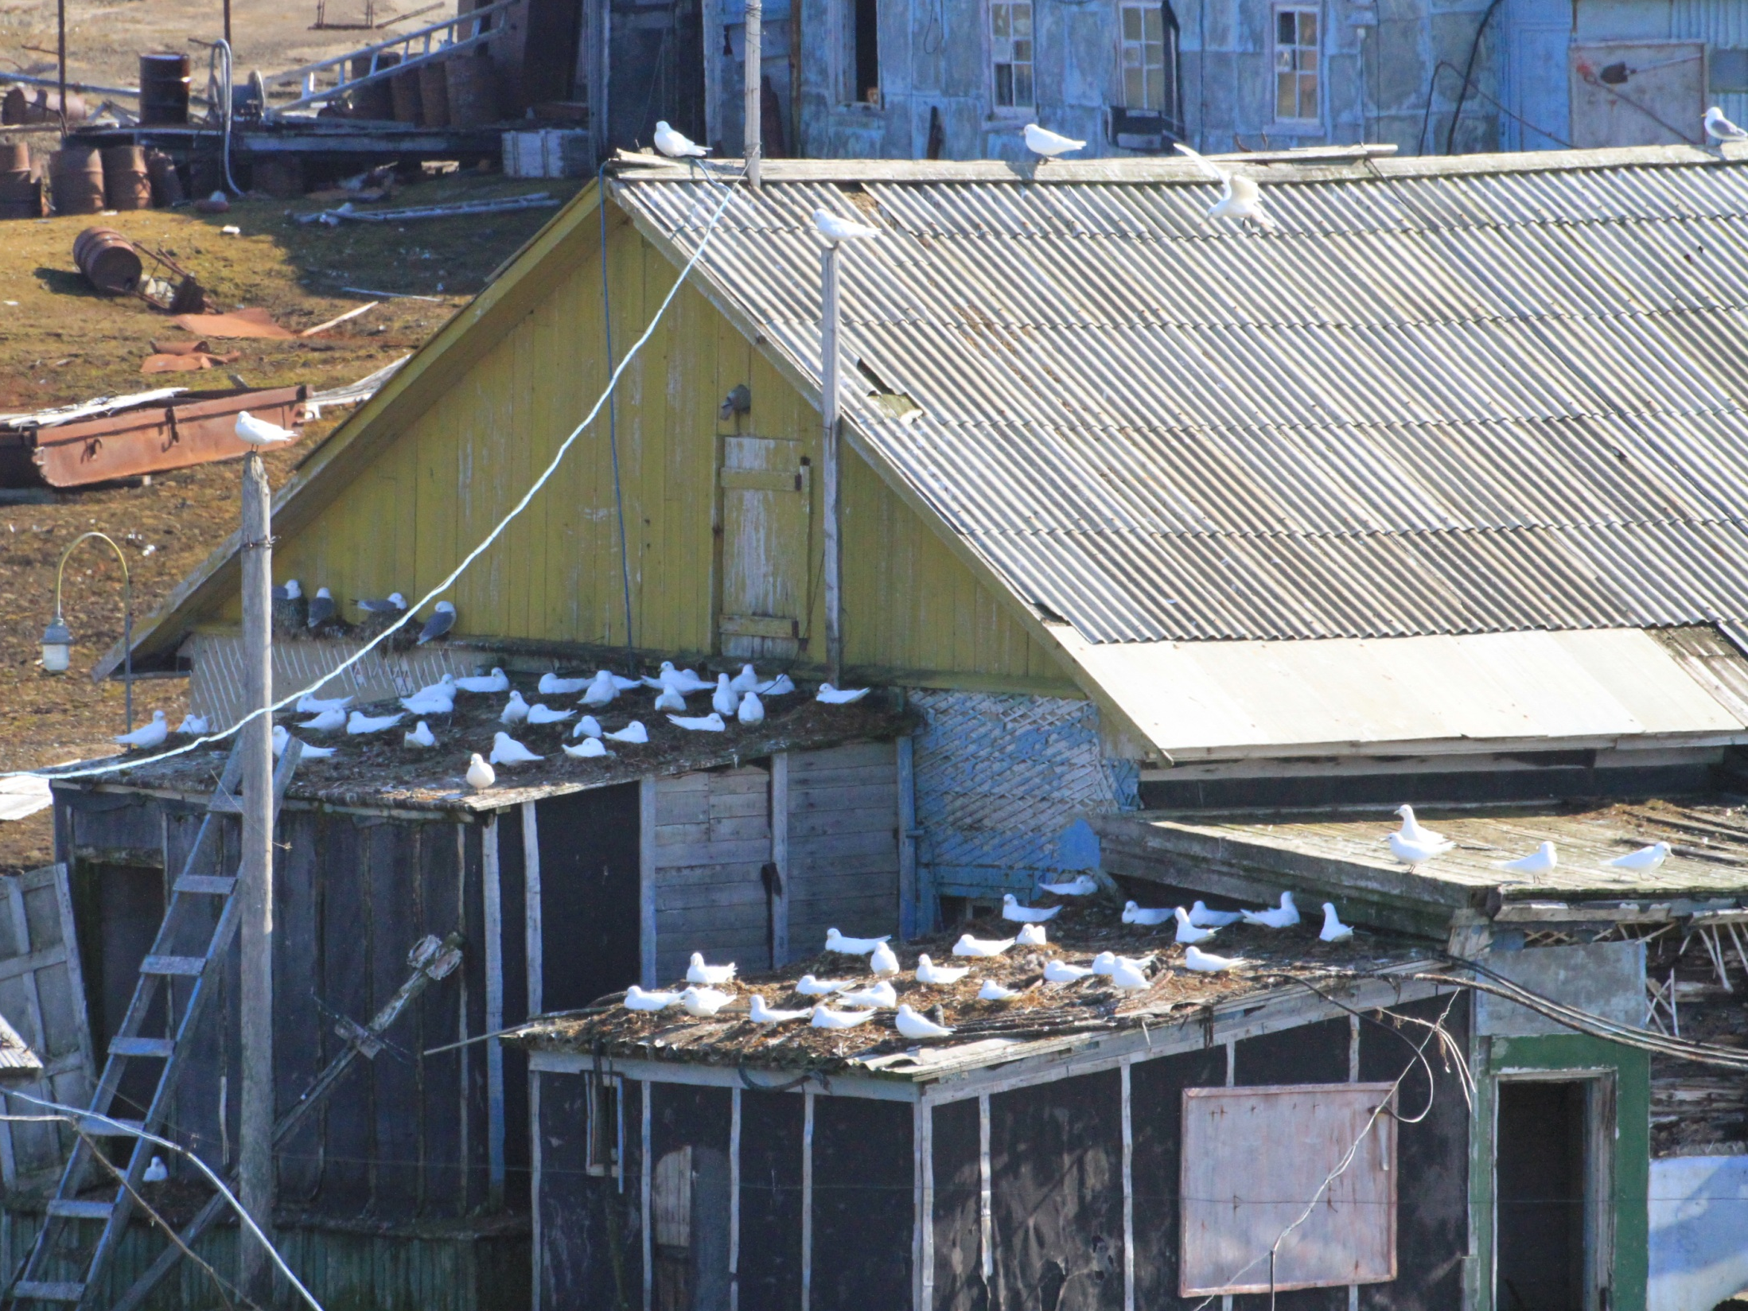
Breeding habitat: man-made structures

Slide 7
Conservation concern
Huge decline in Canada 1985-2011 (70 %)
Decline in Southeast Greenland
Reduction/changes in sea ice cover
Highest levels of contaminants
Illegal hunting in Greenland
IUCN & OSPAR – new pop-surveys needed!
CBird/CAFF/Arctic Council initiative

Slide 8
International survey – 2019:
key areas

Slide 9
Svalbard
Svalbard
© Anders Skoglund

Slide 10
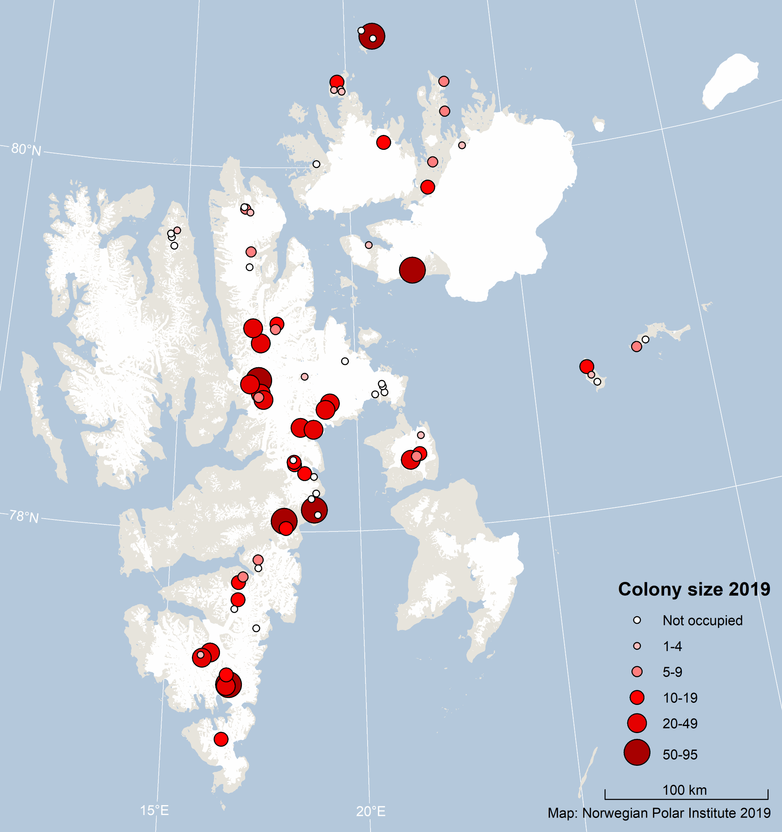
Svalbard

Slide 11
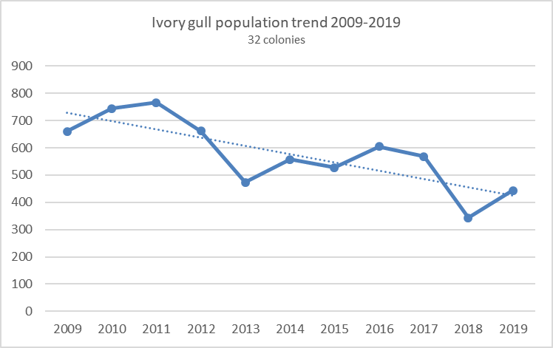
Svalbard
Known colonies surveyd (N = 80)
New colonies discovered: 8
Documented population size: 1200 breeding pairs
Estimated breeding population: ca. 2000 breeding pairs
Trend:
Negative
3 % per annum 2009-2019

Slide 12
Russia

Slide 13
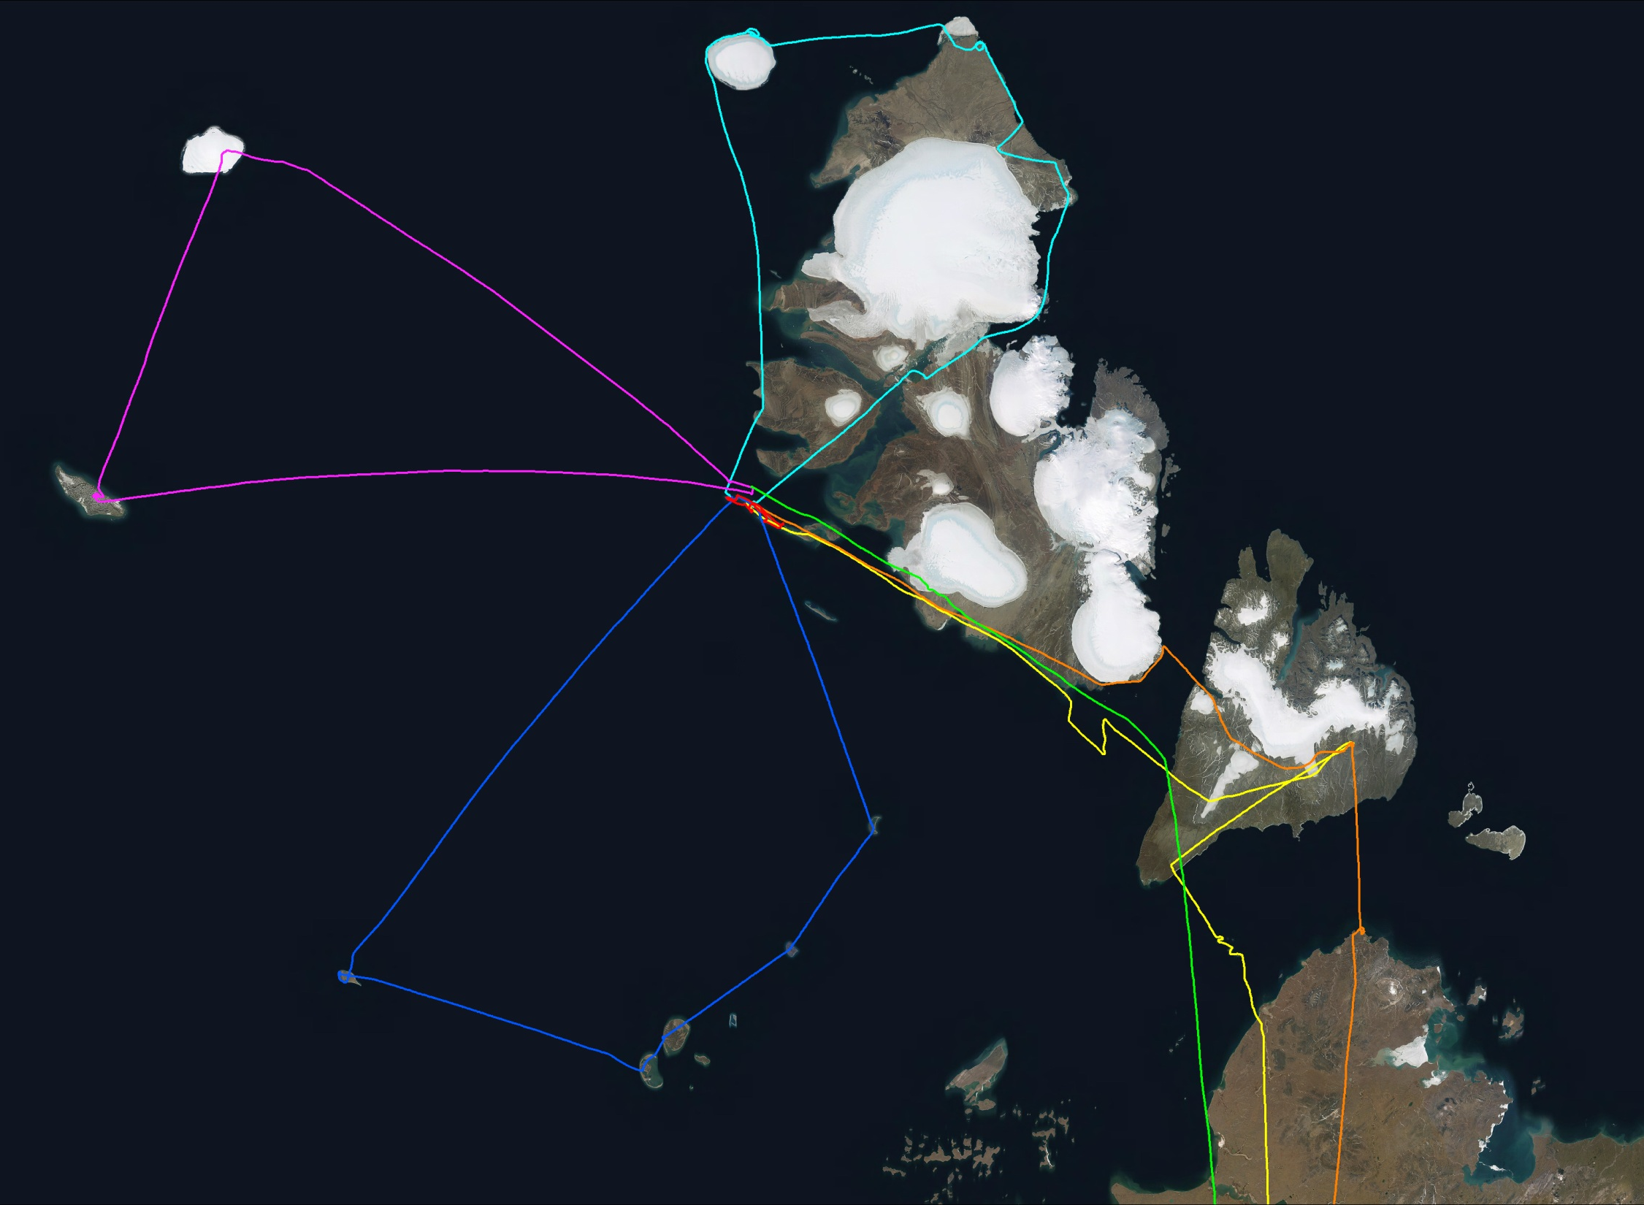

Slide 14
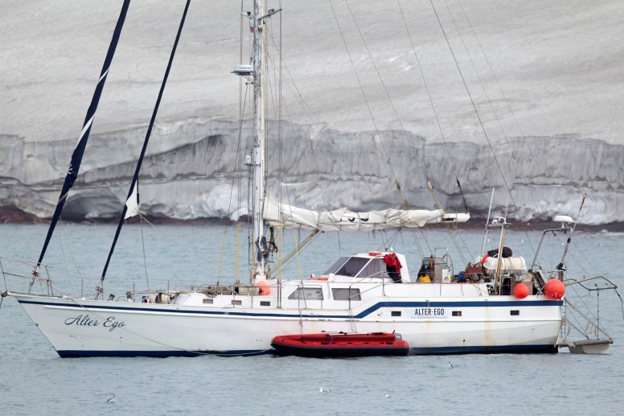
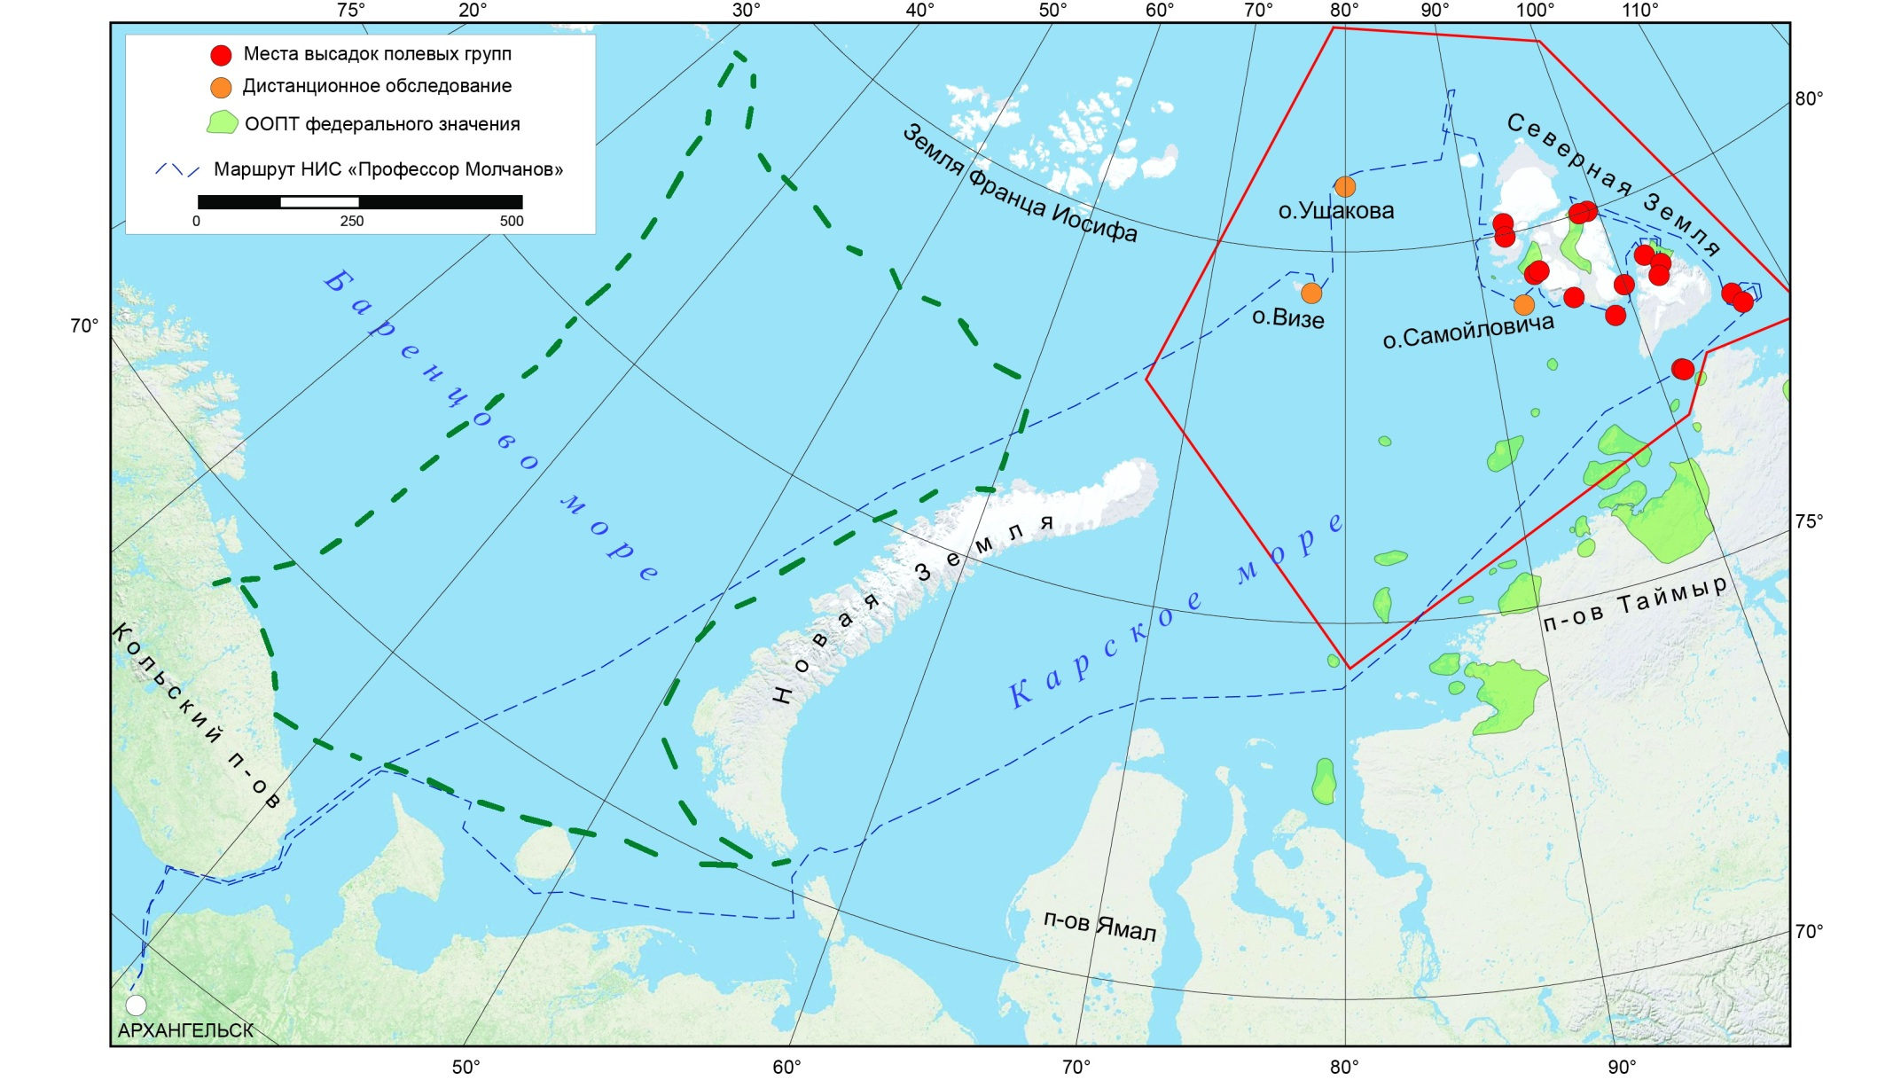
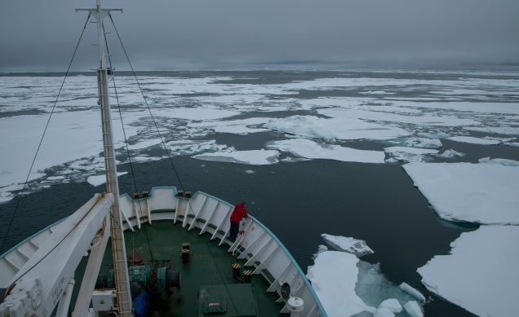
SY Alter Ego
RV Professor Molchanov

Slide 15
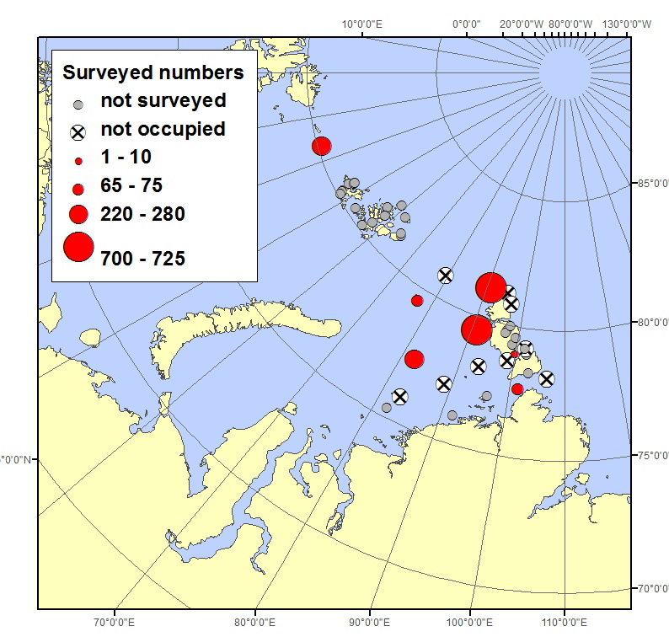

Slide 16
Russia
Of 40 historically known (recent, 1980s+) colonies – 16 surveyd
Documented breeding numbers: ca. 2165 breeding pairs in 7 occupied colonies
Estimated overall breeding population: ?

Slide 17
Russia
Trend in principal monitored colonis
Fluctuating / medium-term decline?? (1990s – 2019)

Slide 18
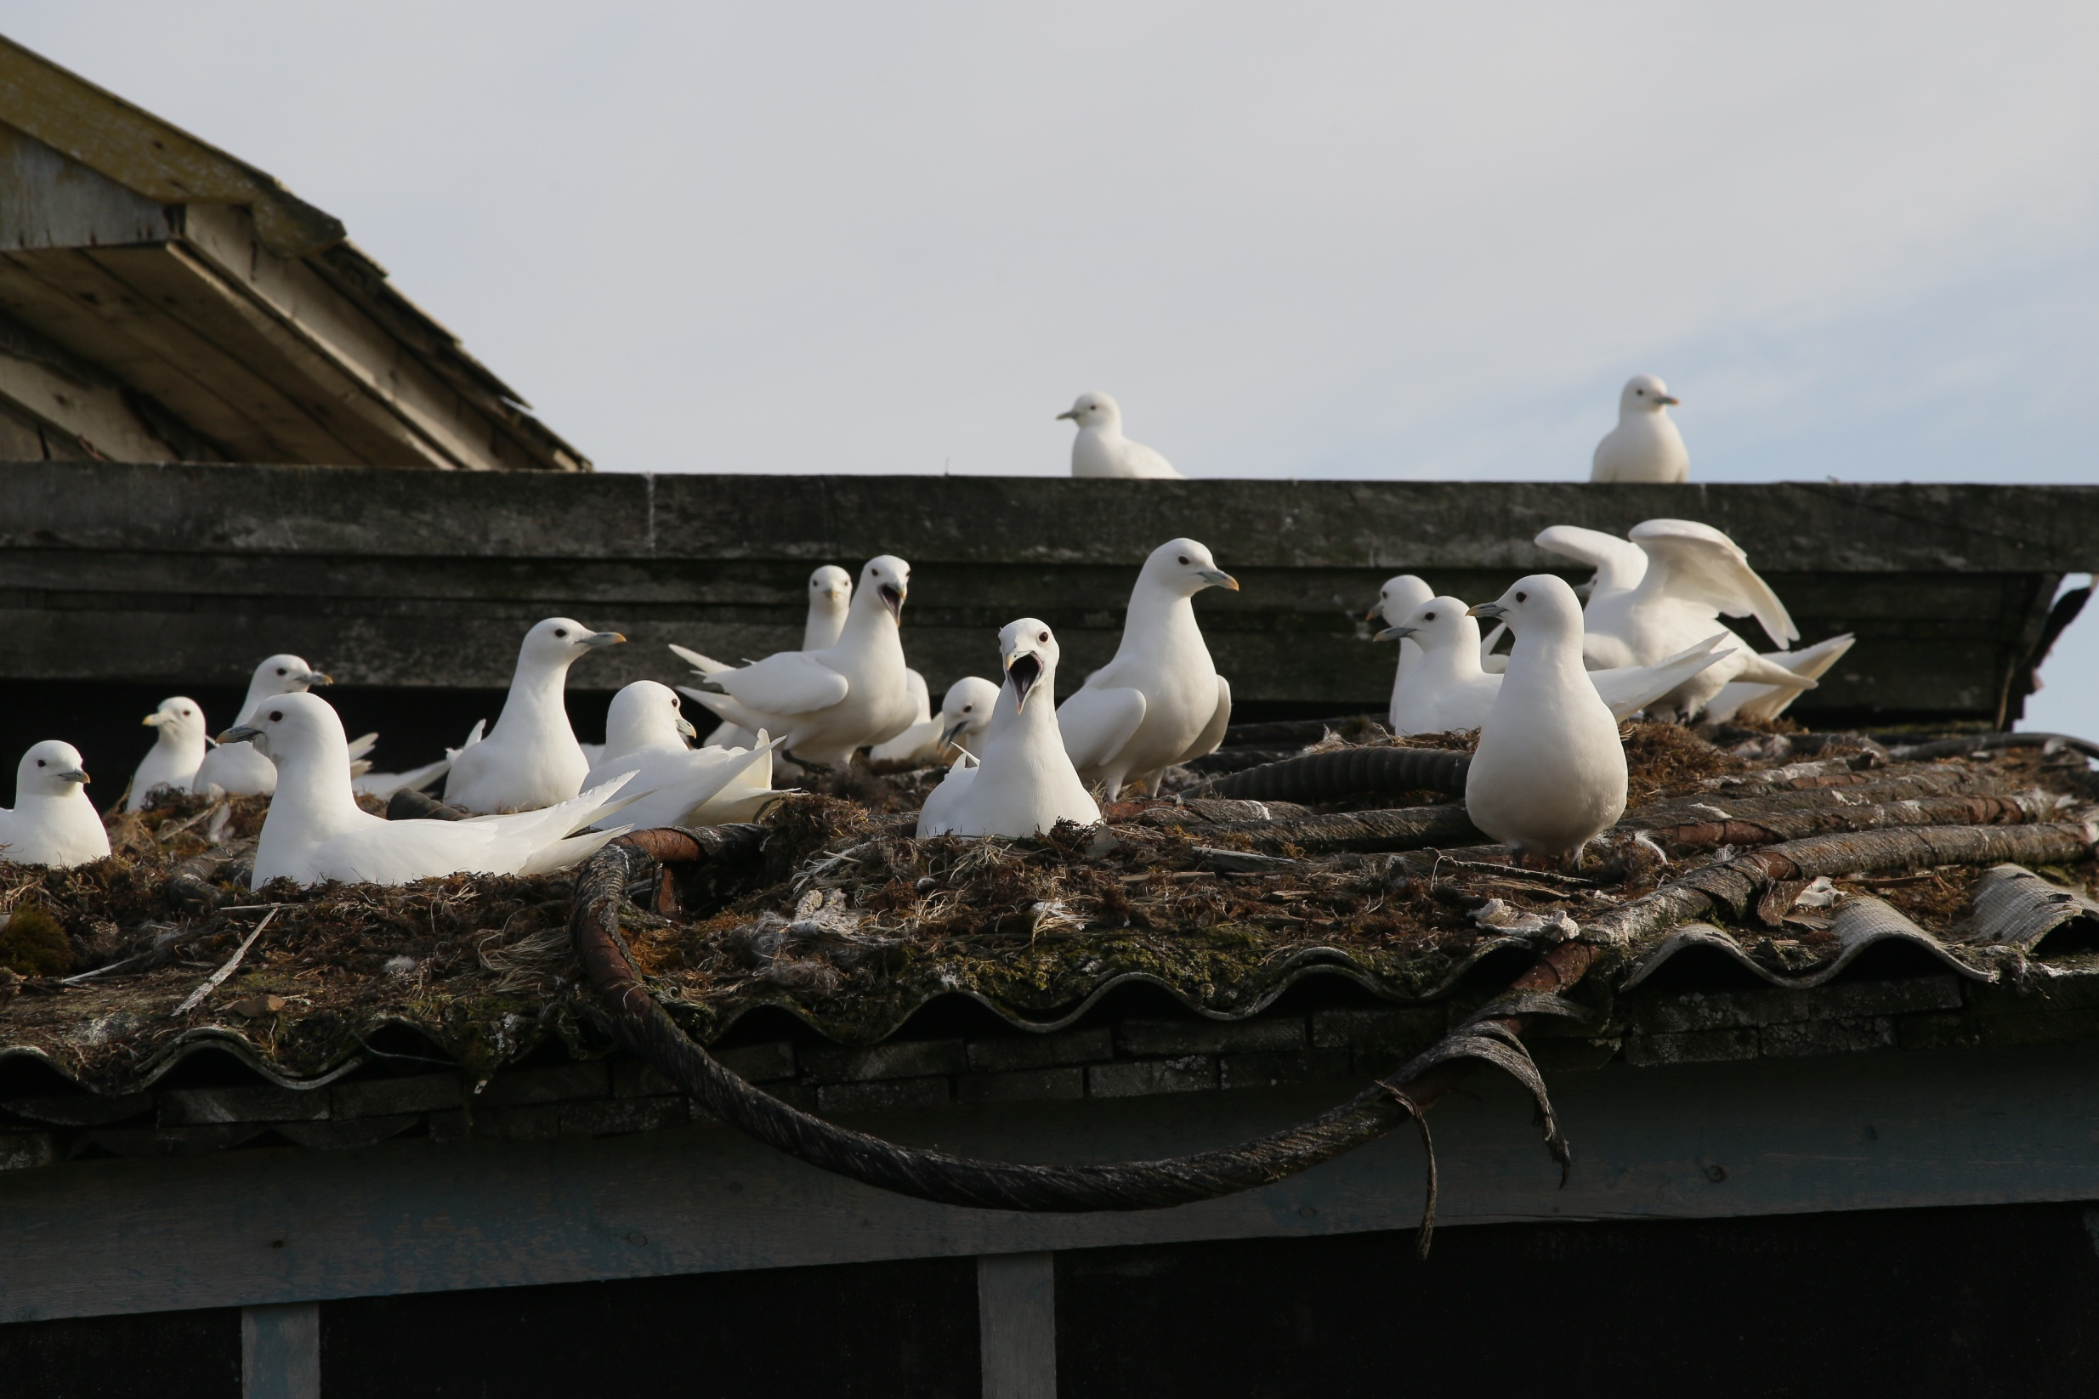
Increasin polar bear predation
Importance of man-made habitats

Slide 19
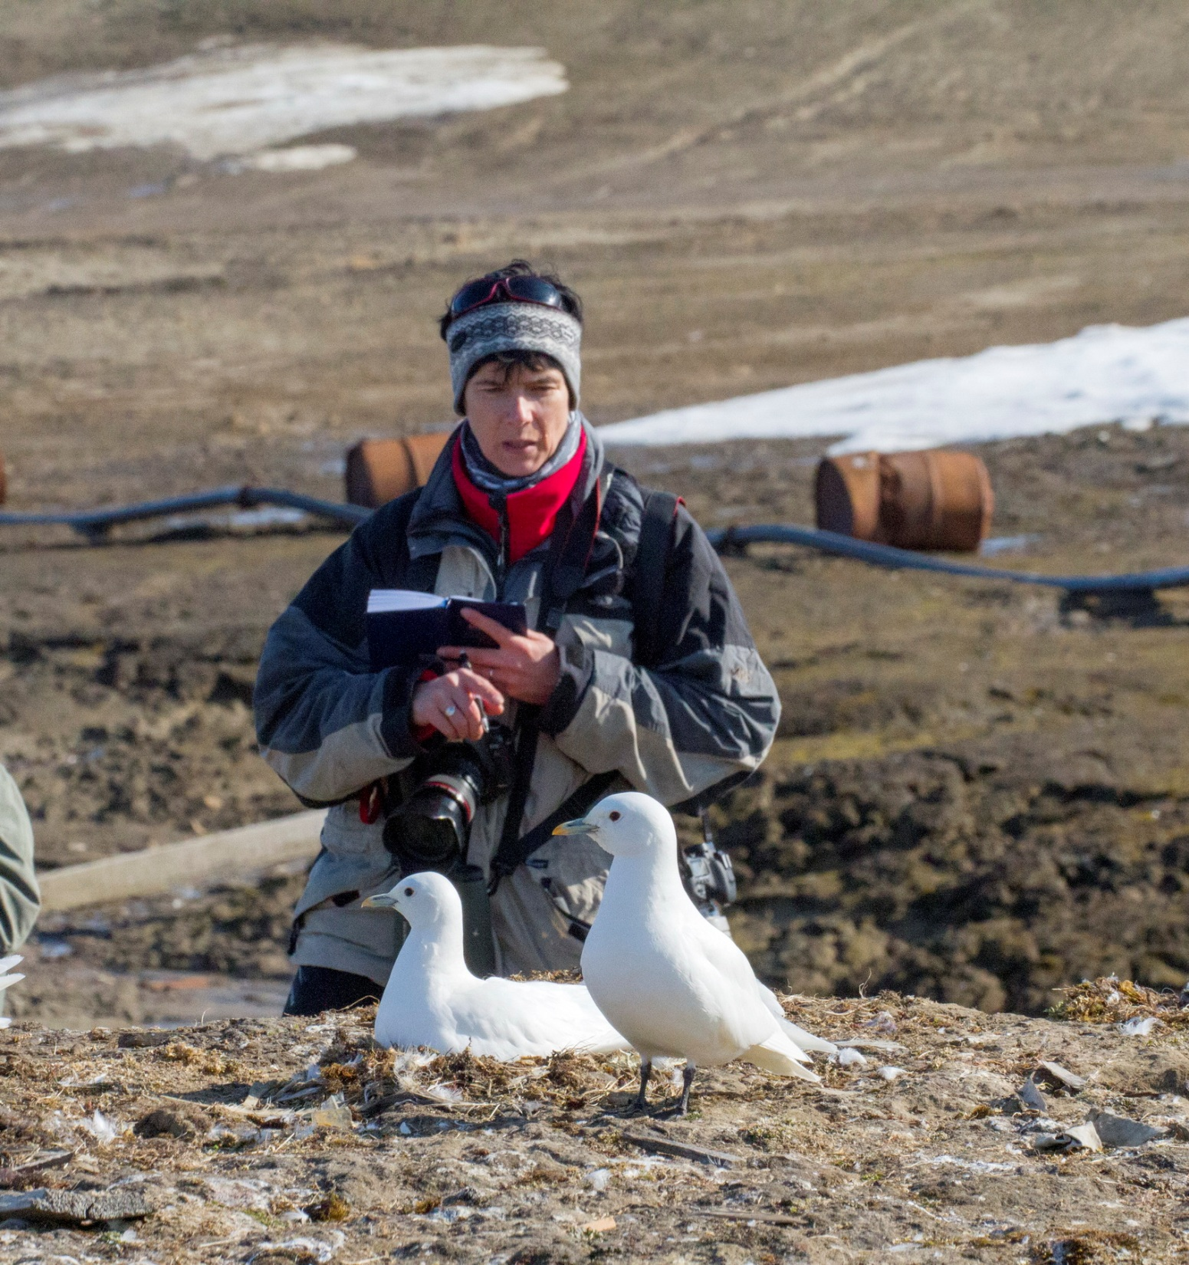
Land work in 4 colonies
Productivity
1.4 eggs/nest
33 gulls ringed
Feathers sampled
20 eggs collected
© Mikhail Ivanoc

Slide 20
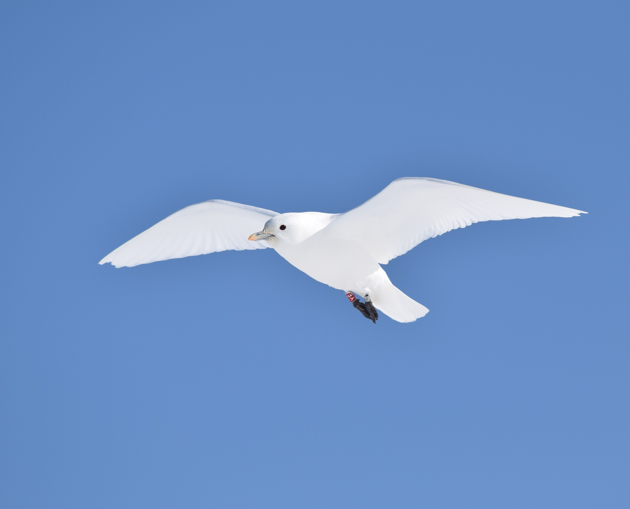
Thanks!
Norway: Vidar Bakken, Anders Skoglund & Vegard Fjeldheim
Svalbard Environmental Protection Fund
Norwegian Environment Agency
Lufttransport & Longyearbyen Værtjenestekontor
Russia: Mikhail Ivanov, Vladimir Filippov, Vasiliy Sarana, Alexey Ezhov, Sergey Golubev
Agency VICAAR, Open Oceanproject & SY Alter Ego crew
© Vegard B. Fjeldheim

Slide 21
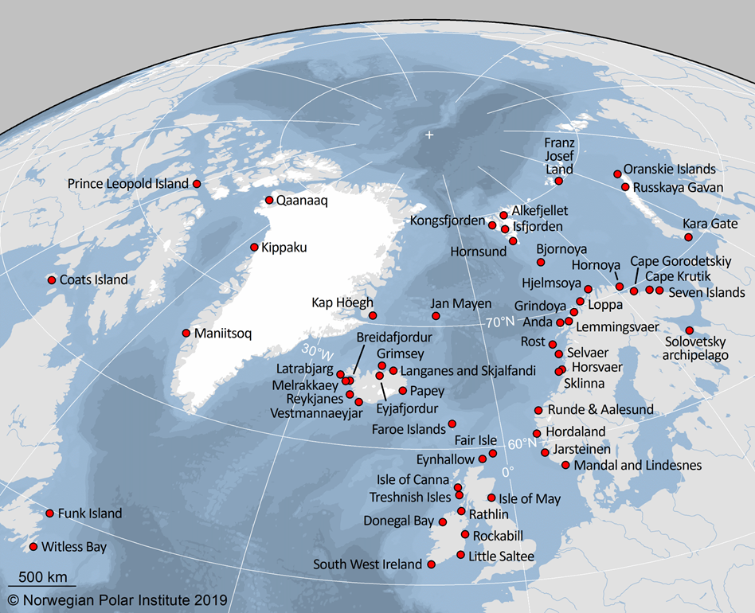
Update
Map the non-breeding distribution of seabirds breeding in colonies encircling the Barents, Norwegian and North Seas
How changes in environmental conditions in wintering areas and migration routes
affect their demography and population trends

Slide 22
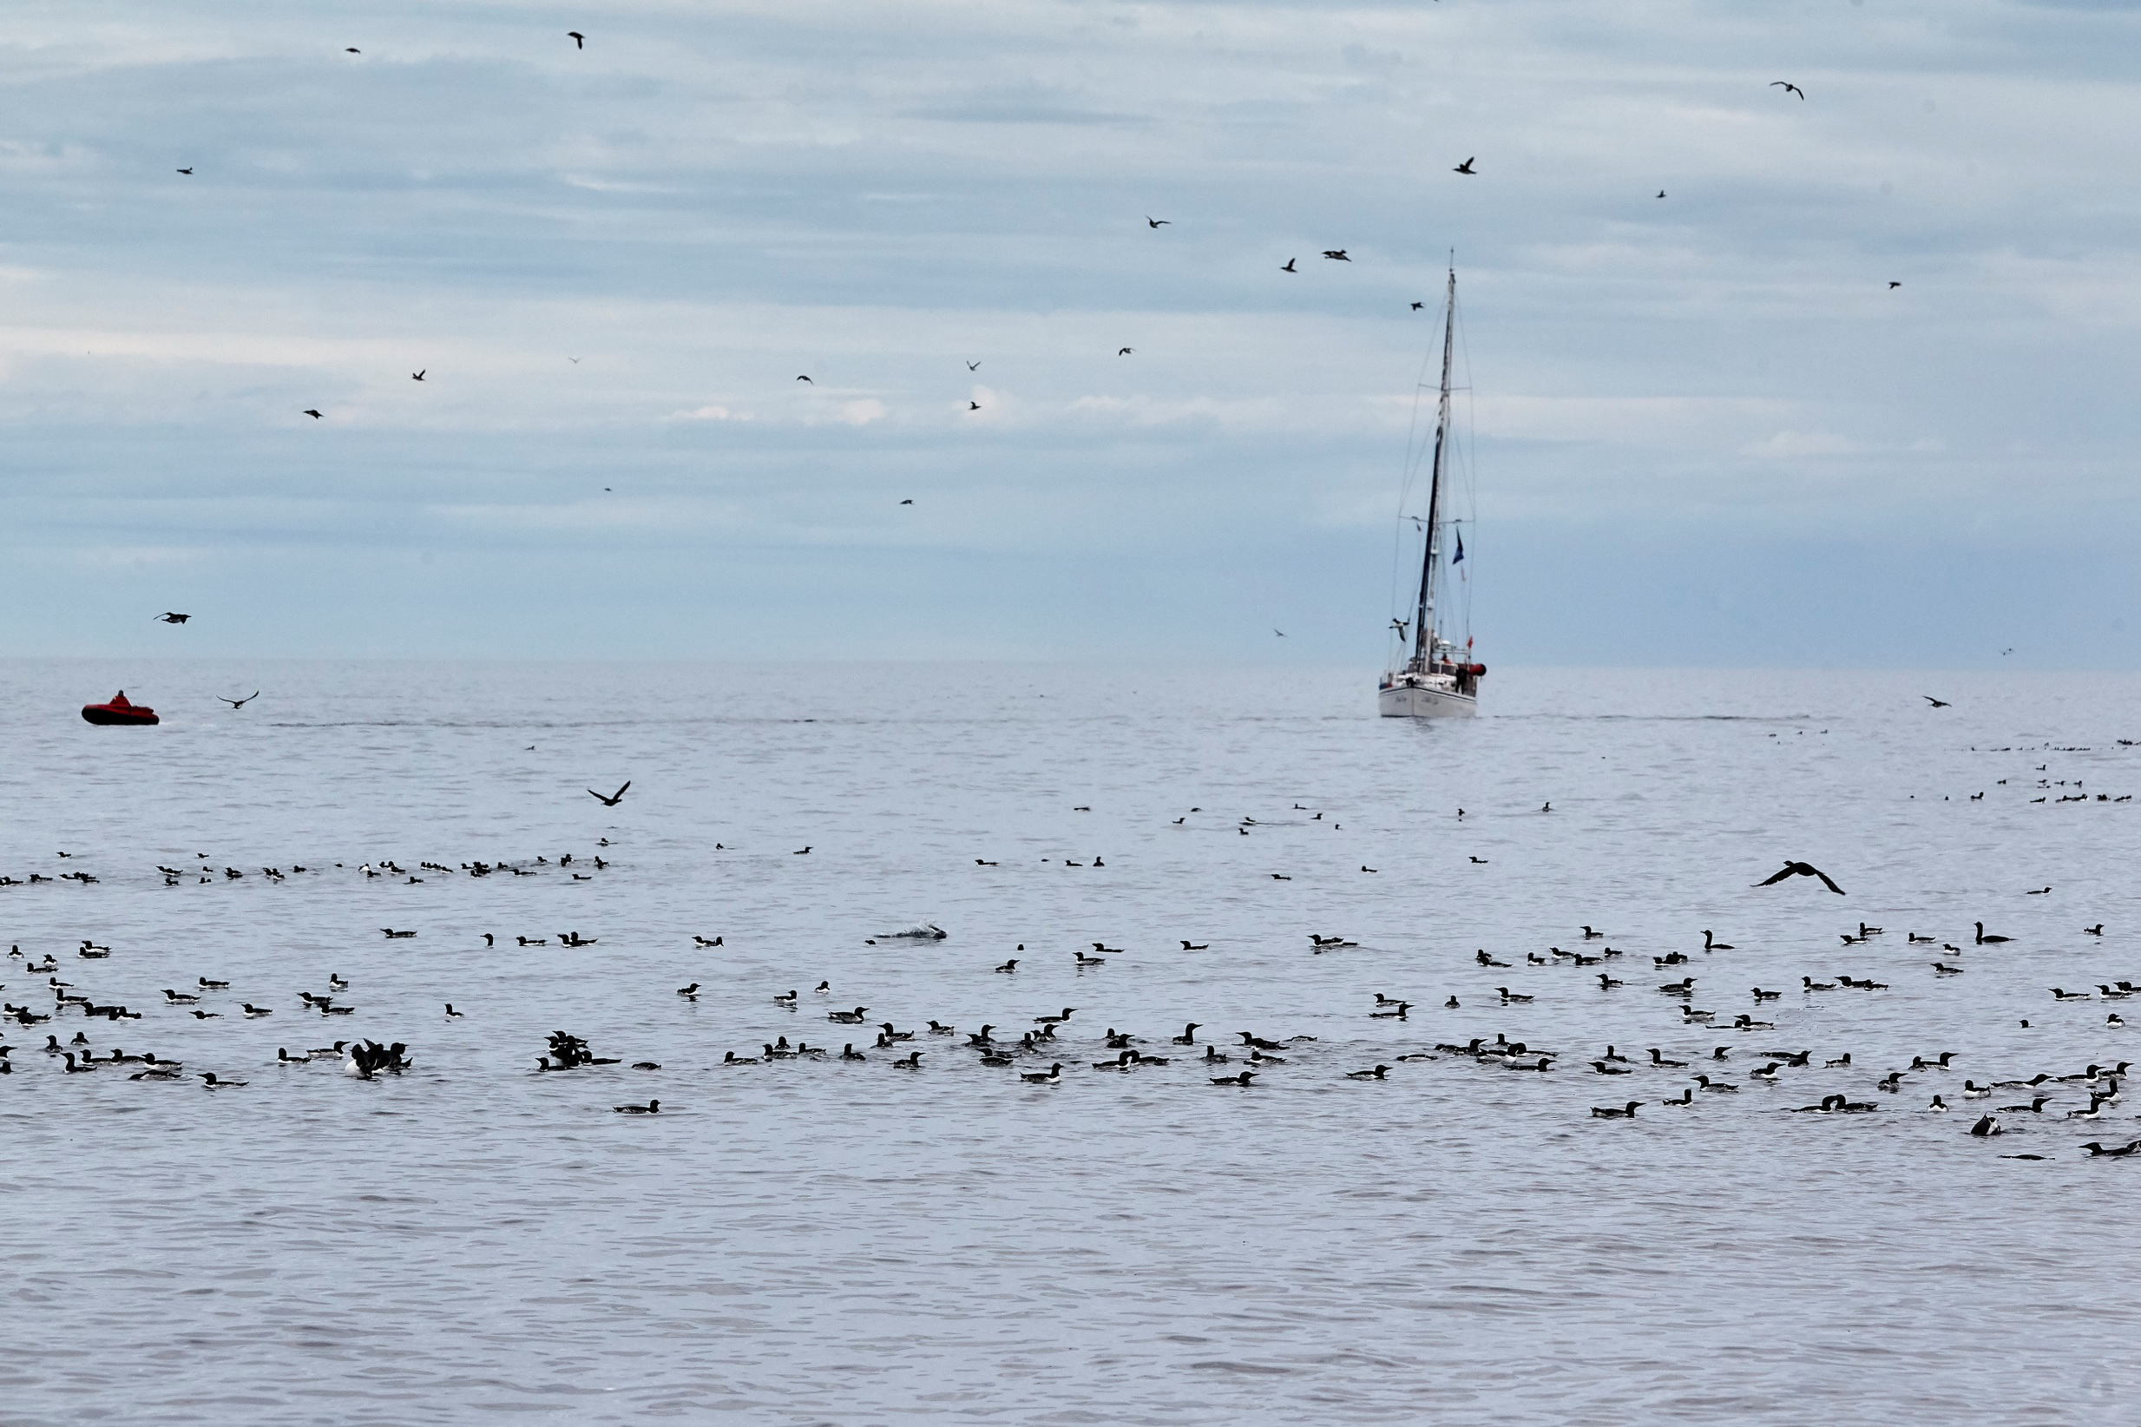
SEATRACK in RUSSIA
9 study sites, 3 SPAs, 10 seabird species
6 institutions, 8 – 12 people annually

Slide 23
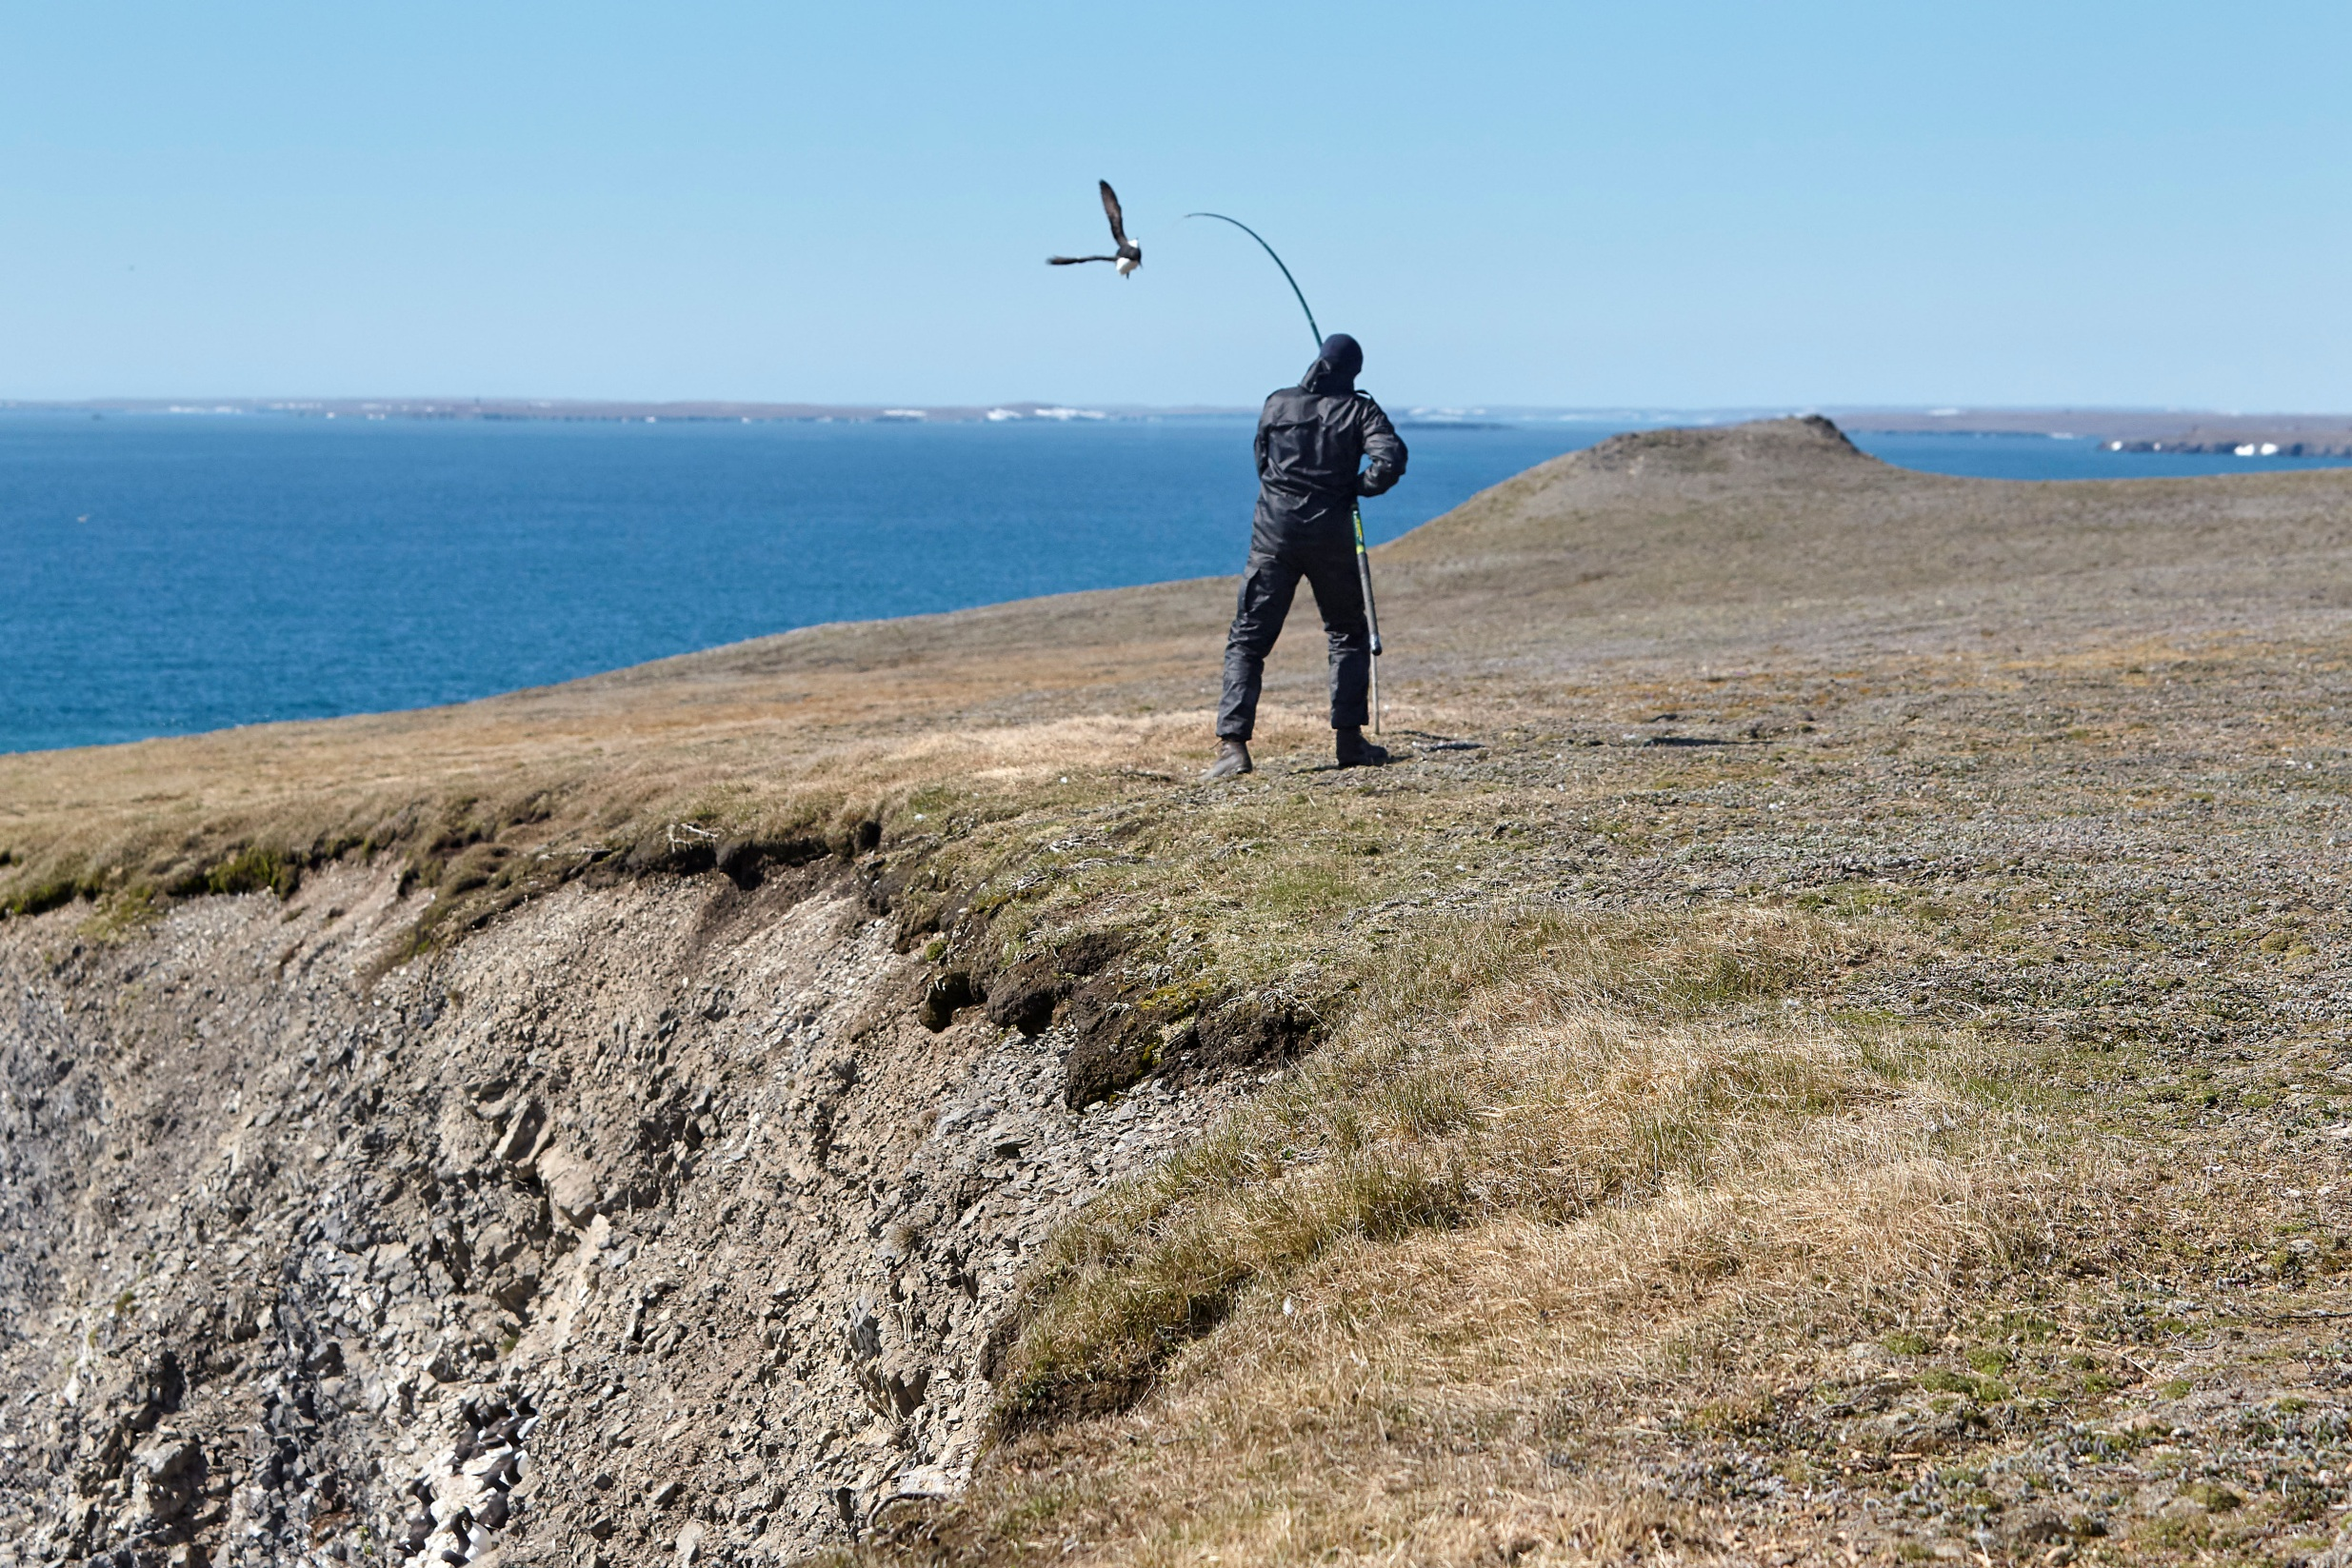
S Novaya Zemlya study plot: SEATRACK & popolation monitoring

Slide 24
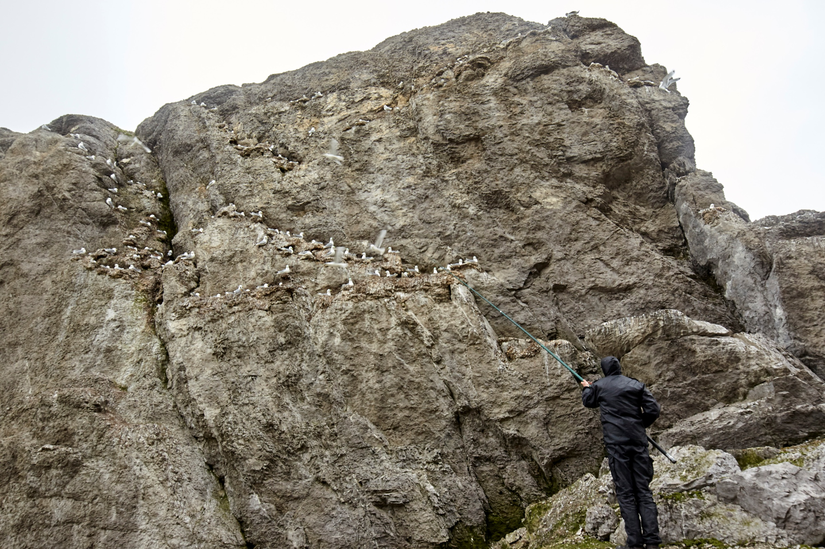
New study plot for kittiwakes established in N Novaya Zemlya in 2019

Slide 25
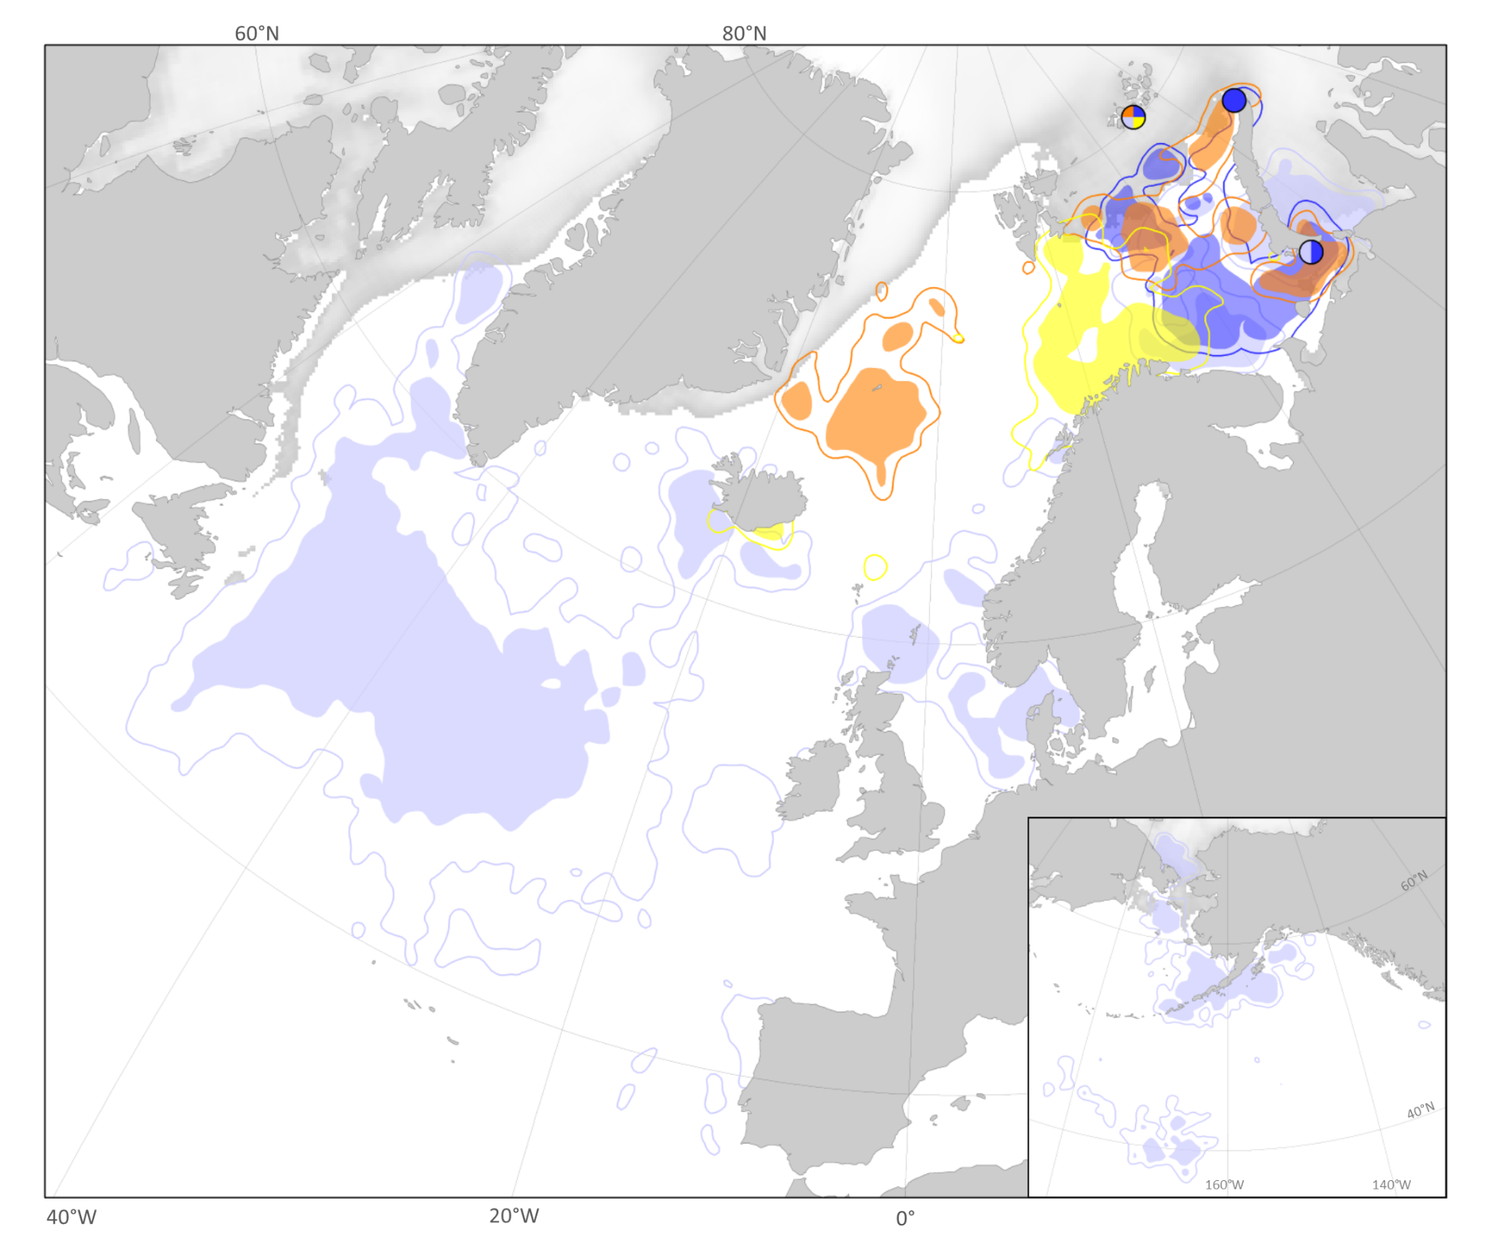
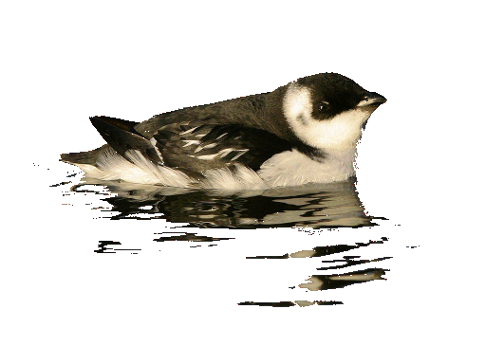
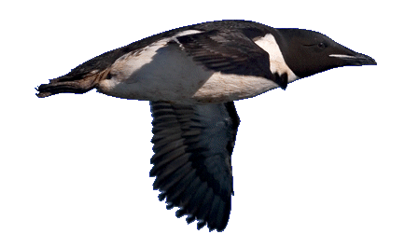
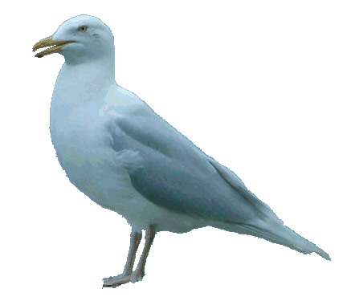
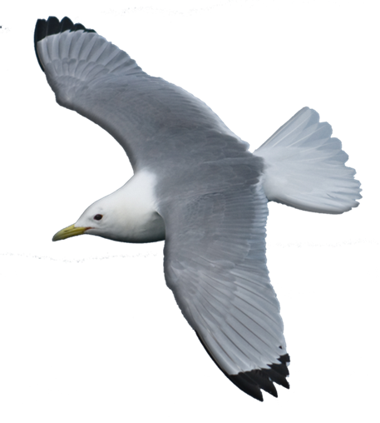
Wintering areas of seabirds breeding in FJL & NZ
Little auk
Brunnichs guillemot
Glaucous gull
Kittiwake
Map: SEATRACK/Benjamin Merkel

Slide 26
Further plans BIO-1:
2019: - Network meeting 26-29 November (Svanhovd)
- Finalize input to HAV-3 (Joint Seabird Monitoring Plan)
- Annual update of joint colony database (COLONY)
2020: - Work in collaboration with BIO-2:
- Joint seabird monitoring manual as implem. of HAV-3 recommendations
- Prepare work for Steller’s Eider winter survey in
March 2021
- Publish results of ivory gull survey
- Network meeting, Russia

