Slide 1
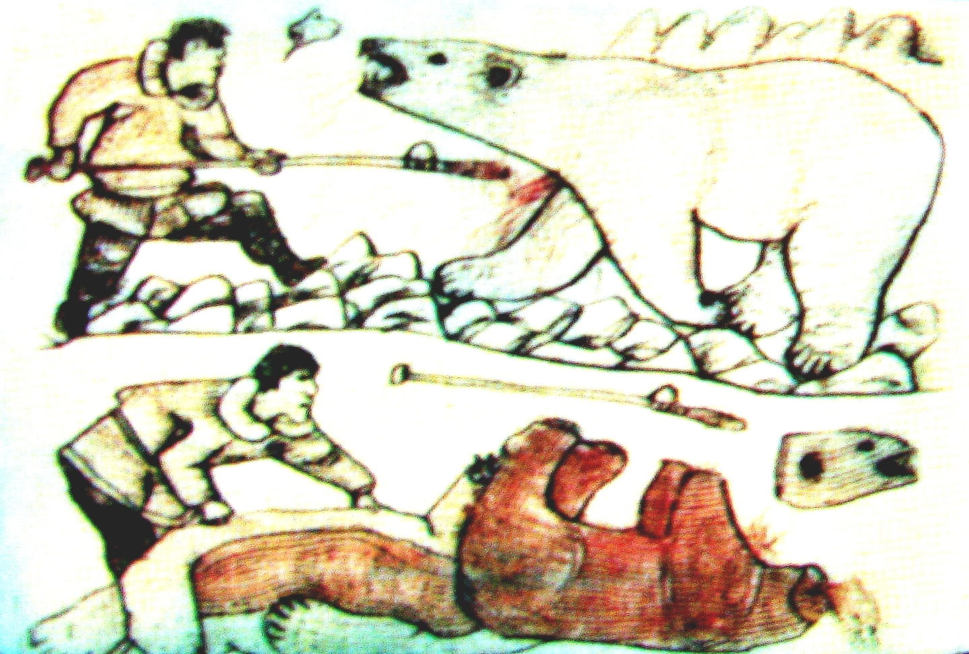
Estimates and Dynamics of Polar Bear Takes in Chukotka
Аnatoly А. Kochnev
Eduard V. Zdor
Mikhail S. Stishov
Россия

Slide 2
Hunting and Use of Polar Bear in Chukotka:
Results of 1999-2012 Study

Slide 3
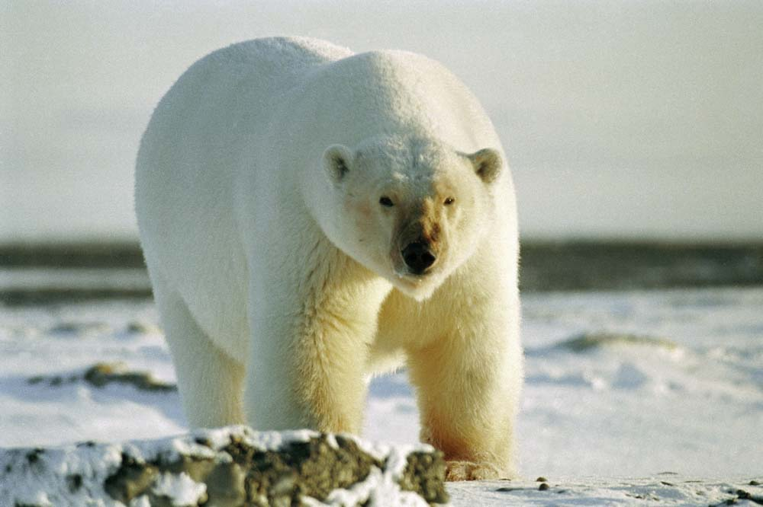
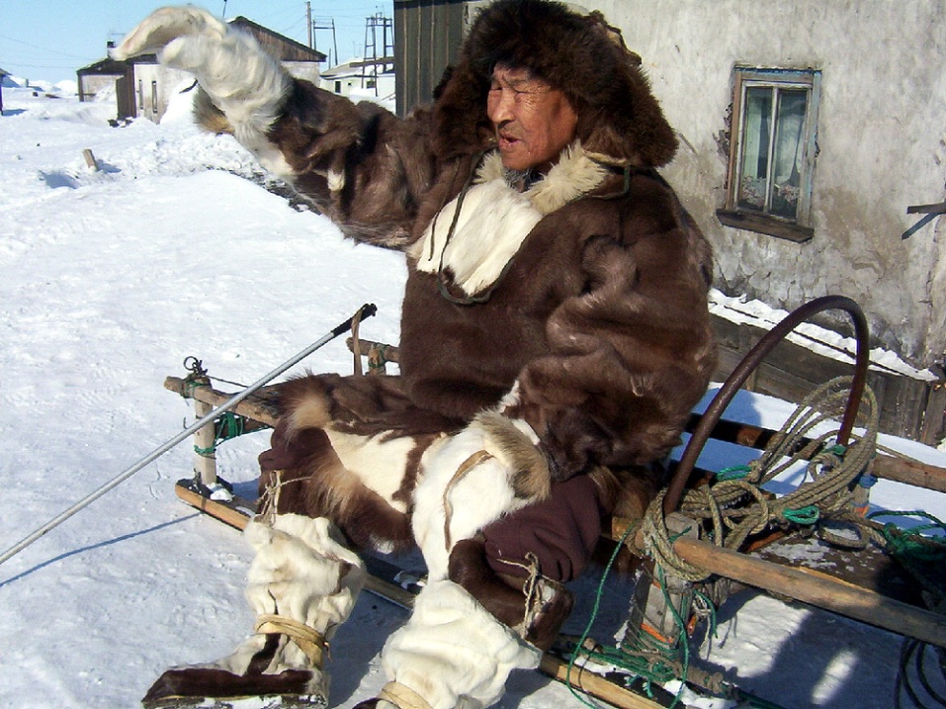
Polar Bear in Villages
Objectives and Peculiarities of Polar Bear Hunting
Use of Polar Bear Hunting Products
Size of Polar Bear Harvest

Slide 4
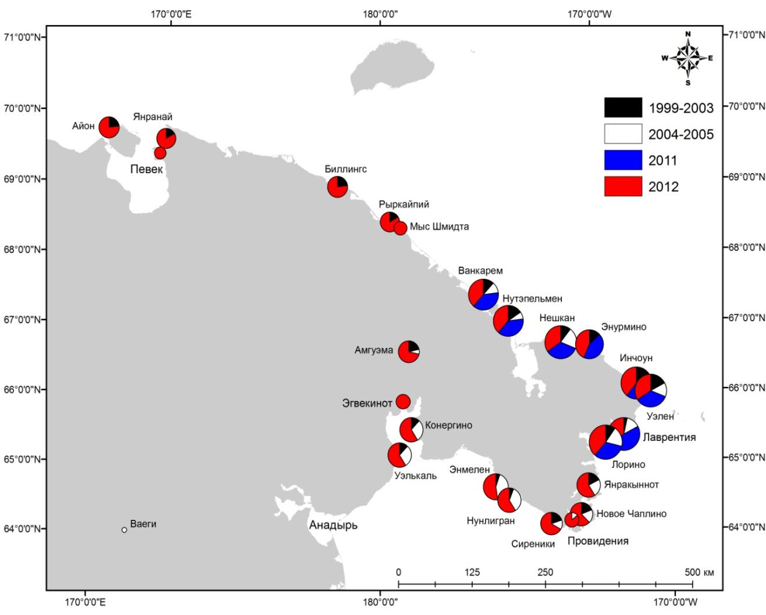
Distribution of Respondents by Village
22 communities, n = 118
8 communities, n = 84
24 communities, n = 227

Slide 5
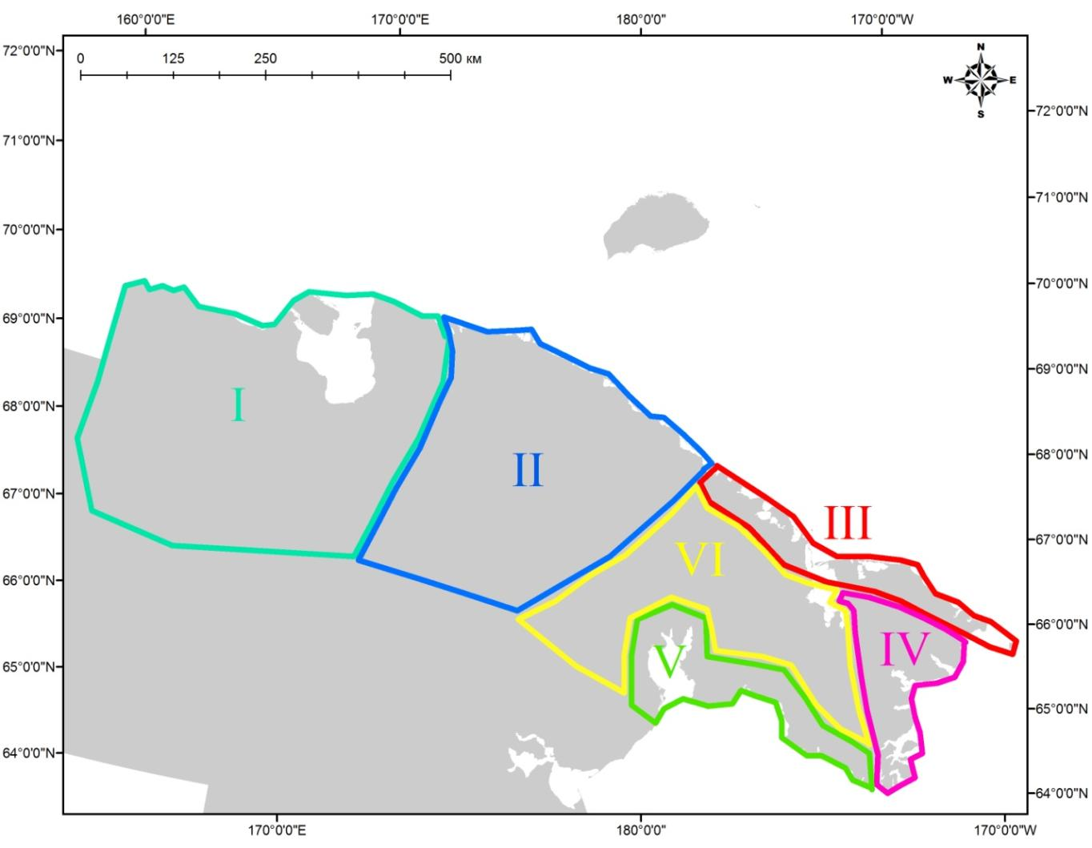
Geographic zones, delineated to reflect polar bear abundance in relation to local use of resource
I - «East-Siberian»
II - «Long Strait»
II - «Chukchi Sea»
V - «Bering Strait»
V - «Gulf of Anadyr»
VI - «Tundra»

Slide 6
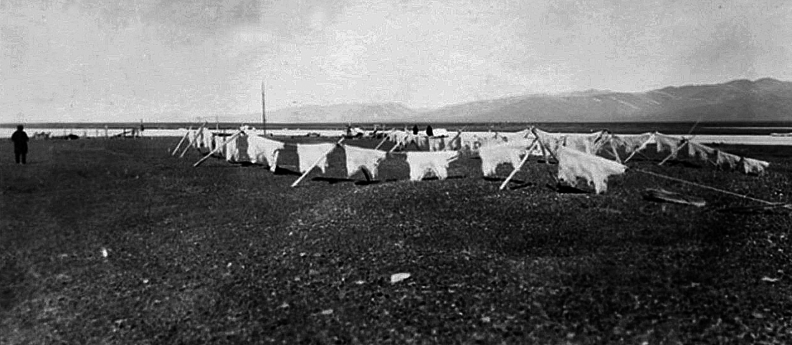
1910-1956
(Uspenskiy, 1977)
Years | Annual harvest
1910-1930s | 300
1940s | 200
1950s | 100

Slide 7
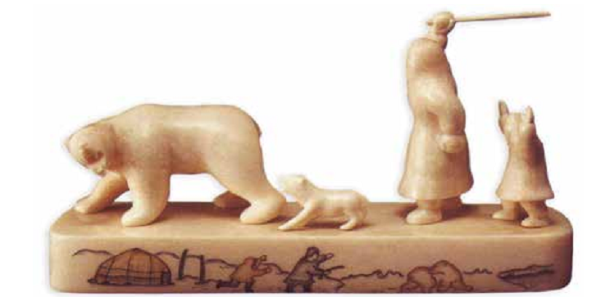
1957-1993
Official data
Years | Annual takes of “problem” bears | Annual illegal hunting | Source
1975-1983 | 3-4 | about 2 | Belikov, 1993

Slide 8
1957-1993
This study
30 respondents from 17 communities
Data rounded to whole number
Zone | N | Min | Max | Average
East Siberian | 3 | 5 | 14 | 10
Long Strait | 1 | 10 | 13 | 11
Chukchi Sea | 9 | 18 | 34 | 26
Bering Strait | 5 | 6 | 10 | 8
Gulf of Anadyr | 11 | 8 | 16 | 12
Tundra | 1 | 6 | 8 | 7
AVERAGE | 30 | 53 | 95 | 74

Slide 9
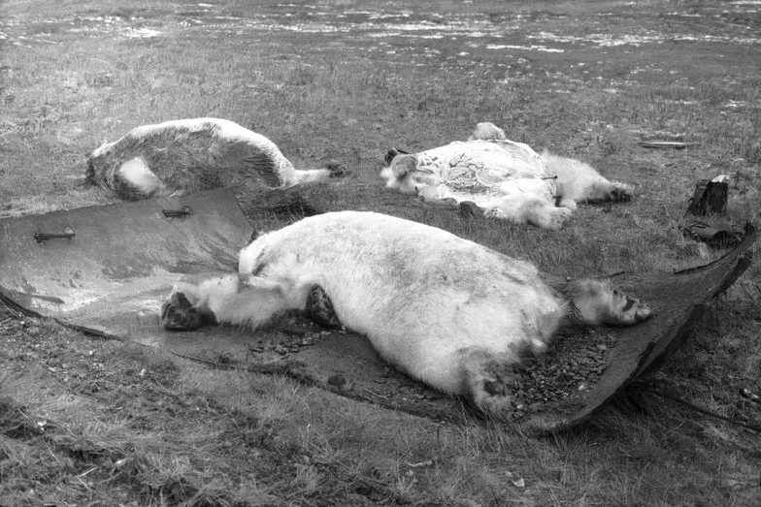
1994-2003
This study
56 respondents from 19 communities
Data rounded to whole number
Zone | N | Min | Max | Average
East Siberian | 4 | 2 | 4 | 3
Long Strait | 1 | 35 | 50 | 43
Chukchi Sea | 24 | 86 | 135 | 110
Bering Strait | 12 | 21 | 36 | 28
Gulf of Anadyr | 18 | 14 | 24 | 19
Tundra | 2 | 5 | 7 | 6
AVERAGE | 61 | 163 | 256 | 209

Slide 10
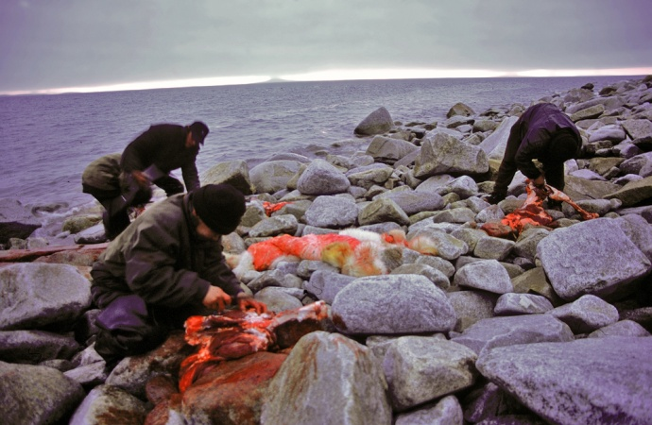
2004-2005
This study
23 respondents from 11 communities
Data rounded to whole number
Zone | N | Min | Max | Average
East Siberian | 0 | 2 | 3 | 2
Long Strait | 0 | 27 | 37 | 32
Chukchi Sea | 7 | 61 | 80 | 71
Bering Strait | 6 | 10 | 15 | 12
Gulf of Anadyr | 8 | 1 | 3 | 2
Tundra | 2 | 1 | 5 | 4
AVERAGE | 23 | 102 | 143 | 123

Slide 11
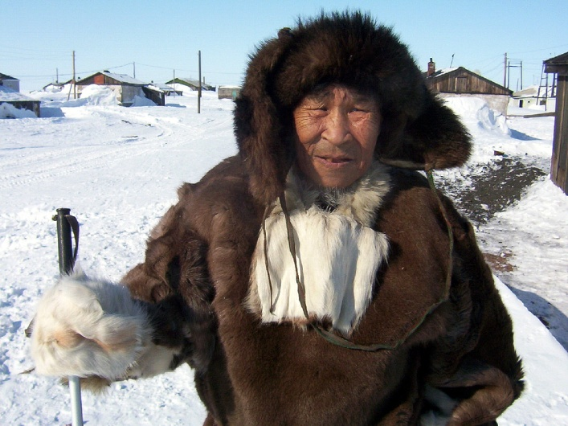
2010-2012
This study
2011
8 communities, n = 84
2012
24 communities, n = 227
«Villagers» group
«Hunters» group
2010
2011*
2011
2012*
22 estimates using 5 methods

Slide 12
2010-2012
Methods
1 –the average number of bear takes per village, extrapolated to 24 villages
2 – In the “Chukchi Sea” zone and in parts of the “Bering Strait” zone, a summation of the average number of takes, calculated for each village. For the remaining zones, we used the proportions of take in each zone during the study conducted in 1994-2003 to estimate the more recent take levels by zone.
3 – an individual trusted by hunters in two villages conducted surveys in those villages. Data from these two villages was calculated using proportional of take in each zone during the study conducted in 1994-2003 to estimate the more recent take levels by zone.

Slide 13
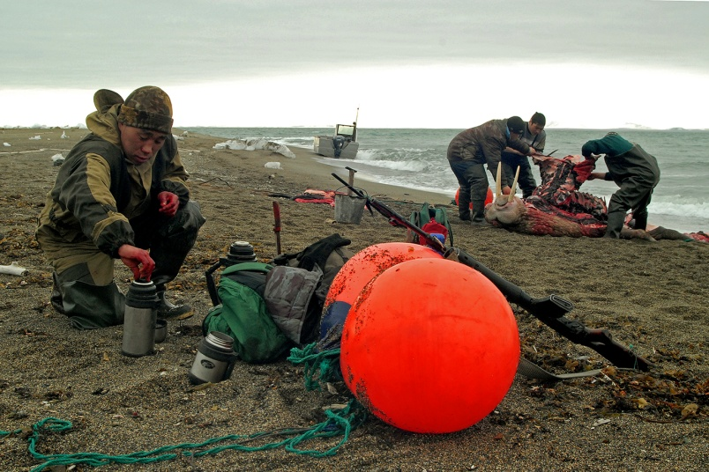
2010-2012
5 estimates using 3 methods
Data rounded to whole numbers
Year | Sample | N | Method | Estimate
2012 | «hunters 2011» | 106 | 1 | 20
2011 | «hunters 2010» | 25 | 2 | 36
2012 | «hunters 2011» | 106 | 2 | 18
2011 | «hunters 2010» | 25 | 3 | 56
2012 | «hunters 2011» | 106 | 3 | 29
AVERAGE |  |  |  | 32

Slide 14
Estimated levels of annual removal

Slide 15
CONCLUSIONS
According this study, after the 1957 prohibition, local hunting of polar bears in Chukotka did not stop and was not reduced by much
The sharp increase of polar bear takes was foremost a result of economic stress felt by Chukotka Natives
During the 2000s, polar bear removal levels decreased, and is currently no more than 15-20 % of the1994-2003 estimates
The principle cause of the decrease in removals is the socio-economic improvements felt by Chukotka Natives, the sufficient quantity of food delivered from the mainland, and self-regulation of hunting activity in communities
The reliability of the estimates is low. Nevertheless, these estimates can be useful for implementing adequate management measures for the subpopulation

